Slide 2
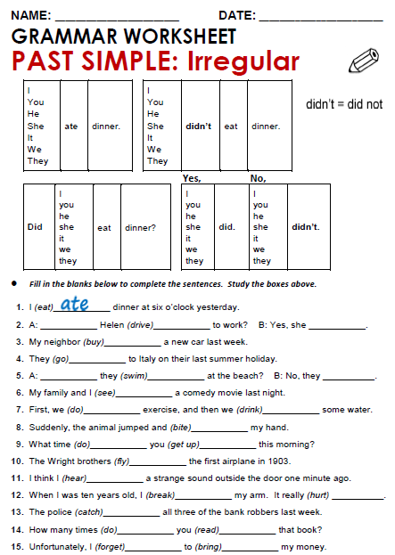
Did
drive
did
bought
went
Did
swim
Didn´t
saw

Slide 3
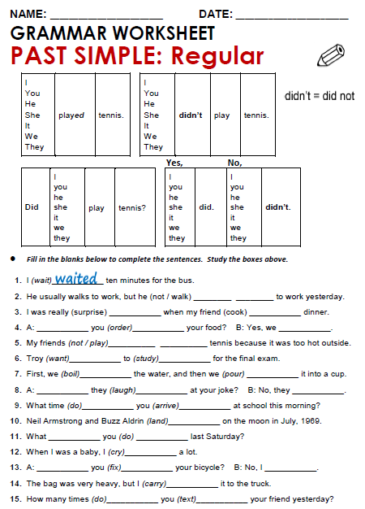
Didn`t walk
surprised
cooked
Did
order
did
Didn`t play
Wanted studied

Slide 4
Practice simple past of irregular, possitive, negative and questions
http://www.eslgamesworld.com/members/games/grammar/New_Snakes_%20Ladders/Past_simple_tense.html
http://learnenglishkids.britishcouncil.org/en/grammar-practice/past-simple-sentences

