Slide 2
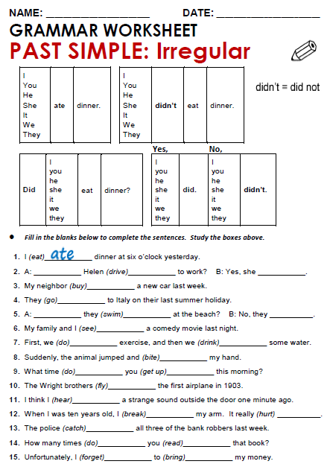
Did
drove
drove
bougth
went
Did
swam
Didn´t
saw

Slide 3
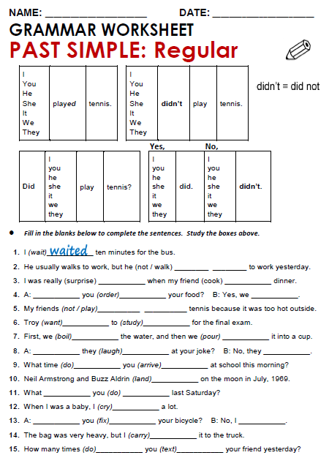
Not walked
surprised
cooked
Did
Not played
wanted
studied

Slide 4
Practice simple past of irregular, possitive, negative and questions
http://www.eslgamesworld.com/members/games/grammar/New_Snakes_%20Ladders/Past_simple_tense.html
15/20

Slide 5
http://learnenglishkids.britishcouncil.org/en/grammar-practice/past-simple-sentences
Teacher, este juego venía en la actividad pasada.

