Slide 2
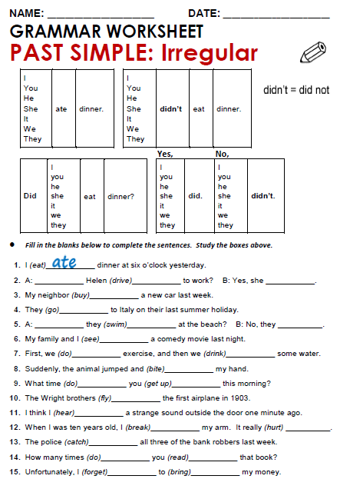
Notes:
2. Did Helen drive to work? B: Yes, she did.
3. My neighbor bougth a new car last week.
4. They went to Italy on their last summer holiday.
5.A: Dis they swim at the beach? B: No, they didn’t
6. My family and i saw a comedy movie last night.

Slide 3
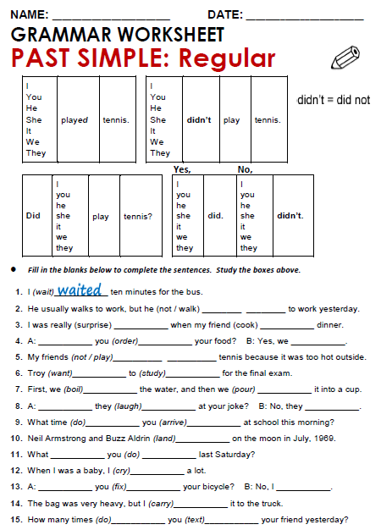
Notes:
2. He usually walks to work , but he didn’t walk to work yesterday.
3. I was really surprise when my friend cooked dinner.
4. A: Did you order your food? B: Yes, we ordered
5.My friends didn’t play tennis because it was too hot outside.
6. Troy wanted to study for the final exam.

Slide 4
Practice simple past of irregular, possitive, negative and questions
http://www.eslgamesworld.com/members/games/grammar/New_Snakes_%20Ladders/Past_simple_tense.html
http://learnenglishkids.britishcouncil.org/en/grammar-practice/past-simple-sentences

Slide 5
