Slide 2
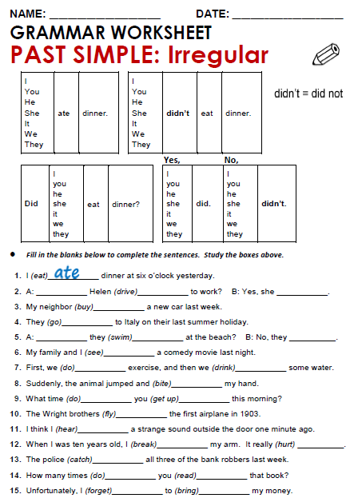
drove
did
bought
went
swam
didn't
saw

Slide 3
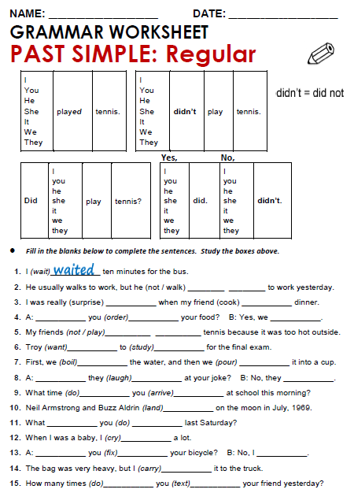
didn't walk
Cooked
surprised
Ordered
did
Wanted
didn't play
studied

Slide 4
Practice simple past of irregular, possitive, negative and questions
http://www.eslgamesworld.com/members/games/grammar/New_Snakes_%20Ladders/Past_simple_tense.html
http://learnenglishkids.britishcouncil.org/en/grammar-practice/past-simple-sentences

Slide 5
