Slide 2
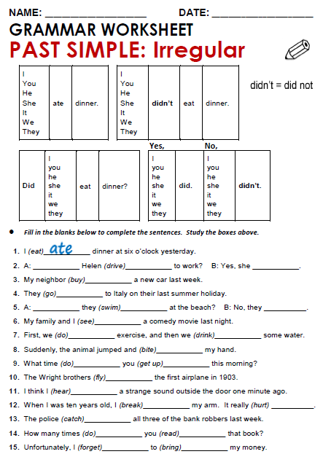
Did
drove
did
bay
went
Did
swam
didn’t
saw

Slide 3
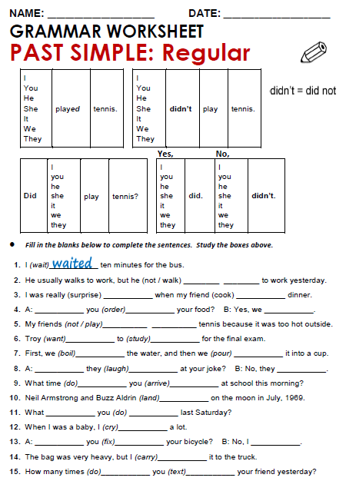
didn’t walk
susprised
cooked
Did
ordered
did
didn’t play
wanted
studied

Slide 4
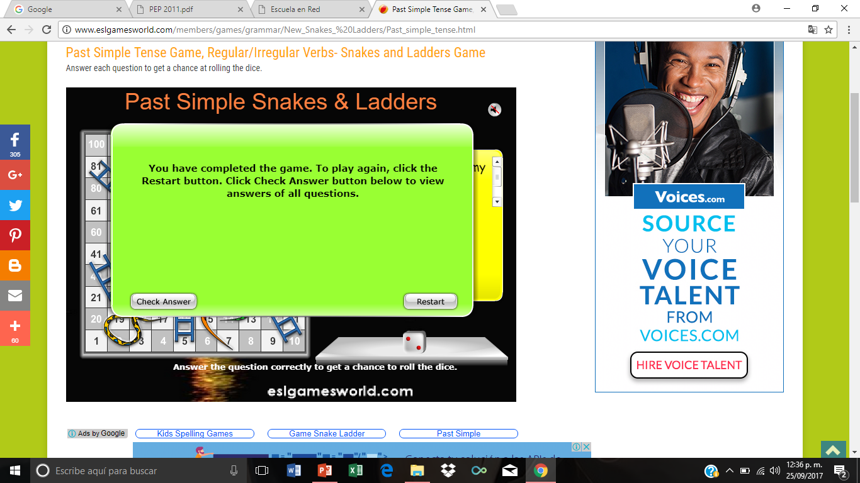
Practice simple past of irregular, possitive, negative and questions
http://www.eslgamesworld.com/members/games/grammar/New_Snakes_%20Ladders/Past_simple_tense.html
http://learnenglishkids.britishcouncil.org/en/grammar-practice/past-simple-sentences

Slide 5
