Slide 2
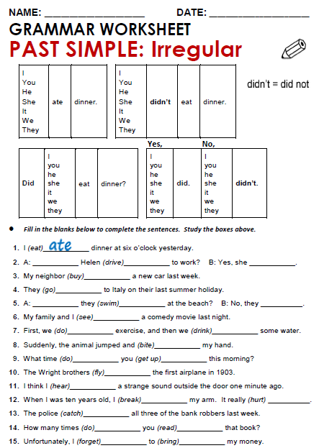
Did
drove
did
bought
went
Did
swam
Didn’t
sow

Slide 3
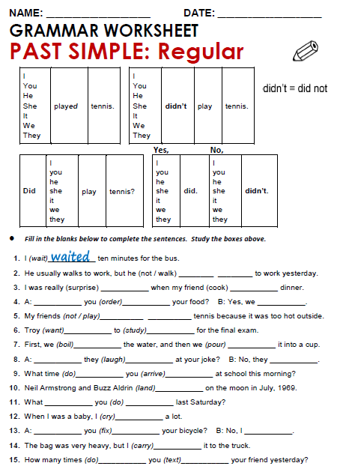
Didn’t walked
surprised
cooked
Did
odrered
did
Didn’t played
wanted
studied

Slide 4
Practice simple past of irregular, possitive, negative and questions
http://www.eslgamesworld.com/members/games/grammar/New_Snakes_%20Ladders/Past_simple_tense.html
http://learnenglishkids.britishcouncil.org/en/grammar-practice/past-simple-sentences

