Slide 1
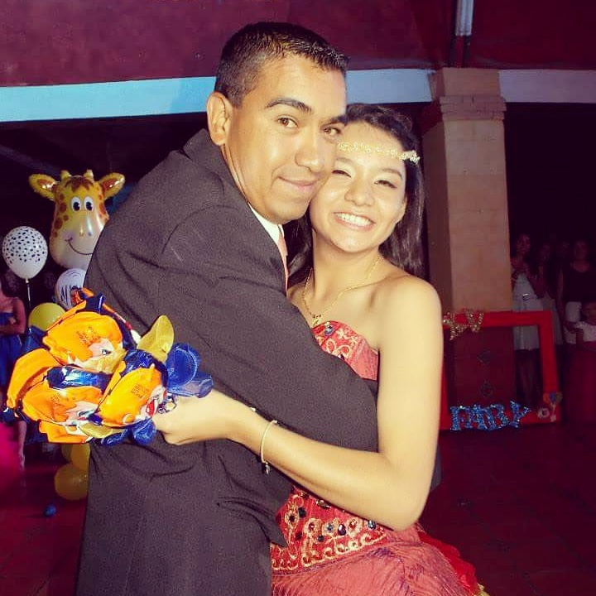
ESCUELA NORMAL DE EDUCACIÓN PREESCOLAR INGLES A1 MISS. MAYELA MODULE 5 “JULIO CESAR MARTINEZ ALVARADO´s Biography” Fabiola Elizabeth Ibarra martinez
Saltillo, Coahuila 26 Octubre 2017

Slide 2
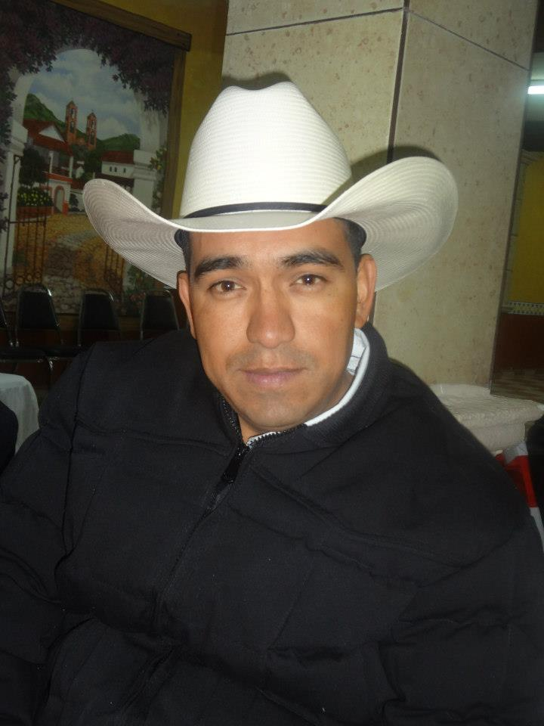
“Julio Cesar Martínez Calderón´s Biography”
He was born on August 12, 1977 in Saltillo, Coahuila.
His parents were Juan Martínez Alejandro and Josefina Calderón Aldaco.
He was the youngest son of 11 siblings therefore small he could play with all of them.
When Julio was 3 years old he had a heart surgery because he had a breath, which prevented him from leading a normal life, but the operation was successful.

Slide 3
Academic Background:
At 4 years of age, he entered the Children's Garden "Teodosia Castañeda" in which he was two years from 1981 to 1983.
Later he continued his studies at "Felipe Calderón García" Elementary School, where he lasted 6 years, so he learned to read and write and acquired several knowledge of the different subjects he took.
In 1989, he began studying at the "Benemérito de las Américas" High School and stayed there for 3 years. At this stage of his life, he could be more autonomous and less dependent on his parents.
The high school did it in the CEBETIS 97 in a lapse of 3 years and later in 1995 began his Professional Career in the Autonomous University Agraria Antonio Narro in Degree in Economy, only lasted two years, because in 1997 it began to work like Security Guard in Soriana and could not finish his studies.

Slide 4
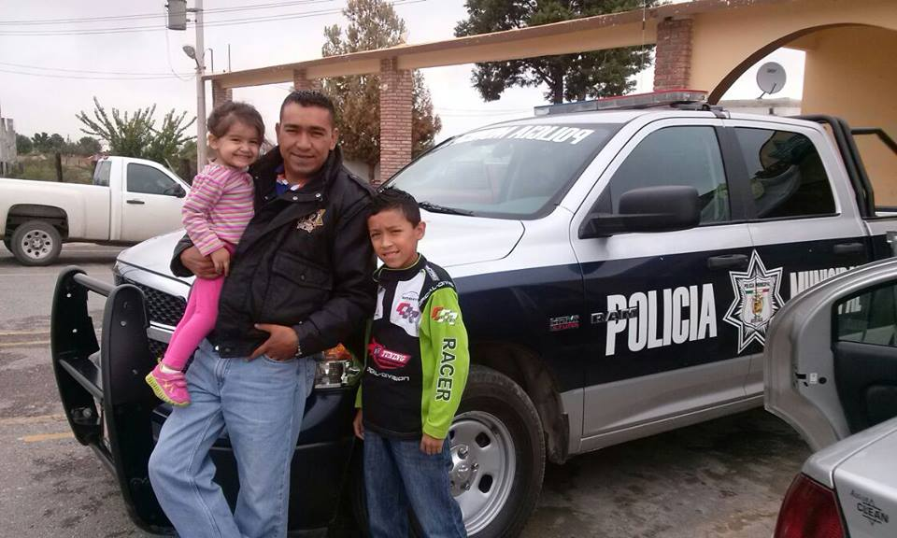
Julio had several jobs but the most outstanding were: Worked in the Municipal Police of Arteaga Coahuila from year 2012 to year 2014. From 2014 to 2015 he was promoted to the Federal Government (SEDESOL) where he was dedicated to be in charge of the ejido opportunities program.

Slide 5
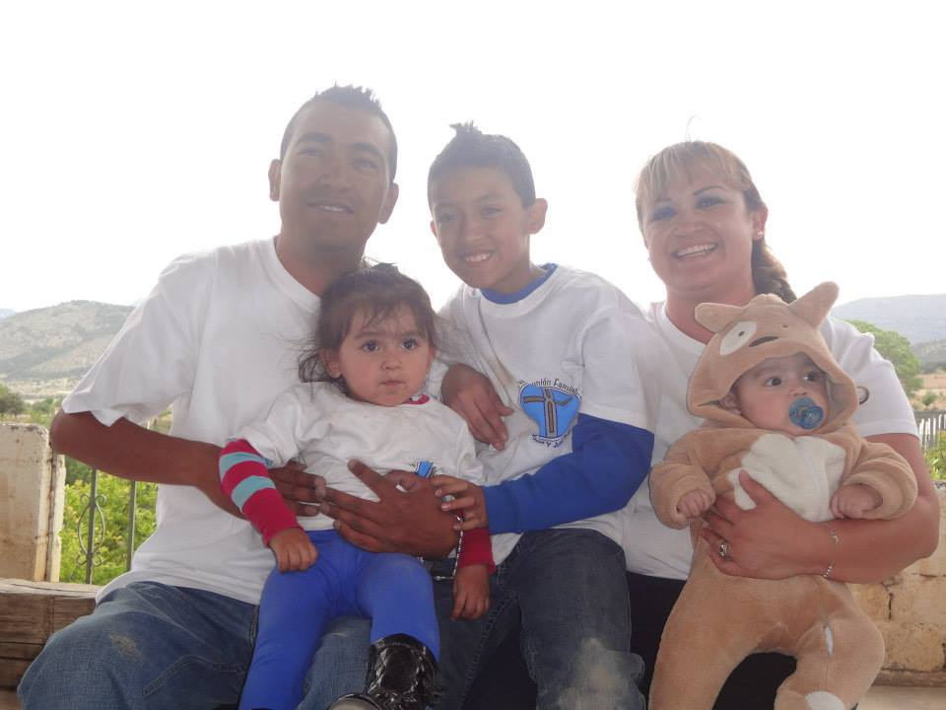
Familiar scope: In 2002, at age 25 he married Beatriz Adriana Alvarado Ramos with whom he could have 3 children.
In 2003 he had his first son Julio Cesar Martínez Alvarado. On February 14, 2012, she was operated for the second time surgically by a tumor in the left ventricle. This operation was successful and on February 29 of the same year her second daughter María José Mtz Alvarado was born. The 28 of October of 2013 is born his third and last son Jesus Emmanuel Mtz Alvarado.

Slide 6
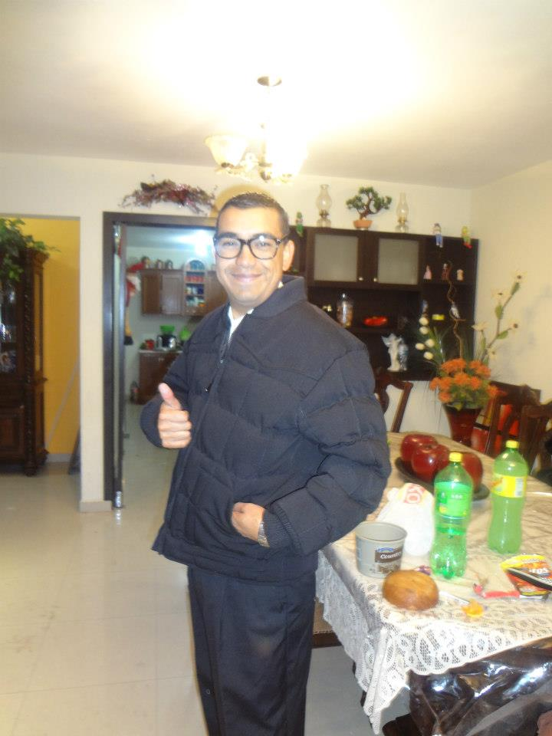
Personal information:
Personal information:
Julio liked being a cop because he enjoyed helping others.
His favorite sport was baseball, although he did not practice it, he liked to watch the games in his time of rest.
He enjoyed pass time with his family.
He was cheerful and funny, for he often joked and it was rare that he was afraid of anything.
He professed the Catholic religion.
He belonged to a group in Perpetuo Socorro Parish where he was dedicated to community service and attended once a week as it was delivered.
The last years of his life, I give to his family and God.

Slide 7
Finally on September 18, 2015, he suffered a car accident at 9:05 am in Arteaga Coahuila, he was surgically operated again and his operation was successful but in the recovery process, his body did not resist and he died on September 24, 2015 at at 5:30 p.m.
Julio lived 38 years of life, happy, loving and living each day as the last, in the company of his family and loved ones, always delivering everything he went to God.

Slide 8
Rest in peace…

