Slide 1
May / Might / Could
When we are not sure about something:
Jack may be coming to see us tomorrow. Oh dear! It’s half past ten. We may be late for the meeting. There may not be very many people there.
When we are not sure about something:
I might see you tomorrow. It looks nice, but it might be very expensive. It’s quite bright. It might not rain today.

Slide 2
Practice with may / might
Choose the correct answer to complete the sentence
I dont´know. I _________________________ to the party. I´m very tired.
I ´m going to take a coat. It _______________ cold later.
Try to call Nick´s house. He__________ home by now.
They ________________ to come but yo can invite them.
I_______________________ time to finish today. Will tomorrow be OK.
We _____________ this house It´s too old.
might be
might sell
might not want
might not have
might not go
might be
http://www.englishgrammarsecrets.com/maymight/exercise2.html

Slide 3
Match with the correct answer

Slide 4
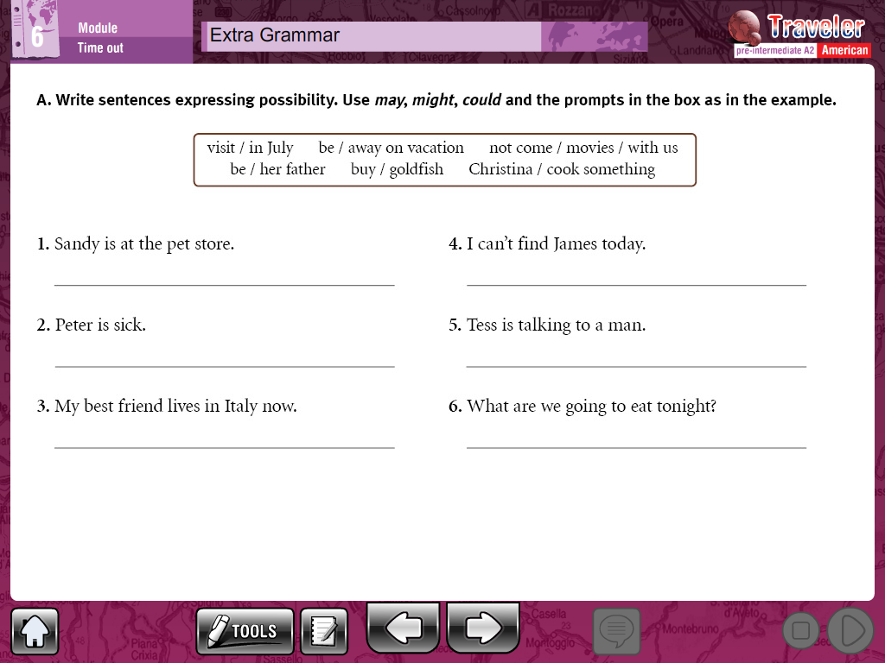

Slide 5
Jon’s Story
Read the story and answer the question using modal verbs of possibility and certainty.
One evening, Jon was sitting at home watching TV when the phone rang. It was his girlfriend Kate. Kate asked Jon if he would like to go out tonight. Jon had had a hard day at work and was feeling lazy and tired. So, he told Kate he was sleepy and was going to bed soon. Kate wished him sweet dreams and hung up the phone. Twenty minutes later his ex-girlfriend Anna called Jon. She was in town on business and would be leaving town again tomorrow. She asked Jon if they could meet tonight. They had not seen each other since they split up two years ago. They agreed to meet at a local restaurant for dinner. Anna and Jon met at the local restaurant, and they sat down for a meal together. They were half-way through their meal when in walked Kate with her friends. Kate was shocked to see her boyfriend having dinner with his ex-girlfriend! She walked over to Jon’s table…
What is it possible for Jon, Kate and Anna to do in this situation?
Write a sentence for each person using modal verbs of possibility could, might and may.
____________________________________________________________________________________________________________________________________________________________________________________________________________________________________________________________________________________

