Slide 1
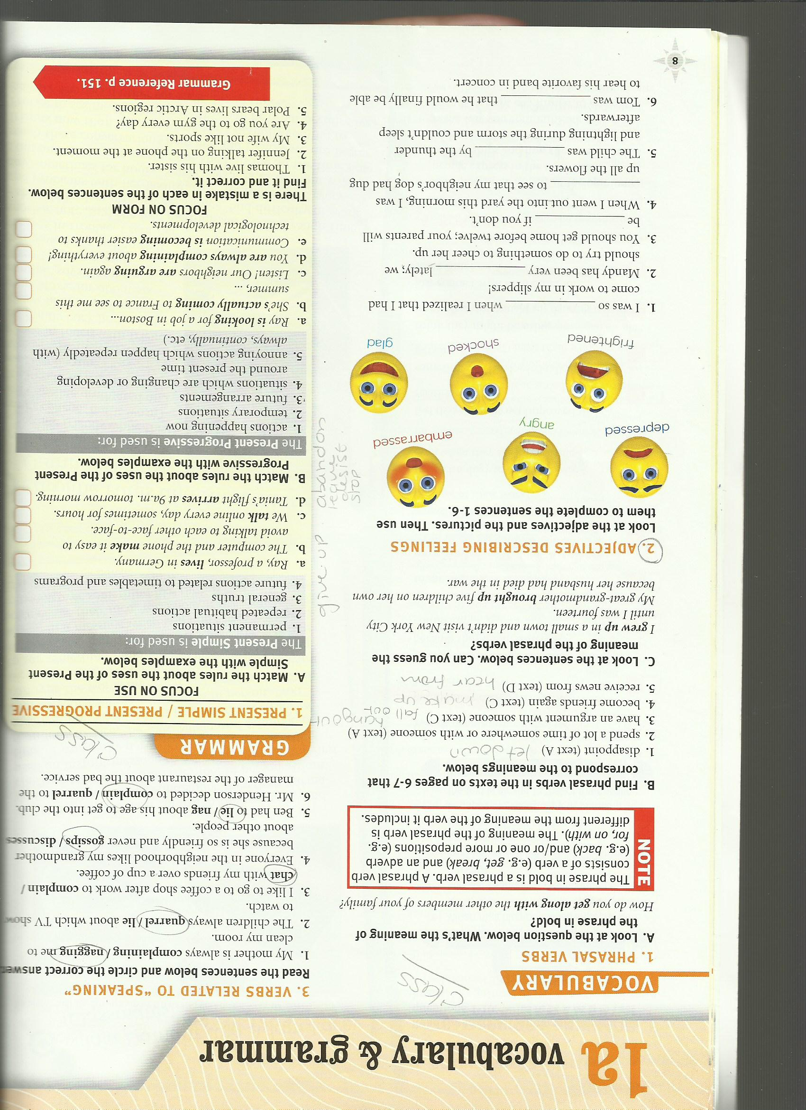
Adjectives that describe feelings

Slide 2
Use the adjective that better completes the sentence

