Slide 2
Word
Prefix
Suffix

Slide 3
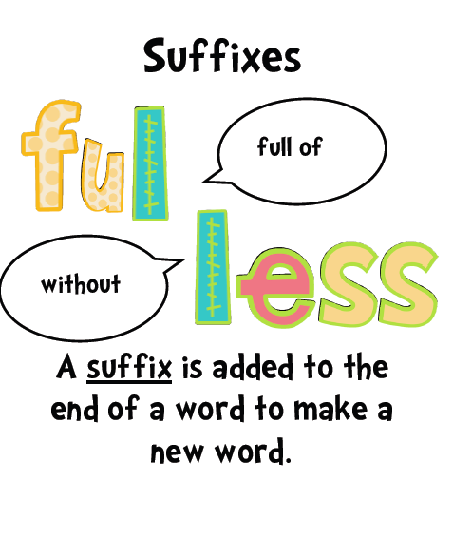
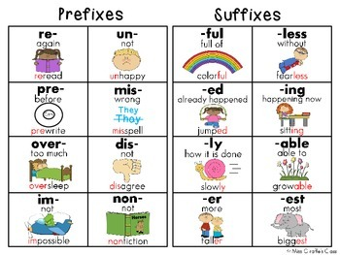

Slide 4
Suffix
-ation
-ment
-sion
-ion
-tion
Information
The act of, or the result of
employment
discussion
reduction
edition
Click on the following link for a detailed explanation of sufixes
http://www.slideshare.net/florizqulshodiq/suffixes-29480221

Slide 5
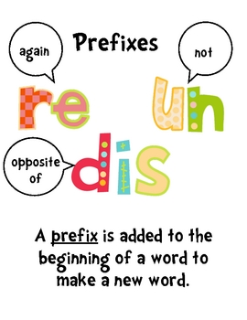
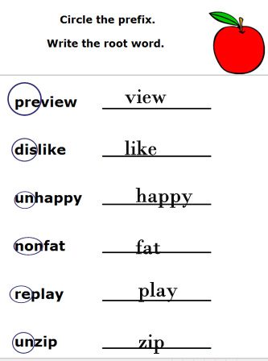
https://www.wisc-online.com/learn/humanities/linguistics/esl1002/practice-with-prefixes-1

Slide 6
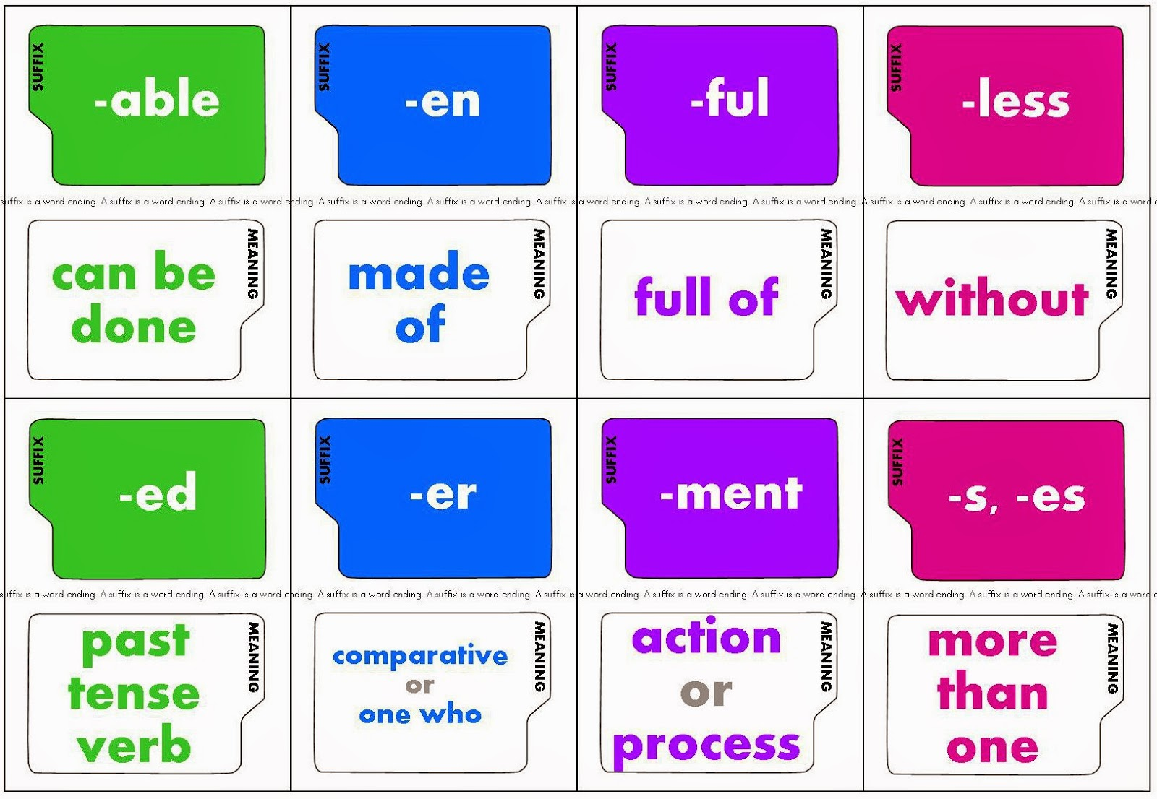

Slide 7
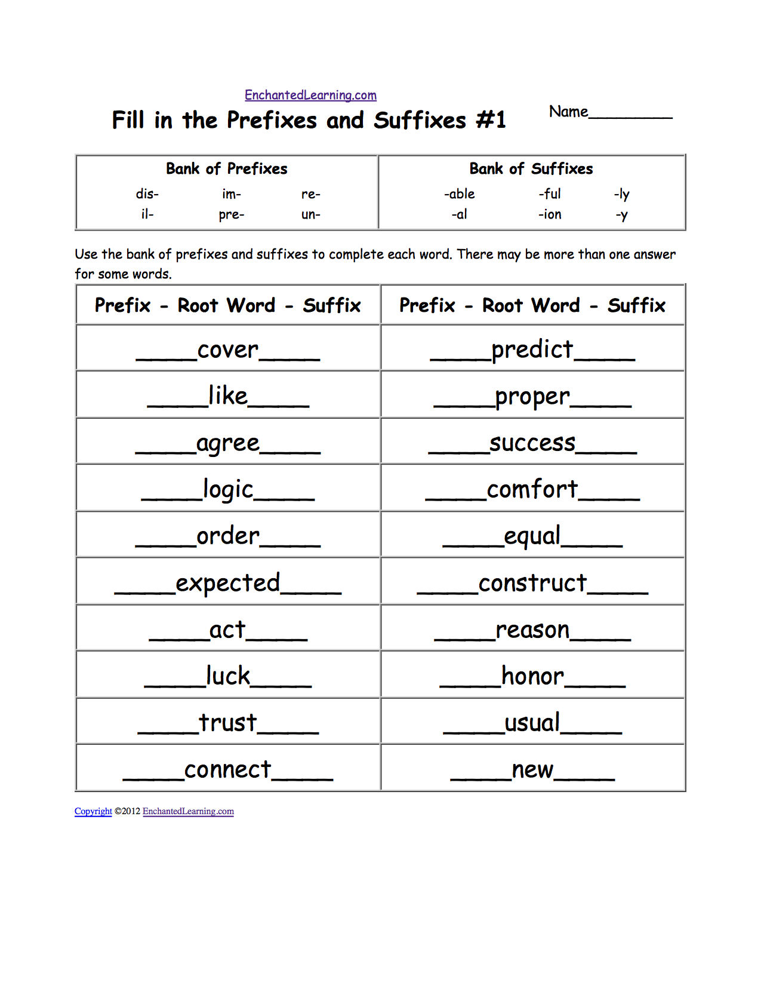
http://www.bbc.co.uk/schools/spellits/activities_y6/activity4.shtml

Slide 8
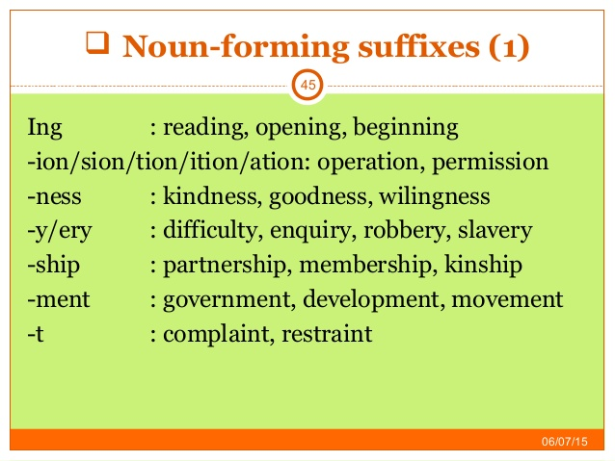

Slide 9
