Slide 1
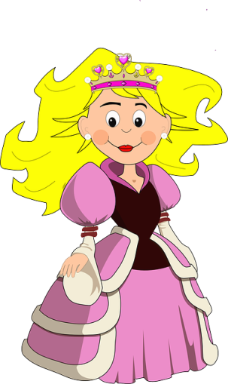
Help Wash Take Study Teach Play Plan Stop See Stay Cook Have Want Return Visit Look Call Miss Dance Watch Fail Find Leave Eat Paint Forget meet
Hands Mathematics Boyfriend A party A monkey Guitar Hat The T.V Hours Piñata Clothes The meal A cake Big house A cat Her mother The buss Baseball Tacos Doll Late Cheese Problems Exam
Last summer the princess of monnaco visited México and…………………………
3 + (possitive sentences)
3 – (negative sentences)
2 ? (questions)
2 ? ( Wh.. questions)
Work in pairs use a verb and a complement to continue the story…..

