Slide 1
http://www.eslgamesplus.com/videos/toys-where-is-my-teddy-esl-video-lesson/

Slide 2
Class work
Practice prepositions of place, complete the following sentences
on
under
Next to
Next to
on
on
in
between

Slide 3
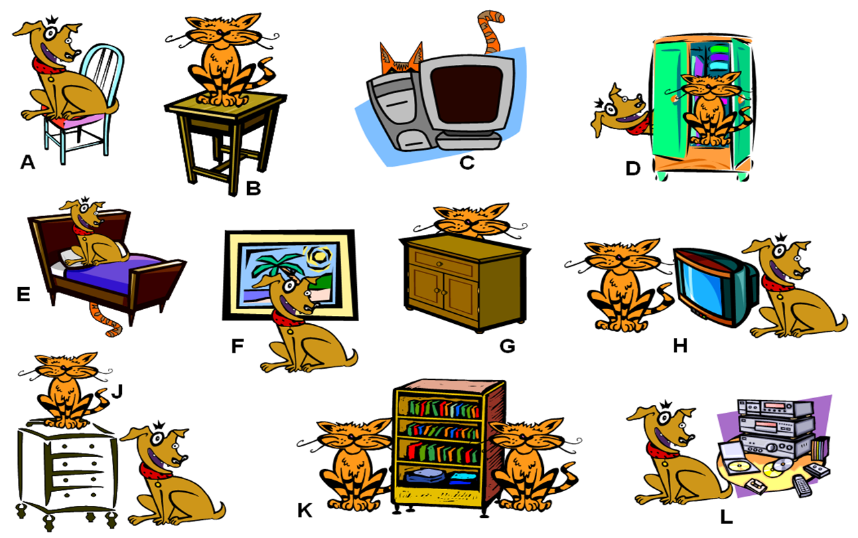
Class work
Write 10 sentences (min). use prepositions of place, practice with your partner orally

Slide 4
The dog is on the cair
The cat is on the table
The cat is behind the computer
The cat is in the closet
The dog is on the bed
The dog is in front of the box
The cat is behind naighttable
The T.V. is between the cat and the dog
The cat is on the nightstand
The bookcase is between the cats
Stereo is next to the dog

Slide 5
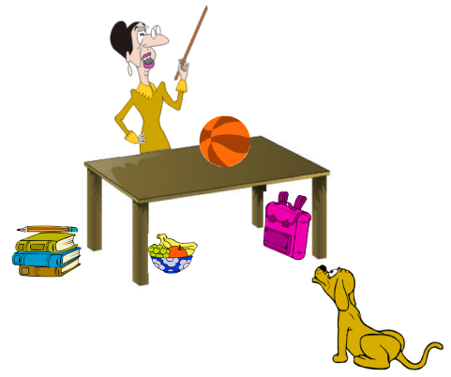
EXTRA Practice At home!!!
Make oral sentences use prepositions of place

Slide 6
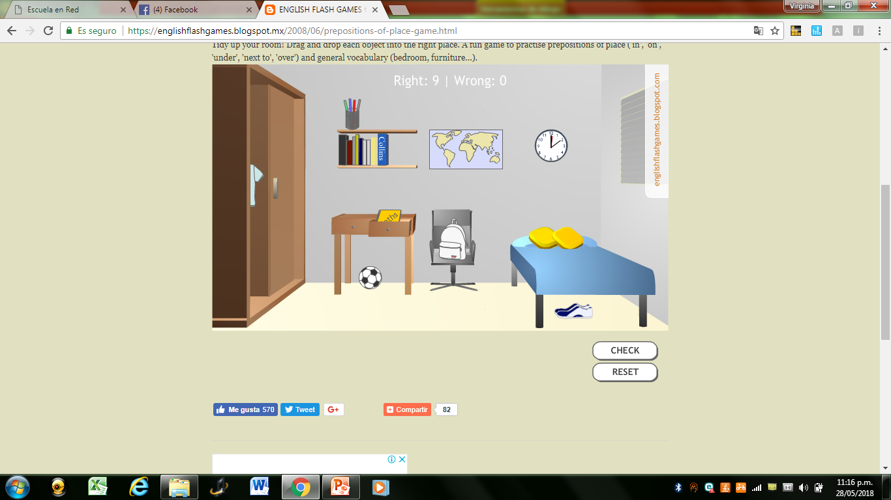
Practice with prepositions of place in the following website
http://englishflashgames.blogspot.mx/2008/06/prepositions-of-place-game.html

