Slide 1
http://www.eslgamesplus.com/videos/toys-where-is-my-teddy-esl-video-lesson/

Slide 2
Class work
Practice prepositions of place, complete the following sentences
On
under
Behind
Next to
On
On
in
Between

Slide 3
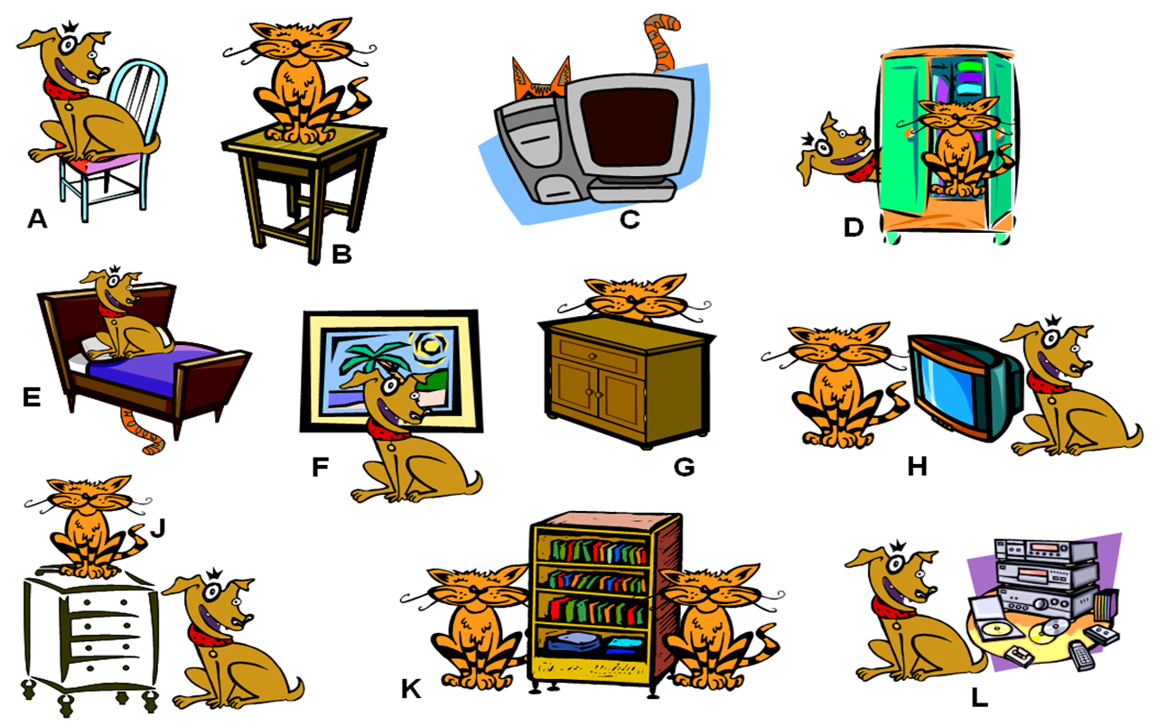
Class work
Write 10 sentences (min). use prepositions of place, practice with your partner orally

Slide 4
The dog is on the chair
The cat is on the table
The cat is behind the computer
The cat is in and dog is behind the closet
The dog on the bed
The dog is in from the picture
The cat is behind the nightstand
The T. V is between the cat and the dog
The dog is next to the radio

Slide 5
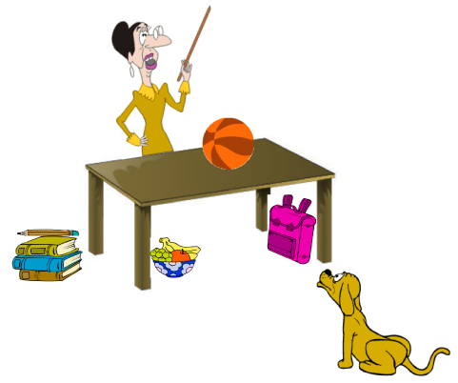
EXTRA Practice At home!!!
Make oral sentences use prepositions of place

Slide 6
Practice with prepositions of place in the following website
http://englishflashgames.blogspot.mx/2008/06/prepositions-of-place-game.html

