Slide 1
http://www.eslgamesplus.com/videos/toys-where-is-my-teddy-esl-video-lesson/

Slide 2
Class work
Practice prepositions of place, complete the following sentences
on
Under
Next to
Next to
on
On
Under
Between

Slide 3
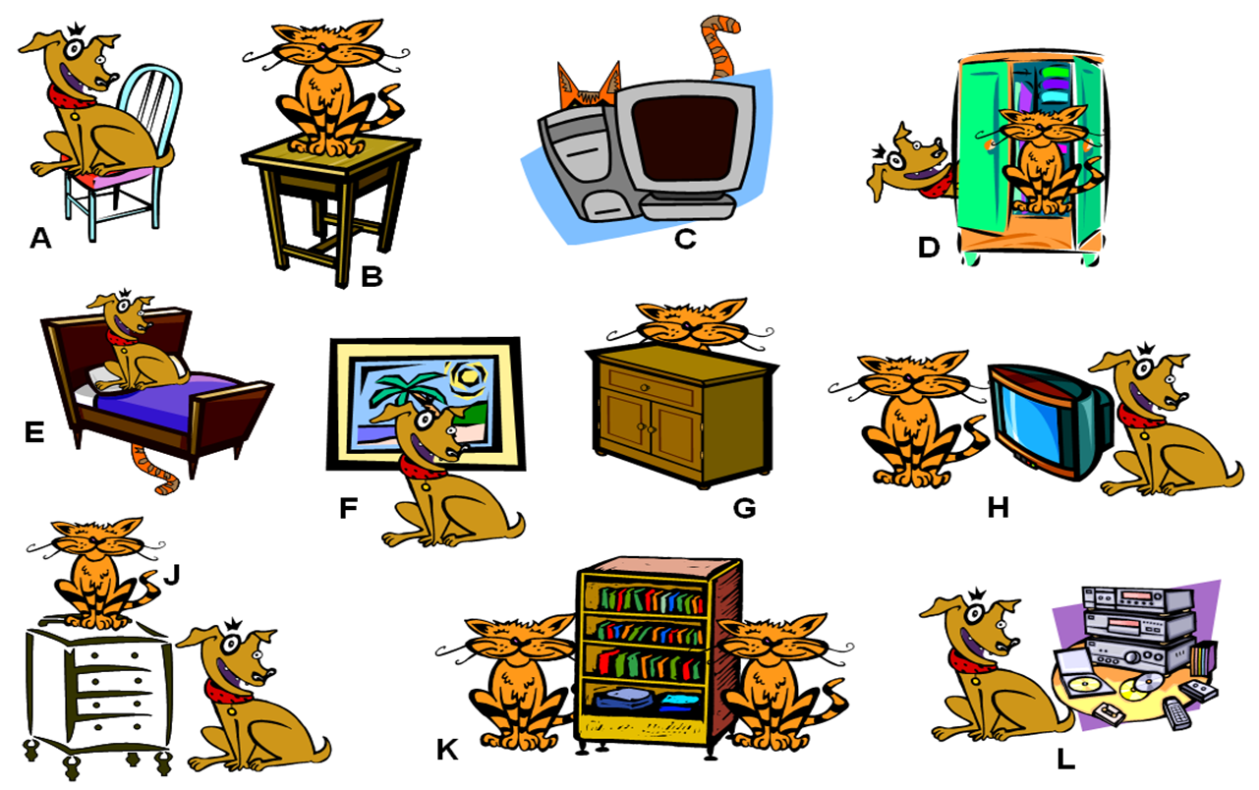
Class work
Write 10 sentences (min). use prepositions of place, practice with your partner orally
The dog is on the chair
The cat is behind the computer
The dog is behind the door
The cat is under the bed
The tv is between the cat and the dog
The dog is front of de paint
The furniture is between the cats
The dog is the next to cds

Slide 4
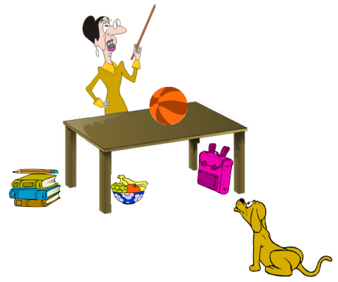
EXTRA Practice At home!!!
Make oral sentences use prepositions of place

Slide 5
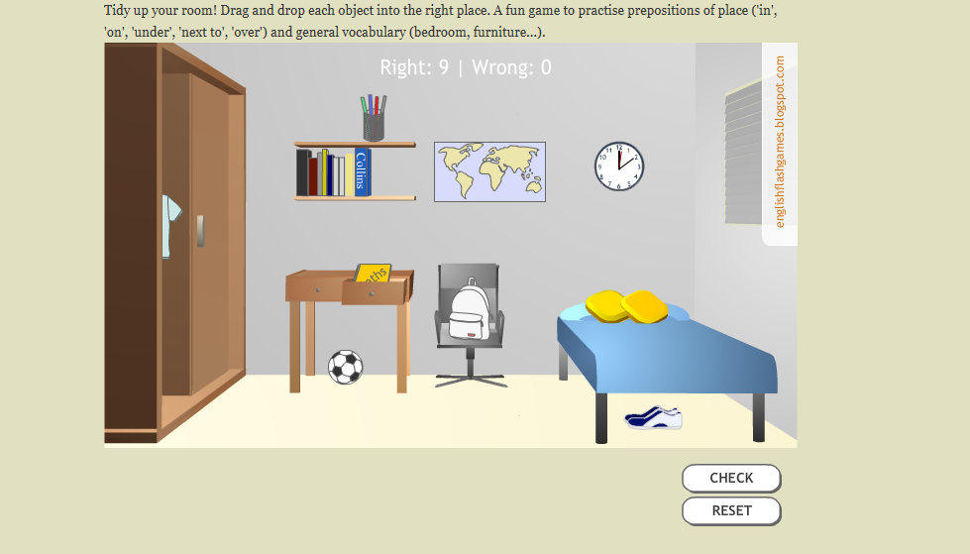
Practice with prepositions of place in the following website
http://englishflashgames.blogspot.mx/2008/06/prepositions-of-place-game.html

