Slide 1
http://www.eslgamesplus.com/videos/toys-where-is-my-teddy-esl-video-lesson/

Slide 2
Class work
Practice prepositions of place, complete the following sentences
on
under
Next to
In front of
behind
above
in
between

Slide 3
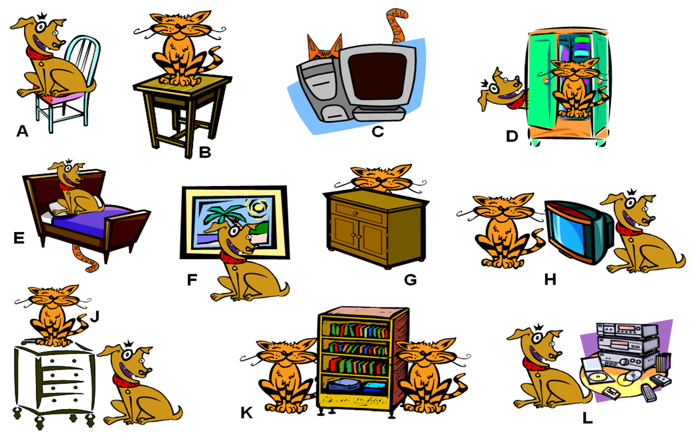
Class work
Write 10 sentences (min). use prepositions of place, practice with your partner orally
the dog is on the chair
the cat is behind the computer
The cat is on the table
The cat is in the closet
the dog is above the bed
the dog is in front of the painting
television is next to the cat and the dog
the dog is under the furniture and the cat
the bookseller betwenn the cats
the dog is next to the stereo

Slide 4
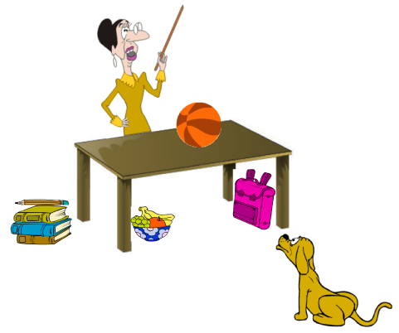
EXTRA Practice At home!!!
Make oral sentences use prepositions of place

Slide 5
Practice with prepositions of place in the following website
http://englishflashgames.blogspot.mx/2008/06/prepositions-of-place-game.html

