Slide 2
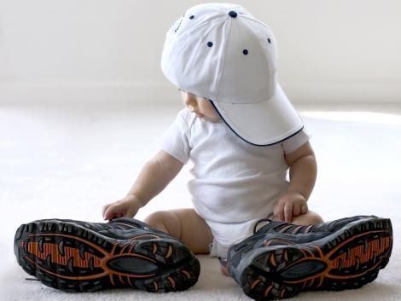
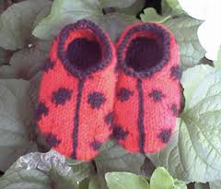
These shoes are too big for me
These shoes are too small for me

Slide 3
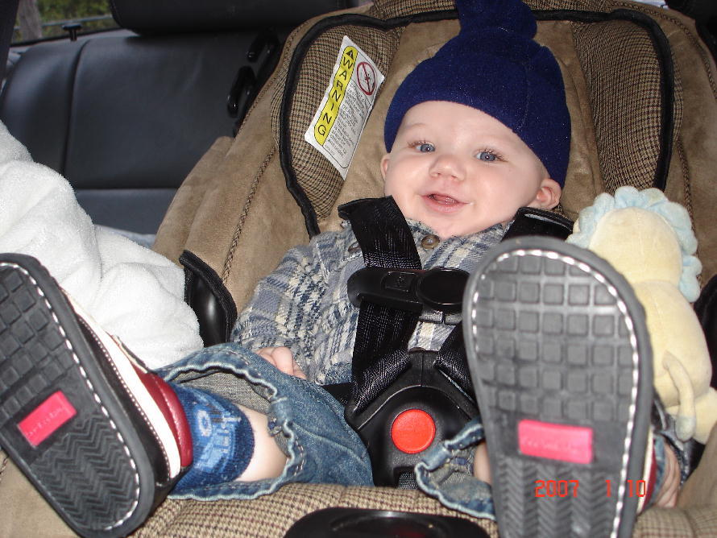
These shoes are big enough for me

Slide 4
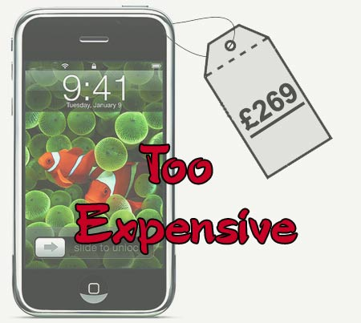
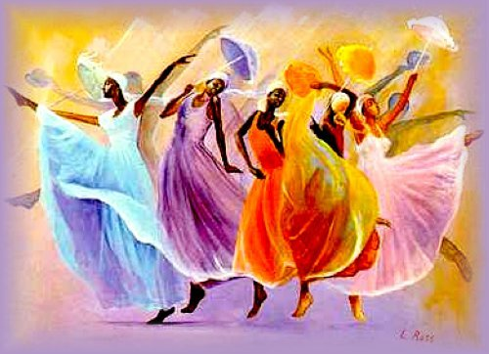
This cell is too expensive
This painting is too coloured

Slide 5
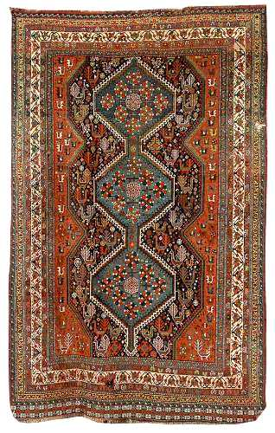
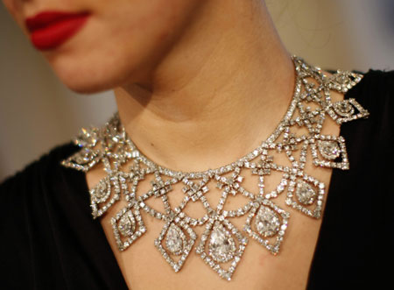
This rug is too old
This necklace is
beautiful enough for me

Slide 6
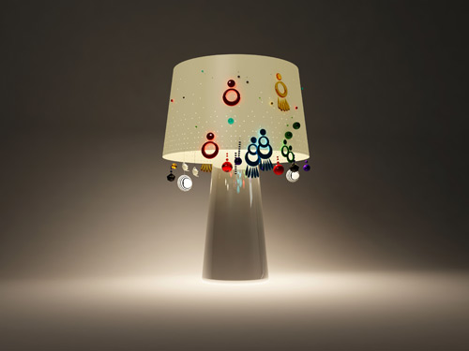
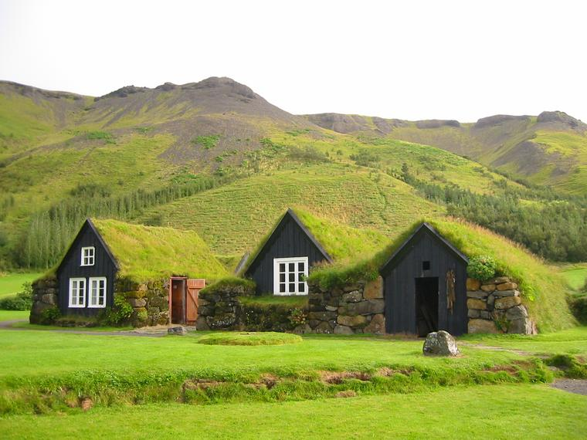
This lamp is not light enough
This place is quiet enough for me
This place is too quiet for me

Slide 7
Answer correctly use the cues from the word bank
1. This computer is _________ to do this calculation.
2. It isn't ___________ to sunbathe.
3. Are you ___________ to reach that shelf?
4. You're ________ to drive.
5. That sweater is big, it's ___________ for you.
6. The garden isn't ____________to play football.
Bigh enough Too big Tall enough
too slow Too young Sunny enough

Slide 8
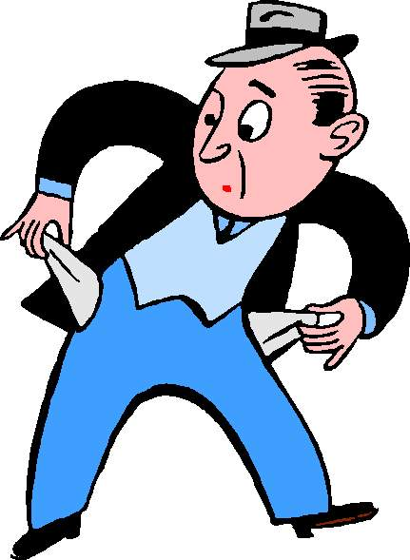
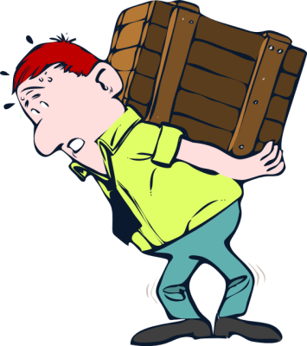
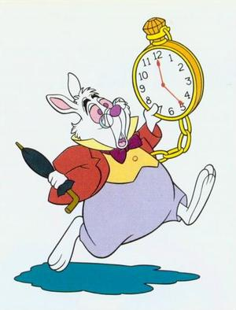
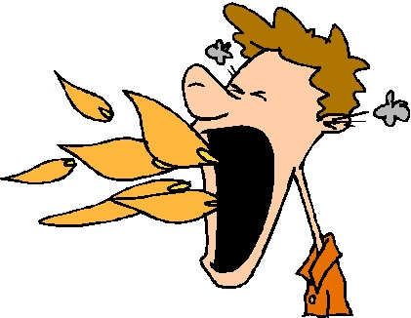
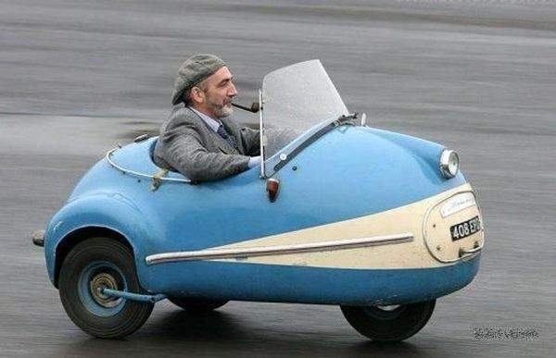
Write sentences using too and enough for each picture
___________________
___________________
___________________
___________________
___________________
___________________
___________________
___________________
___________________
___________________
___________________
___________________
___________________
___________________
___________________
___________________
___________________
___________________

