Slide 1
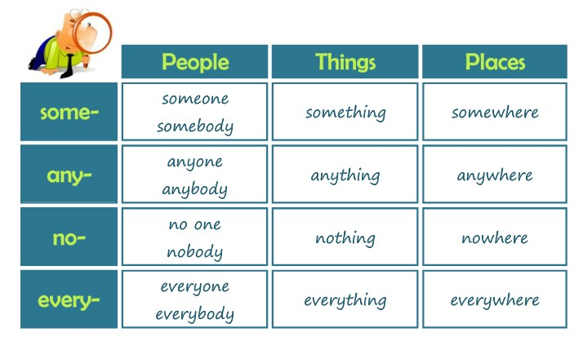

Slide 4
Click on the following link to listen and learn about the use of compounds
http://learnenglishteens.britishcouncil.org/grammar-vocabulary/grammar-videos/some-any-every-and-no
Practice compounds in the following links, copy paste your results
http://www.eslgamesplus.com/some-any-no-none-quiz/
Practice compounds in the following links, copy paste your results
http://www.englisch-hilfen.de/en/exercises/confusing_words/something_anything.htm
Listen and practice compounds in the following links, copy paste your answers
http://www.cram.com/flashcards/something-anything-nothing-somebody-anybody-nobodysomewhere-anywhere-nowhere-2456277

