Slide 1
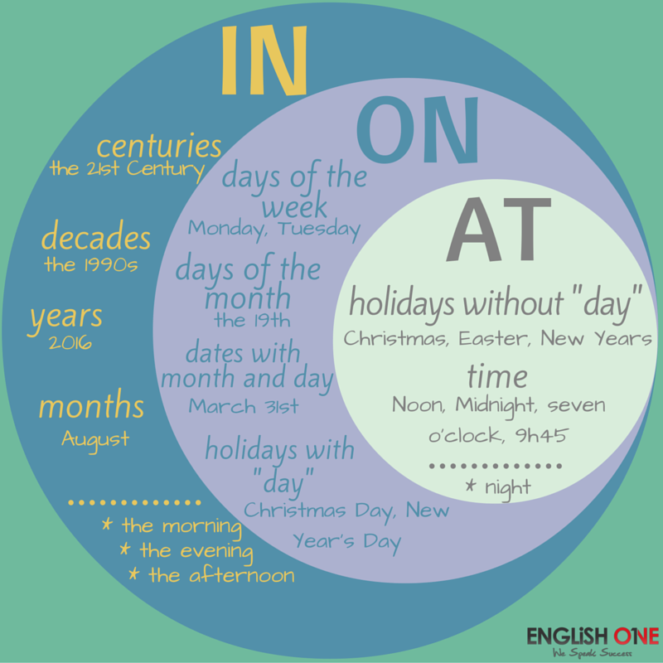
Prepositions of time…

Slide 4
Print and play…

