Slide 1
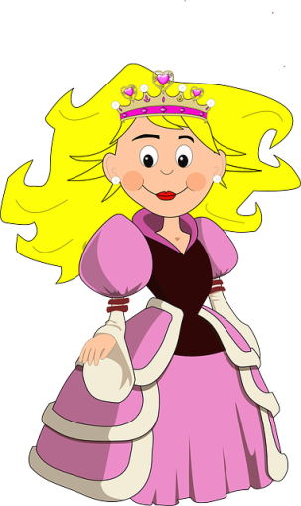
help wash arrive study cry play plan stop wait stay cook need eat see want leave visit look call miss decide watch write do take drink run say get make buy meet
Hands Mathematics Boyfriend A party A monkey Guitar Hat The The bus T.V Hours Piñata Clothes The meal A cake Milk Big house A cat The room Her mother Baseball A book Tacos Doll Late Cheese Problems A letter Pictures Chocolate Mushrooms A Rash Forest Pretty
Last summer the princess of monnaco visited México and…………………………
Continue the story…..with the verbs and the complement words given.
Write a short story including10(+) sentences 10(-)sentences
At the end of the story make and answer 5 questions about the story (?)

