Slide 1
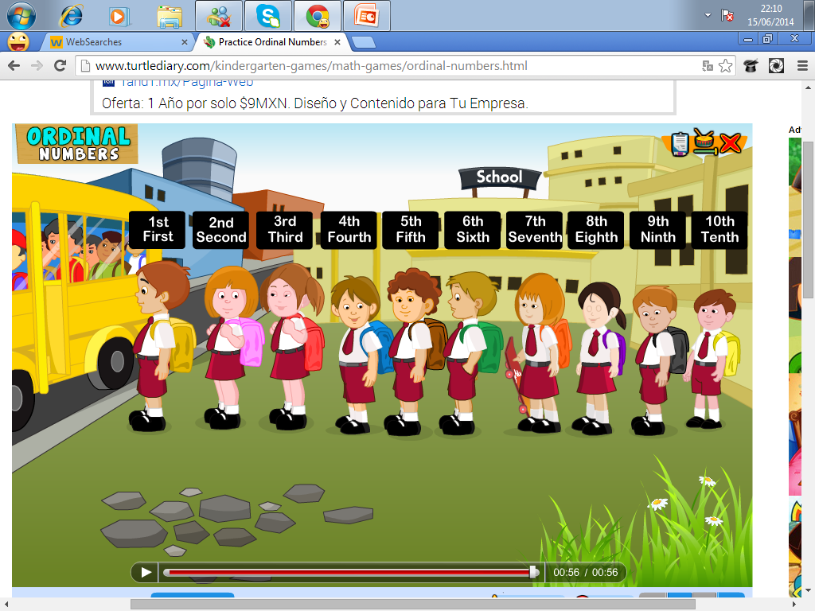
Ordinal NUMBERS
Ordinal numbers refer to a number indicating the position in a serie
Click on the following link to watch explanation
https://www.youtube.com/watch?v=h_3AI-qNBlE

Slide 2
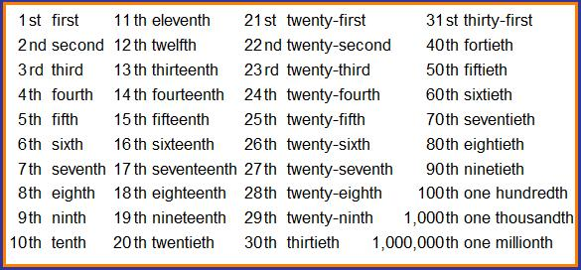

Slide 3
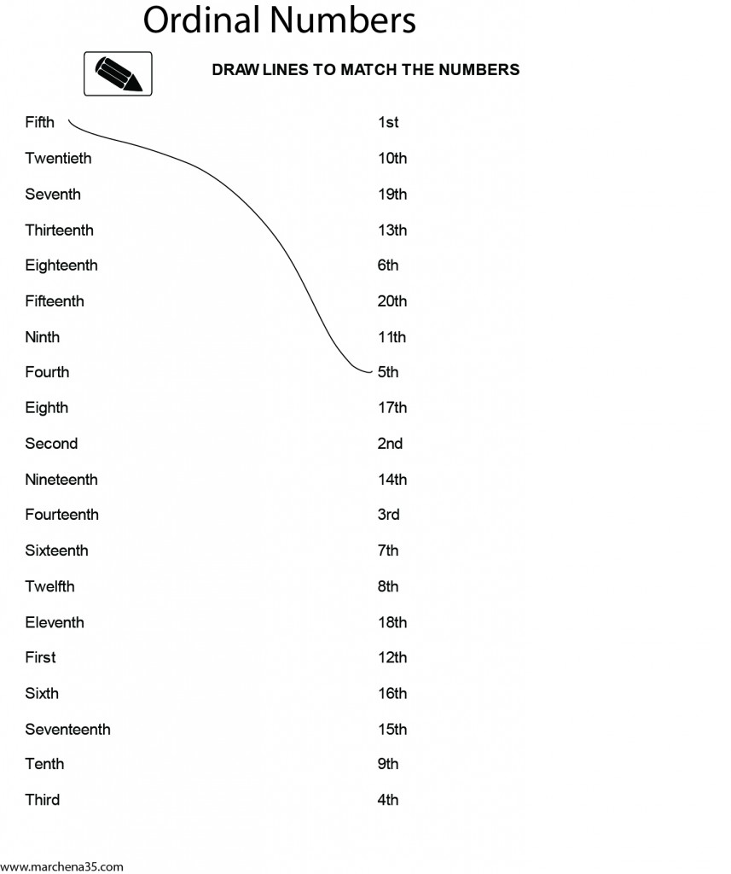

Slide 4
Now put the sentences below in order by numbering them, use ordinals

