Slide 1
ESCUELA NORMAL DE EDUCACIÓN PREESCOLAR
ENGLISH A1.1 STARTING BASIC COMMUNICATION
CRISTINA ARACELY ALVARADO CHAVARRIA
PROJECT UNIT 1. INFORMATION CARDS
TORRES TOVAR NATALIA GUADALUPE

Slide 2
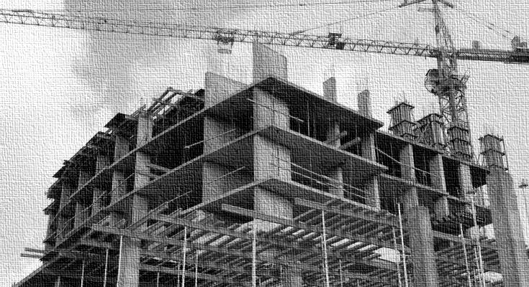
Jesús Esquivel
Natalia Torres
8441633621
cell phone
4177176
8441315453
8441761404
work phone
Home phone
Cell phone
jesusesquivel879@gmail.com
e-mail address
nataliagpetorres@gmail.com
E-mail address

