Slide 1
Victoria Nataly López Venegas
1B Ingles Unit 1

Slide 2
Victoria Nataly López Venegas
Home Phone: 413-13-21
Cell Phone: 844-185-4016
Email: toriv345@gmail.com
Volleyball player - Kpop lover and Dancer

Slide 3
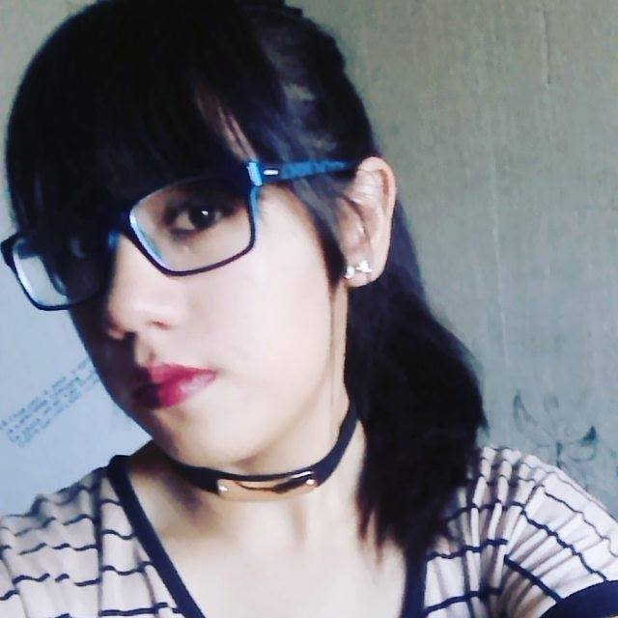
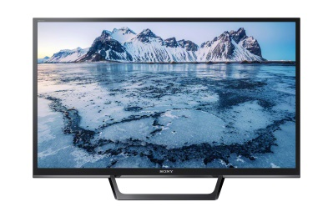
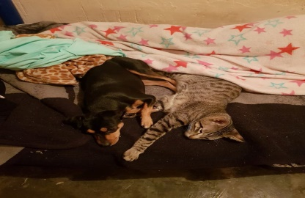
Samantha Ibeth López Venegas
Home Phone: 4-82-70-31
Cell Phone: 844-328-5643
Email: sams-love@hotmail.com
amateur novels have a dog and love to go to parties

