Slide 1
“ESCUELA NORMAL DE EDUCACIÓN PREESCOLAR”
ENGLISH A1.1 STARTING BASIC COMMUNICATION
ENGLISH PROJECT
UNIT 1: WHAT´S YOUR NAME?
AIM: Give students practice giving personal information.
PREPARATION: Students create two personal information cards, one for themselves and one for a partner.
NAME: Mariana Guadalupe Gaona Montes.
GRADE: 1st “B”

Slide 2
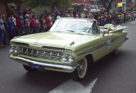
844-439-22-80 (work phone)
844-305-40-02 (home phone)
ivangaona77@hotmail.com (e-mail adress)
IV
Ivan Gaona
MARIANA GAONA
MG
844-464-36-98 (work phone )
844-159-36-77 (home phone)
marianag123@hotmail.com

