Slide 1
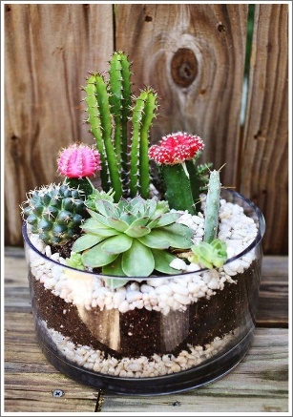
Terrarios Gaby
Terrarios Caro
Karla Carolina García Saucedo
Home phone: 4-43-92-43 Work phone: 844-358-39-88
e-mail address: garcia.enep.99@gmail.com
Gabriela Guadalupe Rodriguez Diaz Home phone: (844) 163-34-47 Work phone: 878-136-61-66
e-mail address: ggrodriguez618@gmail.com
Mándalas Lucia
Luisa Lucia Hernandez Cruz Cell phone: 844-385-89-87
e-mail address: luisaluciahdz.c@gmail.com

