Slide 1
Escuela Normal de Educacion Preescolar.
Ciclo escolar 2018-2019.
First name: Berenice Abigail Farias Arroyo.
Teacher: Cristina Aracely Alvarado.
Year: 2ª.
Competencias del curso:
• Describe ways of living in different cultures to appreciate their diversity
• Use language to establish harmonious and responsible relationships when exercising citizenship
• Reflect on one´s own learning process to act consciously in communicative exchanges
• Understand and produce texts to participate in a variety of everyday and concrete situations
• Exchange basic information about personal and professional experiences
• Recognize cultural differences when participating in brief and common exchanges

Slide 2
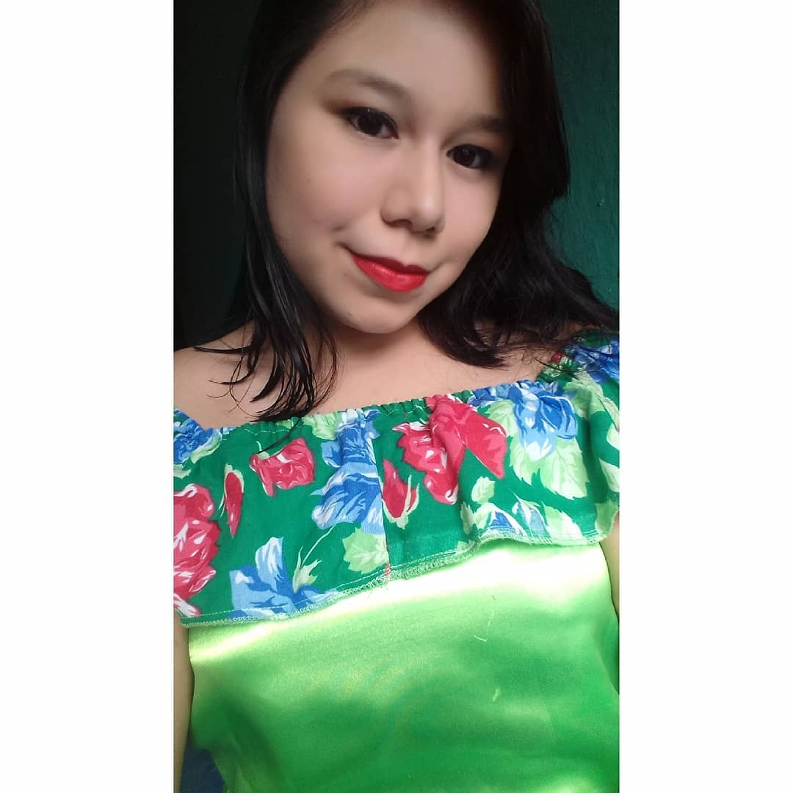
Personal information.

Slide 3
Personal information of my partner

