Slide 2
Escuela Normal de Educación Preescolar English course Framework
Teacher: Maria Elena Meza Aguado

Slide 6
Number of hours/ Credits: 6/ 6.75
Class schedule: Thursdays and Fridays 12:30-14:45 (6 class time hours per week)
Course purpose: The English Language Course for Escuelas Normales is designed to develop students’ ability to communicate effectively in English contexts that will be important for them. As future teachers in a society where English is increasingly important for engaging successfully with professional and social activities, it is essential that all students develop a good level of proficiency in English. English is growing in importance for accessing information, making useful contacts, understanding other cultures and participating in cultural activities.

Slide 7
Competencies of the course
The course is based on the communicative approach to language learning in line with the Common European Framework of Reference from the Council of Europe.
The course has three main aims:
Develop their ability to use English in personal and social communications, to develop relationships, complete transactions and meet everyday needs.
Increase their engagement with cultural and intercultural activities in English, in order to develop a better understanding of their own culture as well as other cultures around the world.
Develop their ability to teach in a school environment where English is an important aspect of the school’s approach. Schools are expected to use English increasingly for various teaching and learning activities, and future teachers need to be confident in using English in the school environment.

Slide 8
Professional Compentencies
Use critical and creative thought for solving problems and taking decisions.
Learn in an autonomus way and demonstrate initiative for self-regulation and strengthen her/his personal development.
Cooperate to bring about innovative projects having a social impact.
Use the information and communication technologies critically.
Apply her/his linguistic and communicative skills in different contexts.

Slide 11
Additional online references and resources
Learning English. http://www.bbc.co.uk/learningenglish
Teaching adults. https://www.teachingenglish.org.uk/teaching-adults
Adult learners. https://elt.oup.com/learning_resources/courses/adultlearners/?cc=mx&selLanguage=en
Learning English. https://www.cambridgeenglish.org/learning-english/
Teacher’s corner. https://americanenglish.state.gov/teachers-corner
Classroom resources. Pearson. https://www.pearsonelt.com/professional-development/resources.html
Teaching adults. Oxford. https://elt.oup.com/teachersclub/courses/teachingadults/?cc=mx&selLanguage=en
For teachers. BBC. http://www.bbc.co.uk/worldservice/learningenglish/teach/
Onestop English. http://www.onestopenglish.com/
The digital teacher. https://thedigitalteacher.com/
https://visuwords.com/
https://www.eslvideo.com/
https://es.lyricstraining.com/
https://www.busuu.com/es
http://intermediatelow.blogspot.com/
https://www.englishclub.com/
http://www.topics-mag.com/
http://www.readableblog.com/
https://dictionary.cambridge.org/es/
http://www.bbc.co.uk/learningenglish
https://www.tefl.net/
http://www.elllo.org/

Slide 12
Personal
Community
B1.1.1
B.1.1.4
B.1.1.2
B.1.1.5
B.1.1.3
B.1.1.6

Slide 13
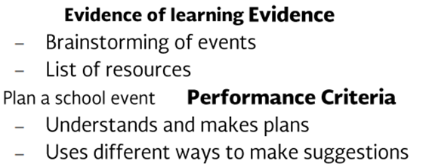
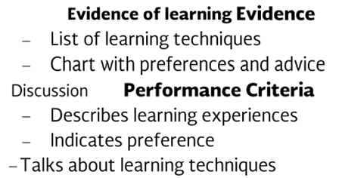
Professional

Slide 14
sesiones
 | Agosto | 20 – 24 Introduction ENEP
 |  | 27 -31 Introduction and diagnosis
1 | Septiembre | 3 -7
2 |  | 10 -14 Observe and assist 2°, Practice 4°
 |  | 17 – 21 Practice 4°
 |  | 24 – 28 Practice 4°
 | Octubre | 1 – 5 Practice 4°
 |  | 8 – 12 Practice 3°
 |  | 15 – 19 Practice 3° Evaluation
 |  | 22 -26 1st Evaluation
 |  | 29 -2 (holiday Friday the 2nd)
 | Noviembre | 5 -9 Observe and practice 2°, Practice 4°
 |  | 12 -16 Practice 4°
 |  | 19 – 23 2nd Evaluation, Practice 4°
 |  | 26 -30 Practice 3°, Practice 4°
 | Diciembre | 3 -7 Practice 2° and 3°
 |  | 10 -14 3rd Evaluation
 |  | 17 -19
 | Enero | 7 -11 GLOBAL Evaluation
 |  | 14 -18
 |  | 21 -25 Grading
 |  | 28 -1
Evaluation and teaching practice dates

Slide 15
Grading Criteria
Period evaluation | Formative | Summative
Participation and daily work (25) Homework (10) | 35%
Project | 20%
Exam |  | 35%
Portfolio |  | 10%
Semestral
Portfolio | 30%
Global assessment |  | 70%

Slide 16
Roles of teacher and learner

Slide 17
Course information and policies
Course Materials: Failure to bring the book results in losing 5 points per day.
Homework: You will have homework every day. There will be regular online homework tasks, as well as homework related to textbook material.
No late homework will be accepted: If you are absent it is your responsibility to find out the homework assigned. You have until the next school day to turn in the missed work. (exceptional case for teaching practice weeks)
Grading: Your course grade will depend on performance on tests, speeches given, and participation. Satisfactory participation means completing the tasks assigned in class and interacting with your classmates. Quizzes, tests, speeches, and dialogue presentations cannot be made up unless the student has an excuse absence by ENEP. This means that if a student is not in class for this work, he or she will receive a grade of 0 for the missed work.

Slide 18
We often take tests and quizzes at the BEGINNING of class time. If you come in late, you will not be given extra time to make up the test/quiz. If you come to class AFTER the test/quiz has finished, you WILL NOT be able to make it up.
You are not allowed to speak to others during a test.
Conduct
Students are expected to:
Attend all classes and arrive on time
Bring the texts, paper, pencil, eraser
Participate in class
Complete homework

Slide 19
Please turn off cell phones during class!
Cell phones should be turned off in class; no texting may be done in class. In addition, students may not use electronic devices with earphones in class nor may they do recreational activities on computers. Electronic dictionaries may be used in class but not during tests.
Policies about being late and being absent
In accordance to ENEP ‘s policies, you are allowed to miss up to 15% of class time. If you miss more than that, YOU WILL FAIL the class and must return to the same level next course.
Minutes will be subtracted if you:
Arrive late
Come back to class late or leave early
Sleep during a class
Read anything during class which is not related to class activities

Slide 20
Cultural notes:
If you are late for some reason, please come in quietly and sit down. Do not disrupt the class saying hello, greeting classmates, etc.
Please do not attempt to negotiate with the instructor. It is very rude and disrespectful to negotiate grades, minutes, etc.
The only way to learn where you are misunderstanding is by asking questions.
You may call me Miss, teacher, Miss Mary
I look forward to a very good session. Thank you for your interest in learning English!
If you really want to improve your English, please remember:
The more you use English, the faster you will learn.
YOU CAN DO IT!

Slide 21
Bibliography
https://www.cambridgeenglish.org/Images/126011-using-cefr-principles-of-good-practice.pdf
https://cevie-dgespe.com/Page/index.php/planes-de-estudios-2018/77

