Slide 1
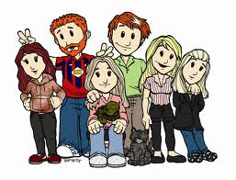
My Family
Write about two members of your family, mention relationship, describe them (use adjectives) and give basic information what do they do, what do they like, etc (5 lines min).
Add a memmorable phrase to your family.
________________________________________________________________________________________________________________________________________________________________________________________________________________________________________________________________________________________________________________________________________________________________________________________________________________________________________________________________________________________________________________________
Family…
Like branches on a tree, we all grow in different directions yet our roots remain as one.

Slide 2
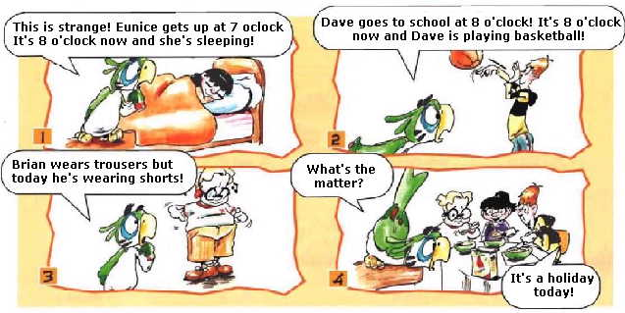
PRESENT CONTINUOUS Invent a crative commic, use vocabulary, expressions (guess what, big day, etc.) and present continuous. Divide in four the slide and use colorful pictures.

