Slide 1
Infinitives or Gerunds
Mayela
Gaona

Slide 2
Knowing the difference between Gerund And Infinitive can save you from making costly grammar mistakes when writing.
Deciding which to use is not always easy, but the more you read and listen to English, the easier it will become. Sometimes either the gerund or the infinitive form can be used, either with the same or different meanings, and sometimes there is only one form which is correct.
Infinitive – are formed with the word to in front of a verb.
Both gerunds and infinitives can be subjects in sentences
both gerunds and infinitives can serve as the object of a verb.
A gerund can be the object of a preposition; an infinitive cannot.
https://www.youtube.com/watch?v=8nGCRGZFuUQ

Slide 3
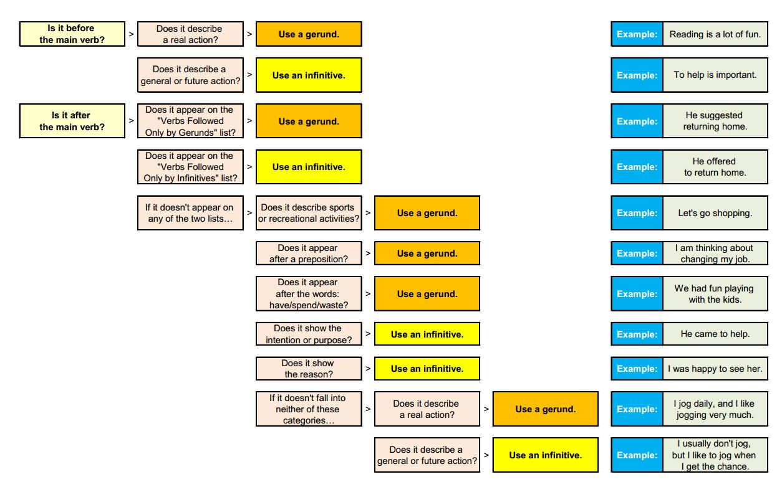

Slide 4
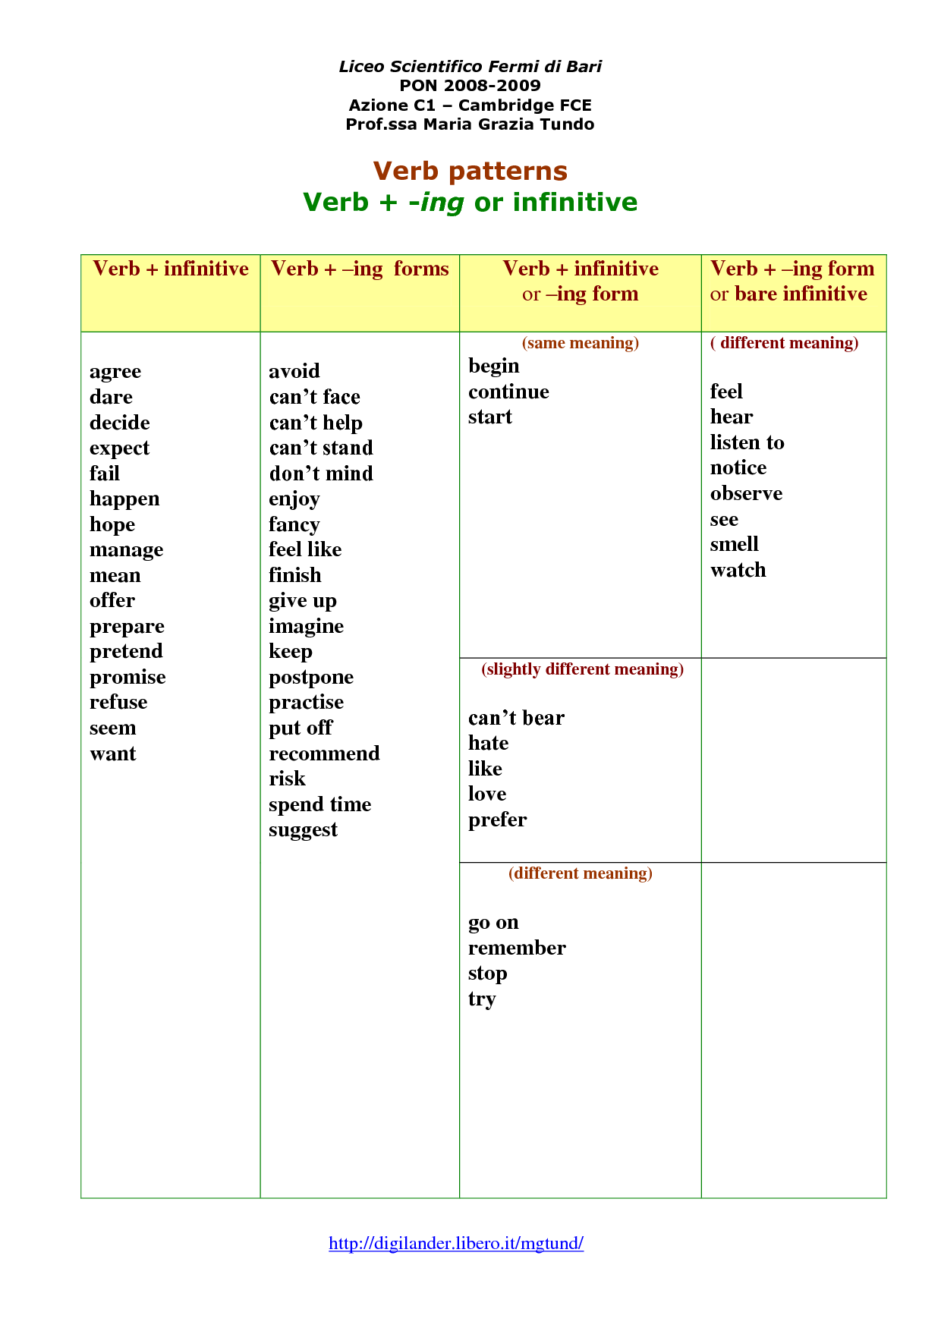

Slide 5
https://www.youtube.com/watch?v=8XdMLCCK5DQ

Slide 6
Click On The Following Links To Practice With Infinitives And Gerunds
Print your results
https://elt.oup.com/student/englishfile/intermediate/i_games/theanteatergame/nef_int_games_ant01?cc=it&selLanguage=it
http://a4esl.org/q/f/z/zz97mkm.htm
http://www.eslgamesworld.com/members/games/grammar/En%20garde/gerunds%20infinitive/gerunds%20or%20infinitive.html

