Slide 1
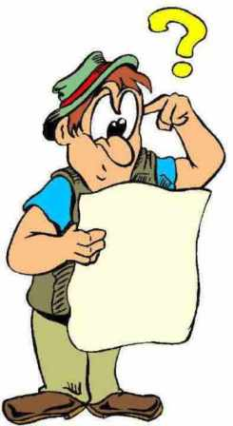
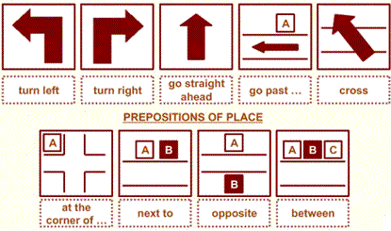
Giving directions Lesson 7d
Click on the following link to watch for better explanation
https://www.youtube.com/watch?v=IDEuyJwOiyA&feature=youtu.be

Slide 2
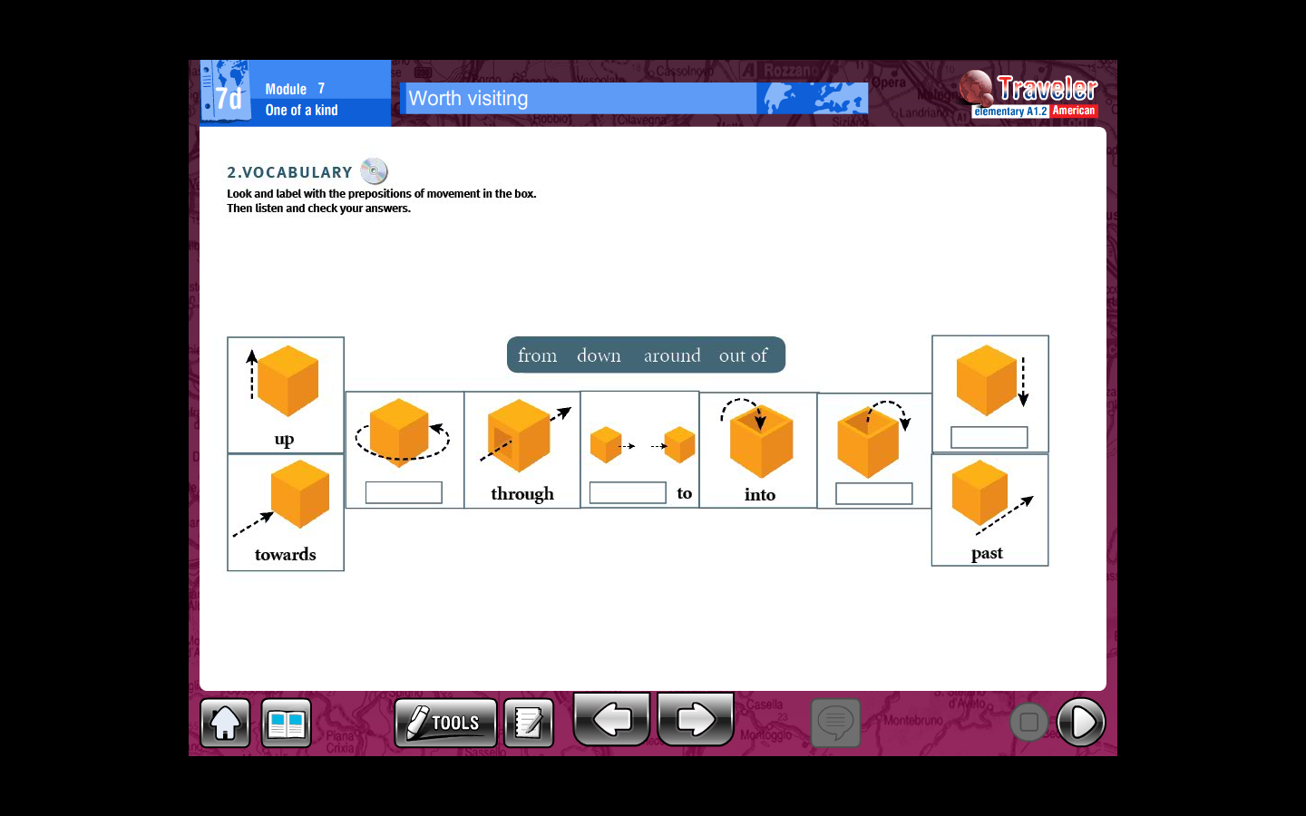
Complete the following prepositions with the word bank

Slide 3
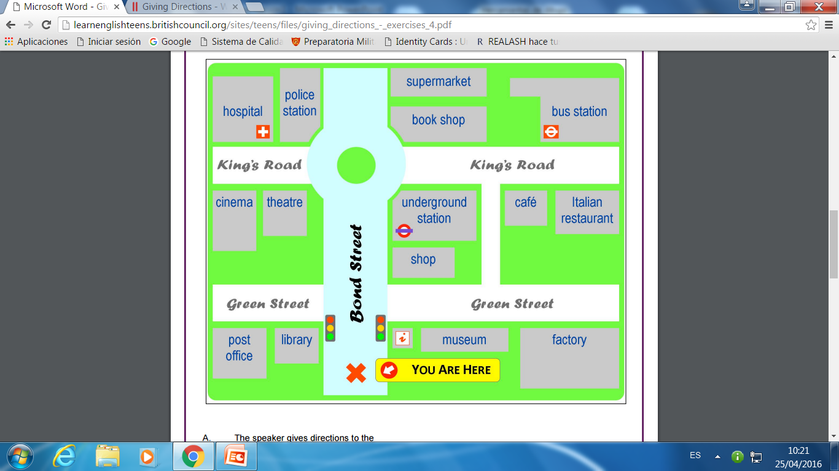
Look at the map, then follow directions and answer
Go straight on. Then take the first left on to Green Street. Walk past the library and it’s the building next to the library on the left. ________________
B. Go straight on. Go past the traffic lights. You will see a shop on the right. Go past that and it’s on the right next to the shop. _______________
C. Go straight on. Go past the traffic lights and go straight on until you get to the roundabout. At the roundabout turn left. Go past the theatre. It’s the building next to the theatre, opposite the hospital. ____________
D. Go straight on. Go past the traffic lights and take the second right on to King’s Road. Go past the bookshop. It’s the building next to the bookshop opposite the café. __________________

Slide 4
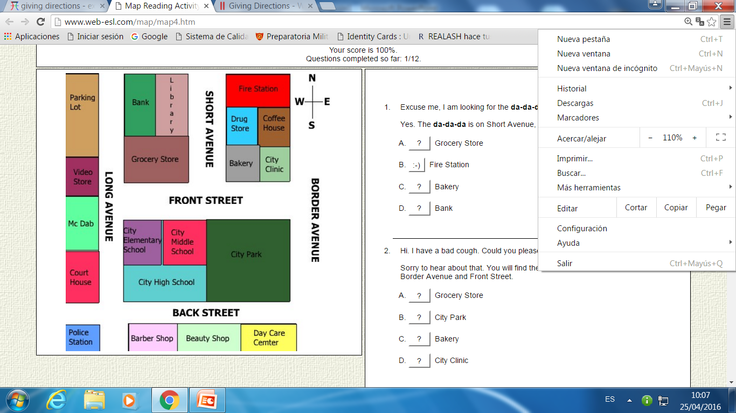
Look at the map, then follow directions and answer
1.- Excuse me, I am looking for the ________. Do you know where I could find it?
Yes. The______________ is on Short Avenue, across the street from the library.
Grocery Store
Fire Station
Bakery
Bank
2.- Hello. Could you tell me where the ______________ is?
Yes, the __________ is across the street from the City Park and next to the City Clinic.
Day Care Center
Grocery Store
City Middle School
Bakery
3.- Can you help me? I am looking for the_____________Do you know where it is?
Sure, it's located across from the grocery store next to the Elementary School.
Bakery
Video Store
City Park
City Middle School

