Slide 1
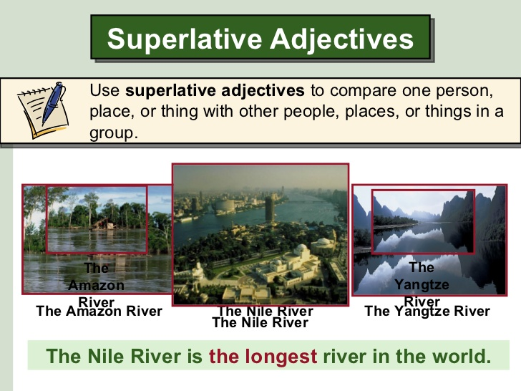

Slide 2
Oral practice, with superlatives
Give examples of cities in the world, states in your country or places, to practice with supperlatives
The most dangerous …..
The most historic …..
The most traditional ….
The most touristic…
The best view….
The most peaceful park….

Slide 3

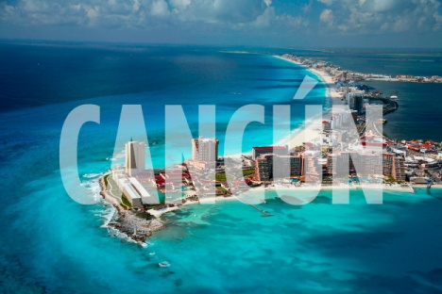
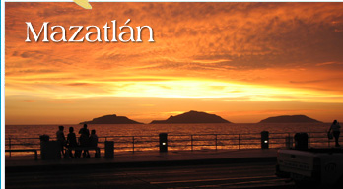
Comparatives with AS……. AS…
We use comparative: as adjective as
To say two persons , things or places are equal
Cancún is as clean as Mazatlan
We use comparative: Not as adjective as
To say two persons , things or places are not equal
Mazatlan is not as expensive as Cancún

Slide 4

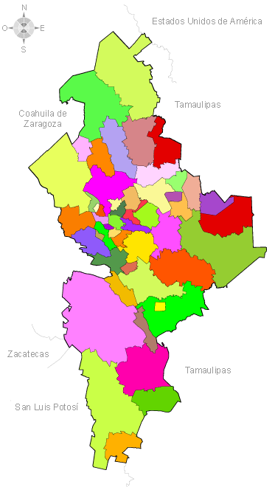
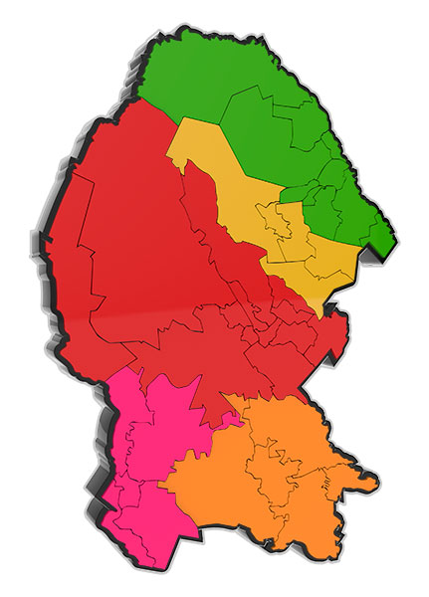
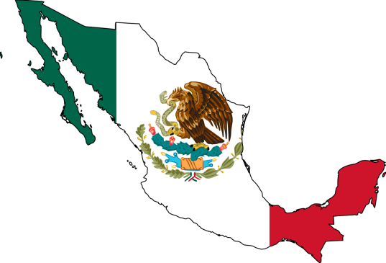
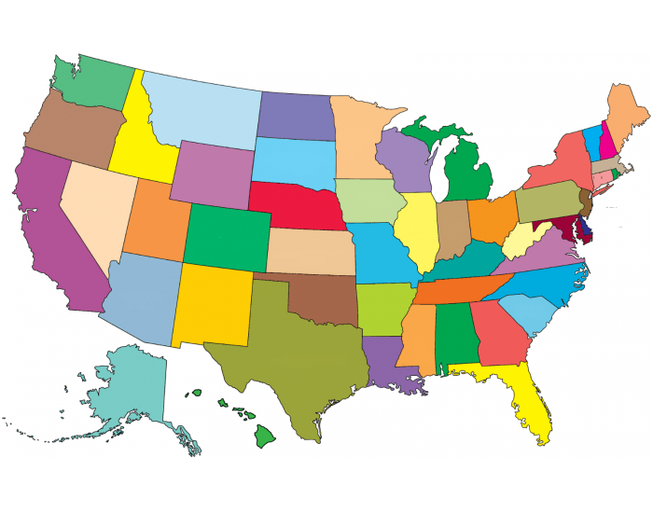
Practice your own examples
Nuevo León
Coahuila
United states
México

Slide 5
Practice with the following links print your results
http://www.englisch-hilfen.de/en/exercises/adjectives_adverbs/adjectives_comparison_as_as.htm
https://www.espressoenglish.net/comparative-adjectives-not-as-as/
http://eolf.univ-fcomte.fr/wp-content/uploads/grammar/comparative_superlative/02.htm

