Slide 2
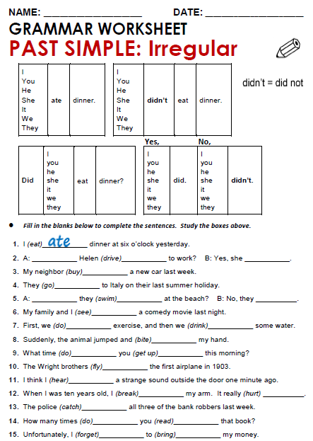

Slide 3
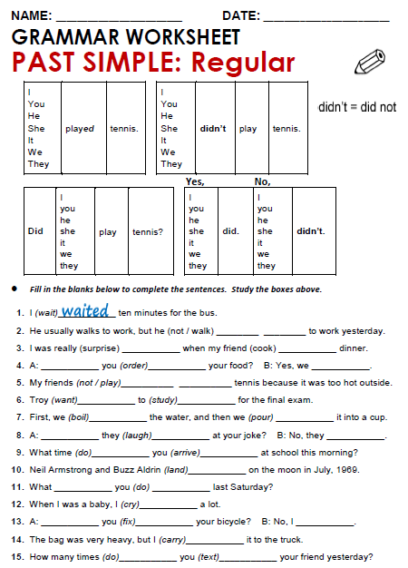

Slide 4
Practice simple past of irregular, possitive, negative and questions
http://www.eslgamesworld.com/members/games/grammar/New_Snakes_%20Ladders/Past_simple_tense.html
http://learnenglishkids.britishcouncil.org/en/grammar-practice/past-simple-sentences

