Slide 1
Practice questions with verb to be

Slide 2
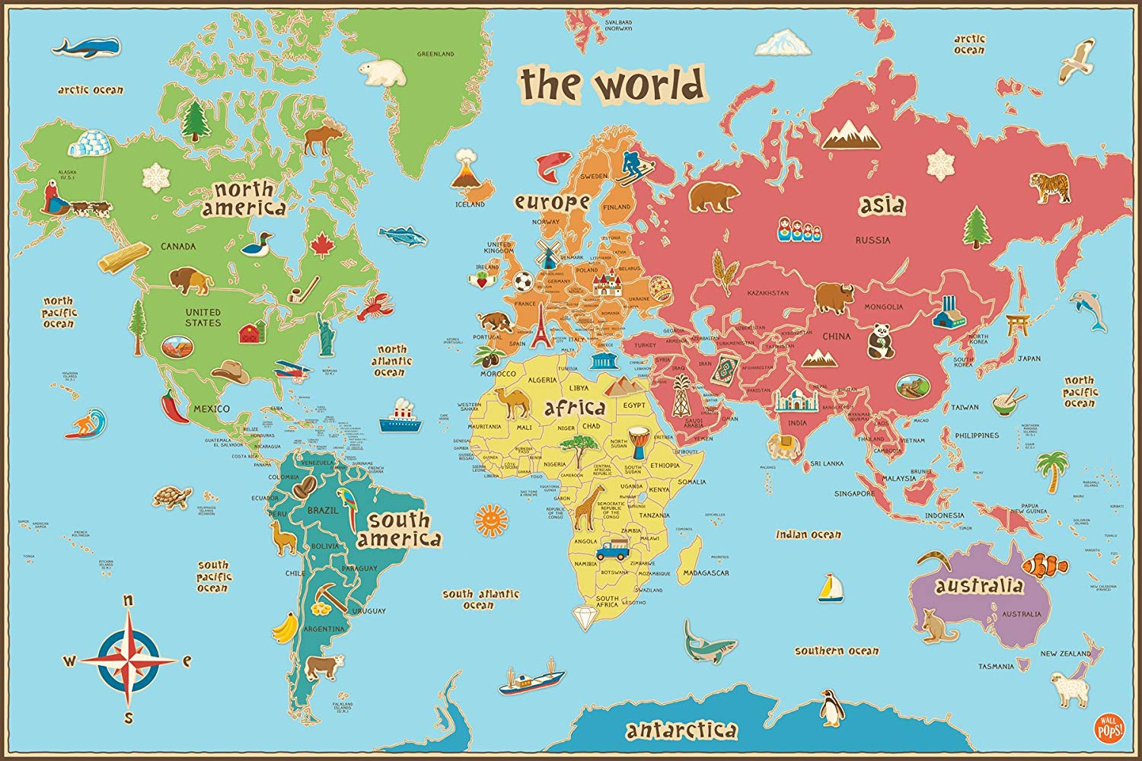
1.- Are Shangai and Beigin in China?
2.- Where is Madrid?
3.- Is Buenos Aires in Argentina?
4.-Where are Barcelona and Madrid?
5.- Is Cairo in South Corea?
6.- Where is Vancouver?
7.- Is Sou Paulo in Italy?
8.- Where are Rome and Venice?
9.- Is Berlin in Germany?

Slide 3
_________from Italy? (+) Yes, ______________ | _________from Brazil? (-) No ____________, ______________________
___________ italian? (+)Yes, ______________ | __________ brazilian? (-) No ____________, ______________________

Slide 4
_____ you _______________? (+) Yes, _________________ | _____ you _______________? (-) No ____________, ________________________
_____ you _______________? (+)Yes, __________________ | _____ you ______________? (-) No ____________, ________________________

Slide 5
_______________________? (+) Yes, _________________ | ________________Germany? (-) No ____________, ________________________
_______________________? (+)Yes, __________________ | _________________german? (-) No ____________, ________________________

Slide 6
_______________________? (+) Yes, _________________ | _________________Holland? (-) No ____________, ________________________
_______________________? (+)Yes, __________________ | __________________dutch? (-) No ____________, ________________________

Slide 7
_______________________? (+) Yes, _________________ | __________________Brazil? (-) No ____________, ________________________
_______________________? (+)Yes, __________________ | ________________brazilian? (-) No ____________, ________________________

Slide 8
_______________________? (+) Yes, _________________ | _________________France? (-) No ____________, ________________________
_______________________? (+)Yes, __________________ | __________________french? (-) No ____________, ________________________

Slide 9
_______________________? (+) Yes, _________________ | _________________China? (-) No ____________, ________________________
_______________________? (+)Yes, __________________ | _________________chinese? (-) No ____________, ________________________

Slide 10
_______________________? (+) Yes, _________________ | ____________United states? (-) No ____________, ________________________
_______________________? (+)Yes, __________________ | _______________american? (-) No ____________, ________________________

