Slide 1
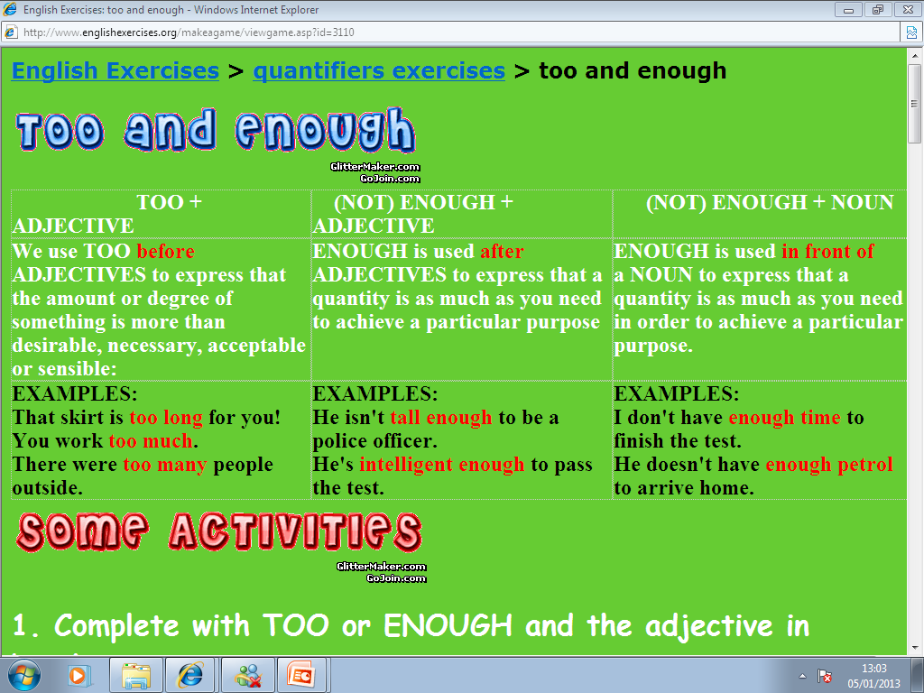

Slide 2
UNDERLINE THE CORRECT ANSWER THAT COMPLETES THE SENTENCE
Q1 - It was _____ so we didn't get it.
expensive enough
too expensive
enough expensive
Q2 - It's ___ to read; I don't understand it at all.
enough difficult
too difficult
difficult enough
Q3 - It's not ____ to go to the cinema.
enough late
late enough
too late
Q4 - It's ____ to pass.
enough difficult
too difficult
Q5 - He ate ____ and felt ill.
enough much
much enough
too much

Slide 3
Fill in the blanks use too or enough on each sentence using the cues on brackets
1) I can't work today. It's ______________. (hot)
2) Tom didn't win the race because his car wasn't ______________. (fast)
3) I'll have to finish it on Friday because I don't have ______________.(time)
4) I can't do this exercise because it's ______________. (too)
5) It's impossible to study in my house because it's ______________. (noisy)
6) Have you got ______________ to buy a new car? (money)
7) I can't drink this coffee because it's ______________ for me. (strong)
8) Have we got ______________ in the fridge? (milk)

Slide 4
ANSWER THE FOLLOWING EXERCISE USING TOO AND ENOUGH
1. This computer is (slow) _________________to do this calculation.
2. Elaine is (old) __________________to enter here.
3. This suitcase is (heavy) __________________to carry.
4. It isn't (sunny) ____________________to sunbathe.
5. Are you (tall) __________________to reach that shelf?
6. You're (young) _____________________to drive.
7. You aren't (old) ____________________to drive.
8. That sweater is big, it's (big) ___________________for you.
9. The garden isn't (big) ___________________to play football.
10. This coffee is (strong) __________________________for me.

Slide 5
Comparative adjectives
Use comparative adjectives to compare 2 things, places, persons.
Words that end in e just add … - R | Words that end in y ommit y add … - ier | Short words that end in consonant preceded by vowel double the consonant | Words of two sylables just add er ending | Words more than three sylables add more adjective | Irregular adjectives
Large / Larger | pretty/ prettier | Big/ Bigger | Tall/ Taller | Expensive/ More expensive | Good/ better

Slide 6

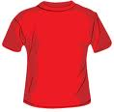
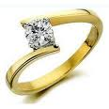
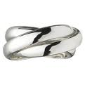
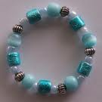
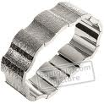
This blue shirt is than this red shirt
more small smaller
The gold ring is than the silver ring
more expensive expensiverer
The fantasy bracelet is than the silver bracelet
more cheap cheaper

Slide 7
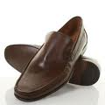


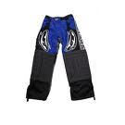

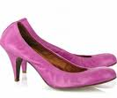
These shoes are than these ones
more big bigger
These pants are than these ones
more large larger
These pumps are than these ones
more high higher

Slide 8
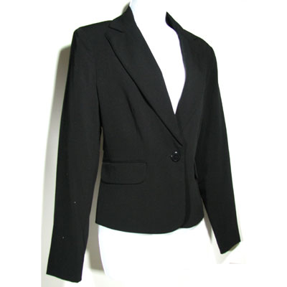

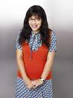
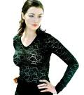
A blazer is than a shirt
more formal formaler
more pretty prettier
Juanita is than Betty
more thin thinner
more old older
more intelligent intelligenter
more conservative conservativer

Slide 9
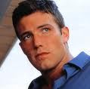

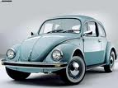

Pablo is than Alejandro
more handsome handsomer
more tall taller
more young younger
more friendly friendlier
A convertible BMW is than a wolskwagen
more good gooder better
more bad badder worse

Slide 10

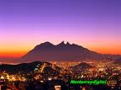
Monterrey city is than Mexico city
more dangerous dangerouser
more clean cleaner
more dirty dirtier
more cool cooler
more hot hotter

Slide 11
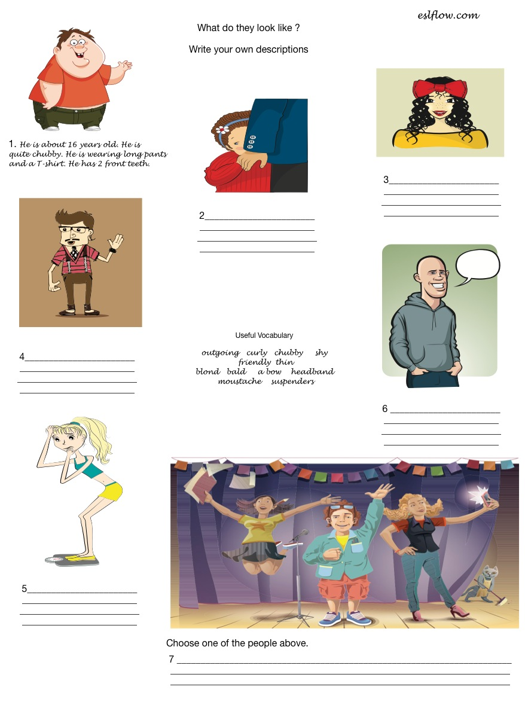
Physical and Personal Appearance

Slide 12
INDUCTIVE GRAMMAR CHART
Look at these examples of the present perfect and the simple past tense.
I’ve met Bill twice. We met in 1999 and in 2004.
FIGURE IT OUT . . .
The present perfect or the simple past tense? Complete these grammar rules.
1. Use ______________________ to talk about a definite or specific time in the past. (We know when.)
2. Use ______________________ to talk about an indefinite time in the past. (We don’t know when.)
.
Look at these examples of The SIMPLE PAST
+ | - | ? | =
We met them. | We didn't meet them | Did you meet them? Did she called him? | Yes, we did. / No, we didn’t.. Yes, she did. / No, she didn’t.
Look at these examples of The PRESENT PERFECT
+ | - | ? | =
We've met them. | We haven't met them | Have you met them? Has she called him? | Yes, we have. / No, we haven’t. Yes, she has. / No, she hasn’t.

Slide 13
Complete these grammar rules by filling in the blanks and circling the correct words.
Form the present perfect with _______ or _______ and the
(base / simple past / past participle) form of a verb.
2. The past participle form of regular verbs like call is the same as the
(base / simple past / past participle) form.
3. The past participle form of irregular verbs like meet is
(the same as / different from) the simple past form.
4. Begin questions in the present perfect with _______ or _______.

Slide 14
Put the verbs into the correct SIMPLE PAST form
Last year I (spend) _________ my holiday in Ireland.
It (be)___________ great.
I (travel)_________around by car with two friends and we (visit) _________lots of interesting places.
In the evenings we usually (go)___________to a pub.
One night we even (learn)__________ some Irish dances.
We (be)________________ very lucky with the weather.
It (not / rain)___________a lot.
But we (see)__________some beautiful rainbows.
Yesterday my father (go)_________ to work by car.
This morning I (have)_________a shower.
Rewrite the sentences in the negative SIMPLE PAST
They collected postcards. →________________________________________
You jumped high. →___________________________________________
Albert played squash. →___________________________________________
The teacher tested our English. ___________________________________________
Fiona visited her grandma. →___________________________________________

Slide 15
Choose the right word that completes the sentence in PRESENT PERFERCT
1.- Lose: I've ______ my grammar book. Have you seen it?
? losen
? lost
? loose
2.- Break: Shelley has ______ her leg. She can't go skiing any more.
? breaken
? broke
? broken
3.- Sell: Have you ______ your car yet?, I haven´t seen it for a long time.
? sold
? sellen
? sole
4.- Become: In the last few years, it has ______ more and more difficult to get into college.
? become
? becume
? became
5.- Show: Stewart hasn't ______ up yet. He must have been delayed.
? showed
? shown
? shew
6.- Fall: The price of oil has ______ rapidly since January.
? fell
? fallen
? felt

Slide 16
Complete the conversation with PRESENT PERFECT and /or SIMPLE PAST TENSE.
1.- A: Bill_____ you ______ (meet) Olivia?
B: Yes. I ______. We ______ (meet) last year in Paris.
Welcome to New York Olivia. ______ you ______ (be) here before?
C: No, I________.
2.- A: _______you________ (go) sightseeing yet, Carlos?
B: No, I_________.
A: Have you taken any pictures?
B: I _____ (take) some pictures of the hotel only.
3.- A: ________ she ______ (take) this tour before?
B: Yes she ______. She _______ (go) to Russia with this group two years ago.
4.- A: _______ you ________ (read) the Miserables novel?
B: No, I ________. I just ________ (see) the movie.
5.- A: _______ Peter _________ (exercice) this week?
B: Yes, He________ __________ (walk) from home to school this week.
6.- A: How about italian food? _______ you _________(eat) any real Italian pizza
or pasta yet?
B: I ________ (have) pasta with seafood last night. But I ___________ (not try)
any calamari yet.

Slide 17
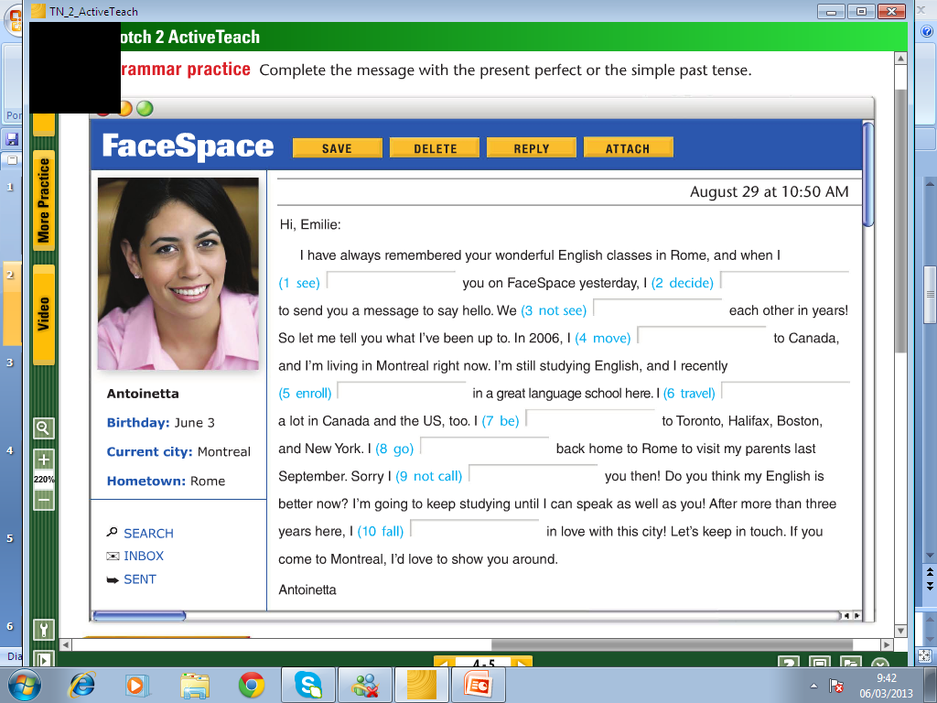
Complete the conversation with PRESENT PERFECT and /or SIMPLE PAST TENSE.

Slide 18
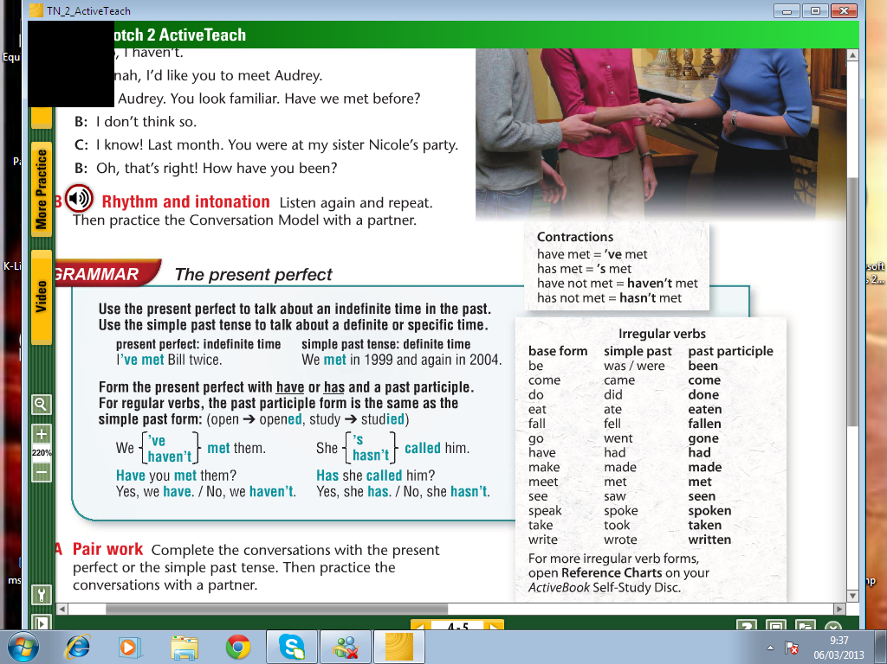
I.- Look at the grammar reference box then start practice

Slide 19
Fill in the blanks to complete the following QUESTIONS in PRESENT PERFECT
1.- _______________ any cofee today? (drink)
2.- _________________ to any foreing countries? (be)
3.- _____________________any good books lately? (read)
4.- ____________________ movies lately? (see)
5.-___________________ any famous people? (meet)
6.- ______________________ lunch today? (have)
7.- ____________________ your homework today? (do)
8.- _____________________to the gym this week? (be)
9.-________________ turkish food? (try)
10.- _________________ in a cementery at night? (visit)

Slide 20
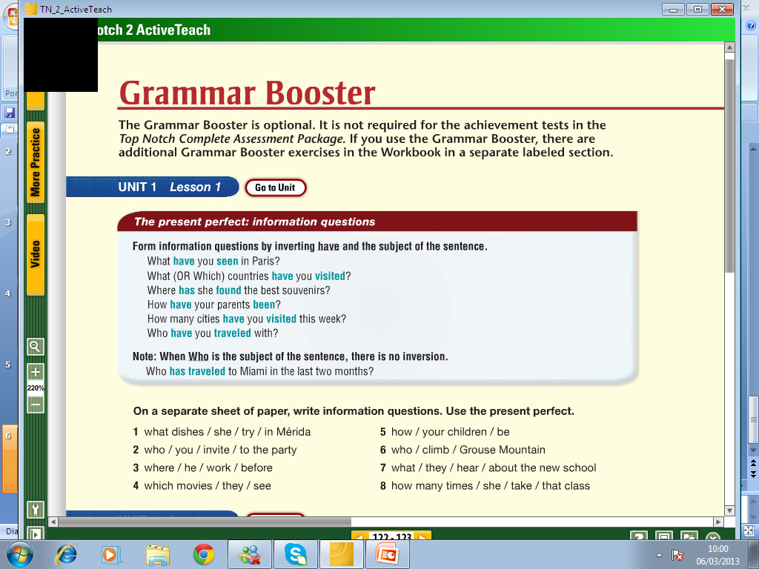
1.- _______________________________________________________________________
2.- _______________________________________________________________________
3.- _______________________________________________________________________
4.- _______________________________________________________________________
5.- _______________________________________________________________________
6.- _______________________________________________________________________
7.- _______________________________________________________________________
8.- _______________________________________________________________________

Slide 21
Since and for
'FOR' is used for general periods of time. It’s to express duration.
- For three days,
- For a week,
- For several years,
- For two centuries.
'SINCE' is used for a starting point, a specific time.
- Since Monday,
- Since 1997,
- Since the last war.
- Since the day we met.

Slide 22






They've been married ________ twenty-five years.
  since
  for
2. Mary has kept a diary ________ she was ten years old.
  since
  for
3. Jon has been a student here ________ March.
  since
  for
4. The beaver has been an emblem of Canada ________ many years.
  since
  for
5. Cougars have almost disappeared from the Victoria area ________ humans settled here.
  since
  for
6. The Canadian two-dollar coin (or toonie) has been in circulation ________ 1996.
  since
  for

Slide 23
Fill in the fol
Practice with since and for
1. They have been living in Madrid ___________ 1972.
2. He has been in prison ___________four years.
3. He has known about the fact ___________ a long time.
4. Conditions have changed a lot ___________ we were children.
5. Our teacher has been very ill ___________ the last month.
6. I haven't eaten anything ___________ twenty-four hours.
7. In fact he is always very rude. We have been waiting for him ___________ half an hour.
8. I haven't seen him ___________ three years. it is because I haven 't been there ---- I left school.
9. I have been trying to mend this old fashioned car ___________ hours.
10. One of my friends has been teaching in Tokyo ___________ three years. I haven't met him ___________ last year.

Slide 24
PAST PROGRESIVE PRACTICE
i.- Decide whether to use 'was' or 'were'.
Boris_________ learning English.
They _________swimming in the lake.
Your__________ father repairing the car.
I ___________reading a magazine.
You __________packing your bag.
My friends _________watching the match on TV.
It _________raining.
II.- WRITE POSITIVE SENTENCES IN PAST PROGRESSIVE.
you / play / cards_______________________________________________________
Alice / walk / around the lake_____________________________________________
Caron / listen / to the radio________________________________________________
we / read / a book about Australia__________________________________________
Linda / look for / her ring_________________________________________________
Fiona and Sam / visit / the castle____________________________________________
Ben / wash / the car______________________________________________________

Slide 25
III.- WRITE NEGATIVE SENTENCES IN PAST PROGRESSIVE.
1.Sarah and Luke / not / work _____________________________________________________
2.Mister Miller / not / teach / chemistry ______________________________________________
3.Barry / not / drive / a chevy _______________________________________________________
4.Mandy / not / have / lunch ______________________________________________________
5.Albert / not / play / tennis ______________________________________________________
6.Taylor and Bob / not / cycle / home _________________________________________________
IV.- WRITE QUESTIONS IN PAST CONTINUOUS
1) the museum?_____________________ (she/to visit)
2) with a pencil? __________________(you/to write)
3) comics? _____________________(the boys/to read)
4) questions?___________________ (Kimberly/to ask)
5) photos?________________ (Helen and Anne/to take)
6) a lot of noise? ____________________(your brother/to make)
7) the classroom? _________________(the teacher/to leave)

