Slide 2
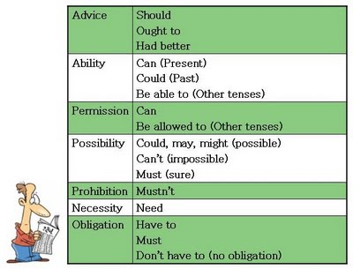

Slide 3
Answer the exercice on the following webpage, practice with modal verbs
Print screen with answers and your score, paste here.
Attach file back
http://www.better-english.com/grammar/mustnt.htm

