Slide 1
Zero conditional
If clause | Main clause
If + Present tense | Present tense
If you freeze water | it turns into ice.
Nature: It is used for scientific facts or statements that are always true
Time: This condition refers to present
If clause | Main clause
If + Present tense | will / can / may / must + verb
If it rains today, | I'll stay at home
First conditional
Nature: Open condition, what is said in the condition is possible.
Time: This condition refers either to present or to future time.
Second conditional
If + Past Simple | would / could / might + verb
If I won the lottery, | I would travel around the world.
Nature: unreal (impossible) or improbable situations.
Time: present; the TENSE is past, but we are talking about the present, now
If clause | Main clause
If + Past Perfect tense | would/could/might + have + past participle
If I had won the lottery, | I would have traveled around the world.
Third conditional
Nature: unreal
Time: Past (so we are talking about a situation that was not so in the past.)

Slide 2
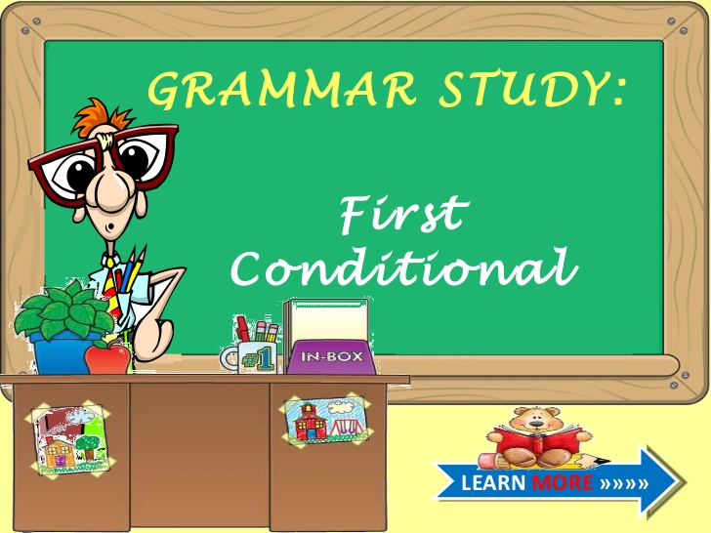
Click on the following link to learn more about first Conditional
http://www.slideshare.net/littlebeli/first-conditionallesson
https://www.youtube.com/watch?v=Htk8TiYa0ic
https://www.youtube.com/watch?v=fSDxMaC0QYc

Slide 3
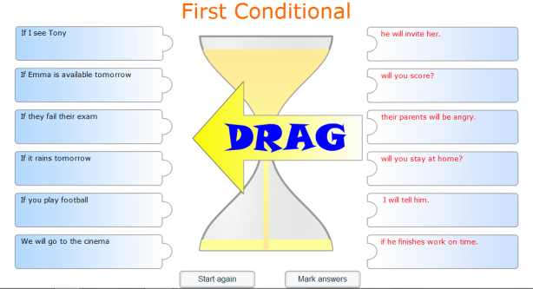

Slide 4
