Slide 1
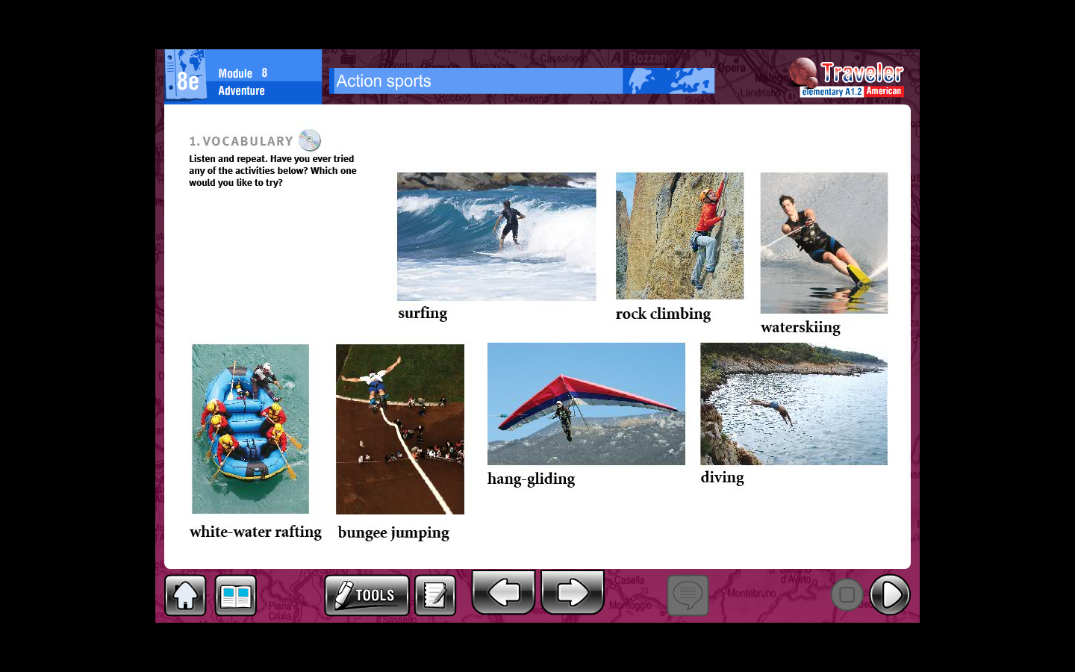

Slide 2
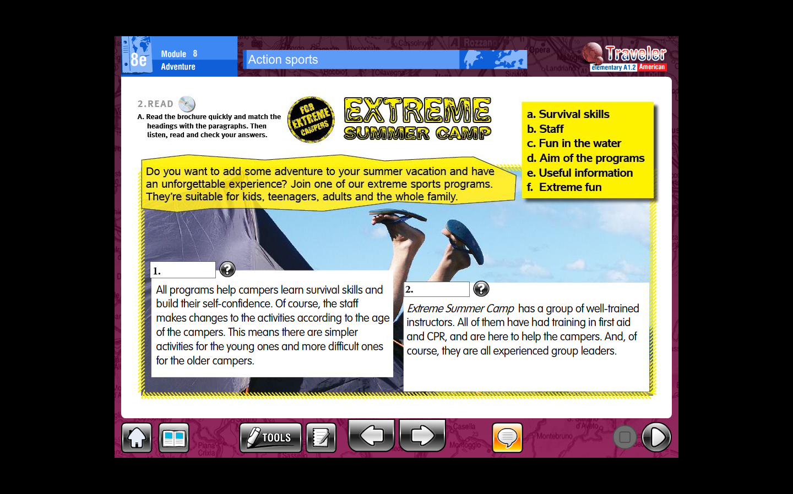
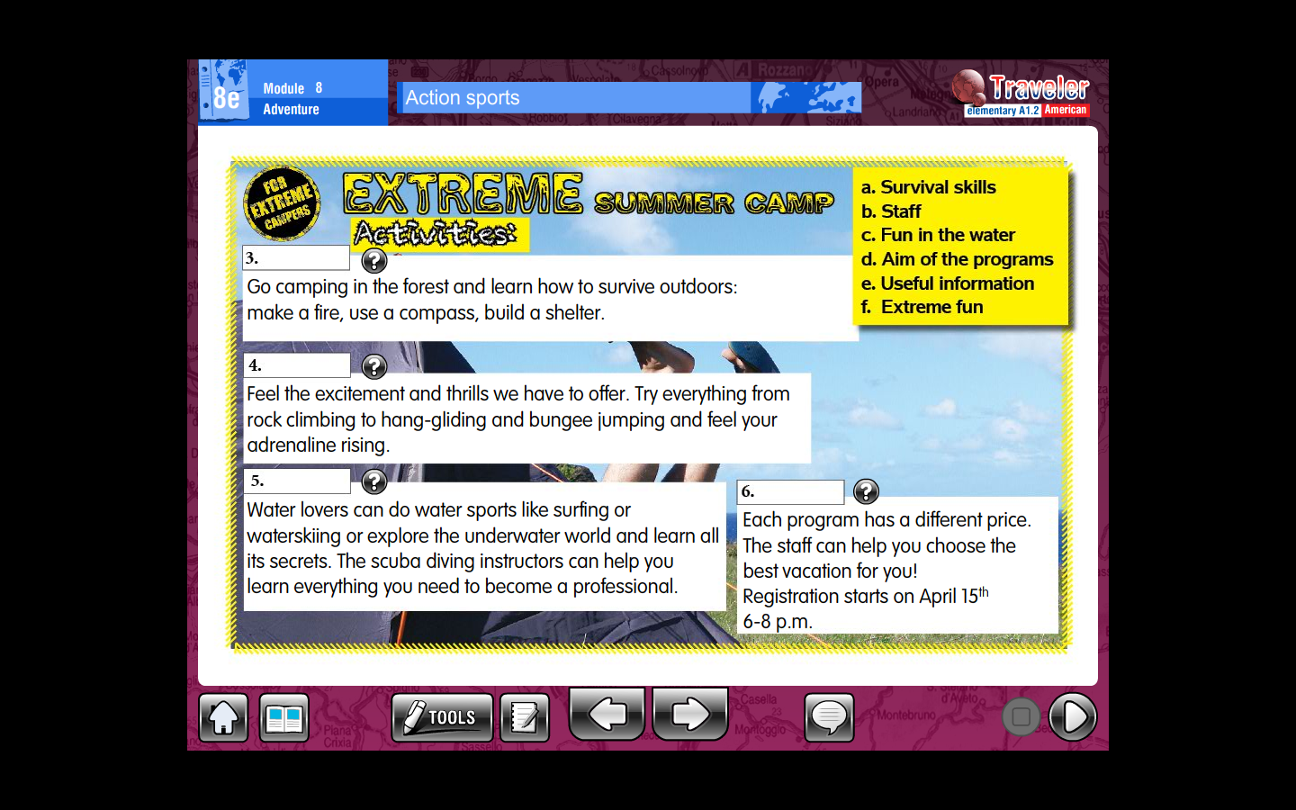

Slide 3
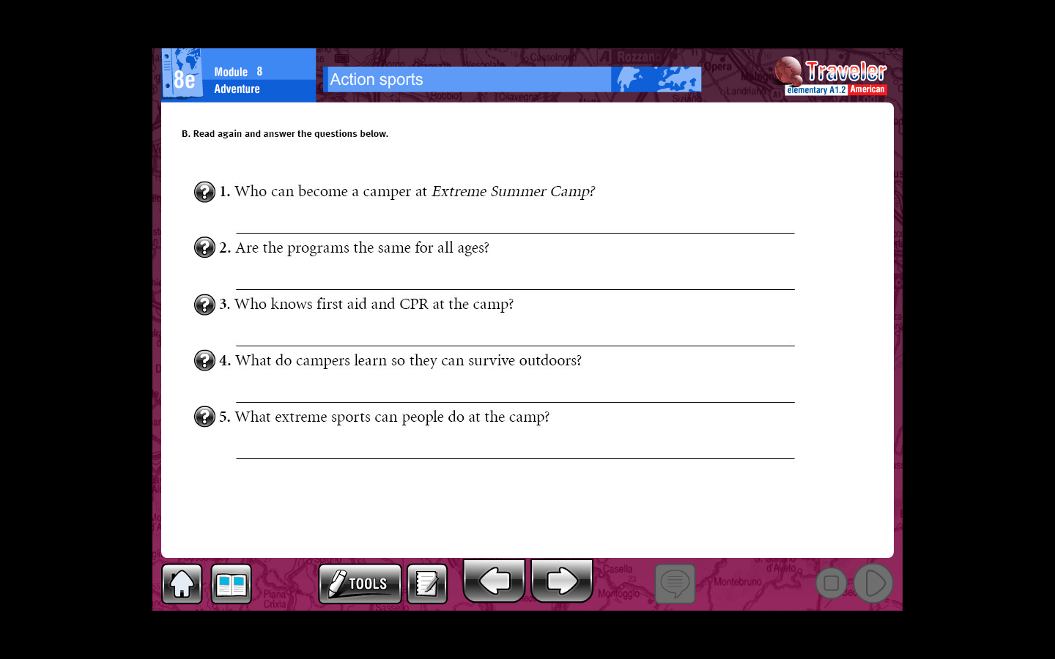

Slide 4
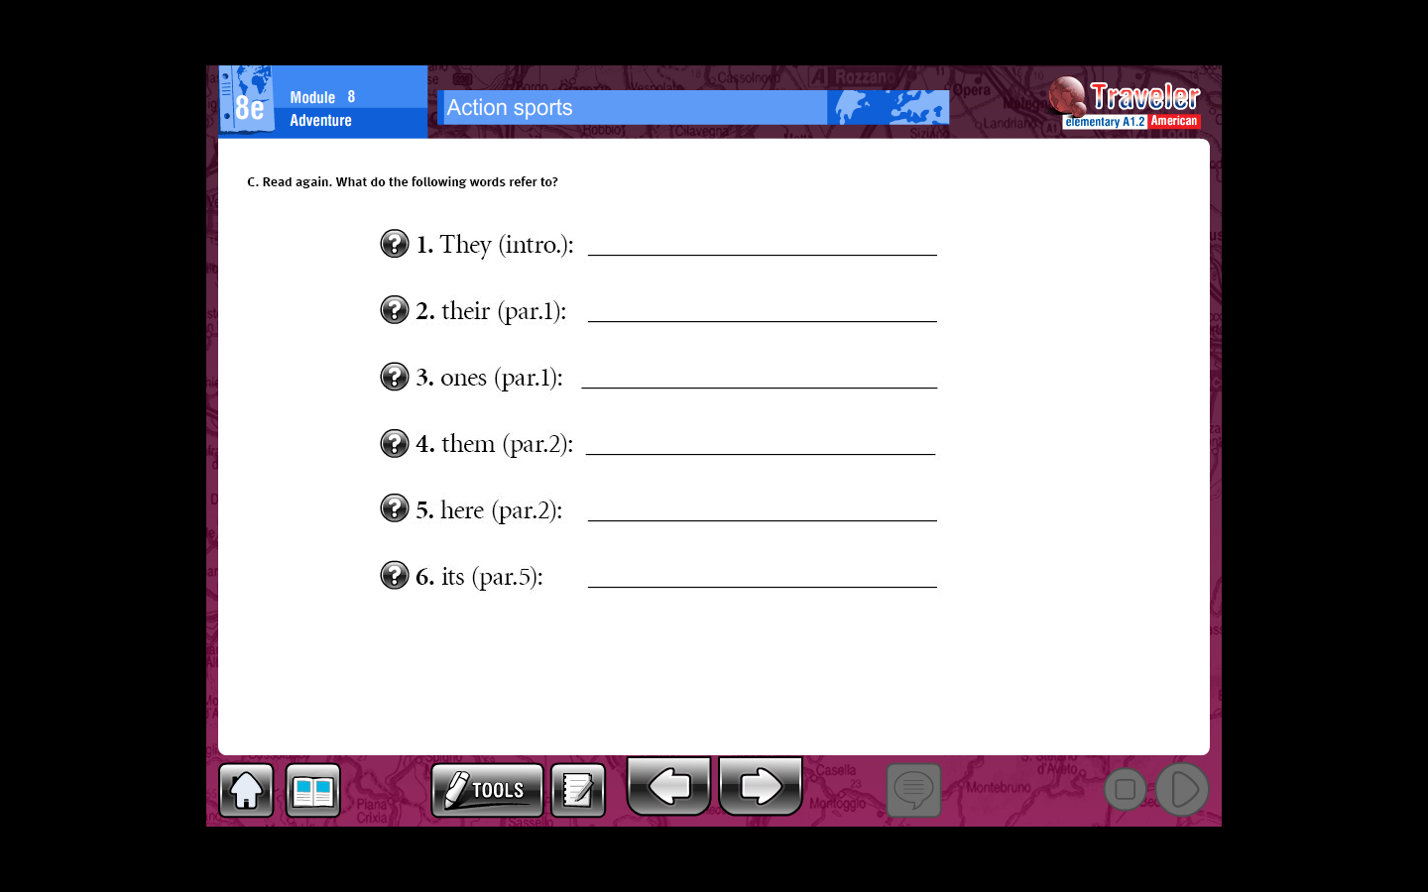

Slide 5
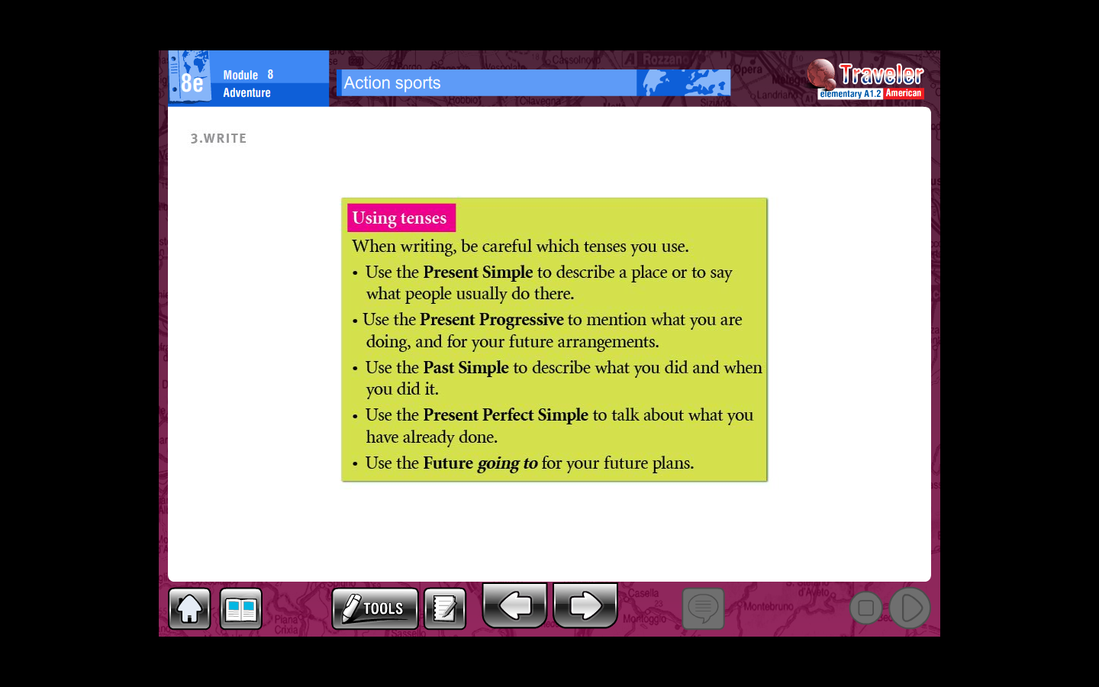
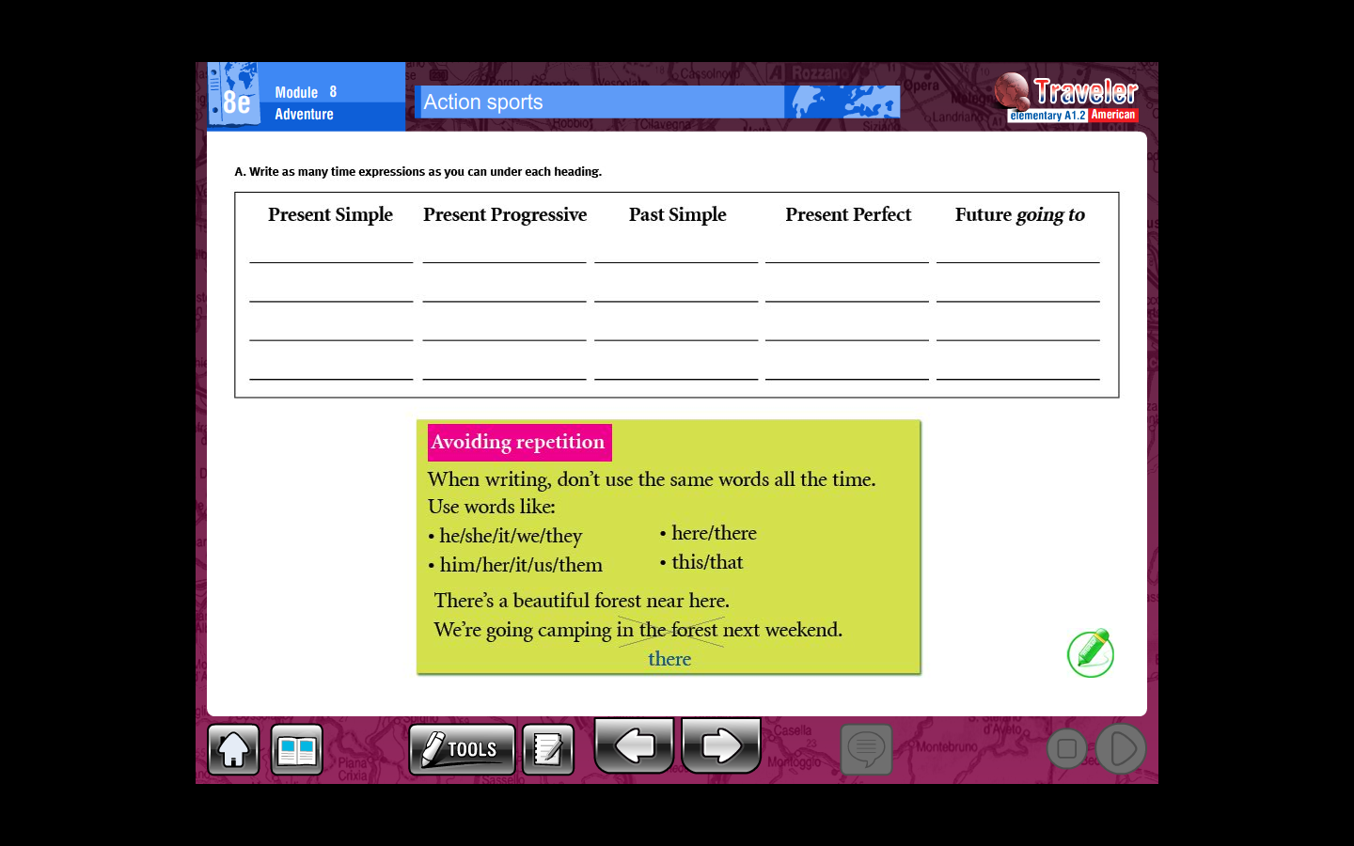

Slide 6
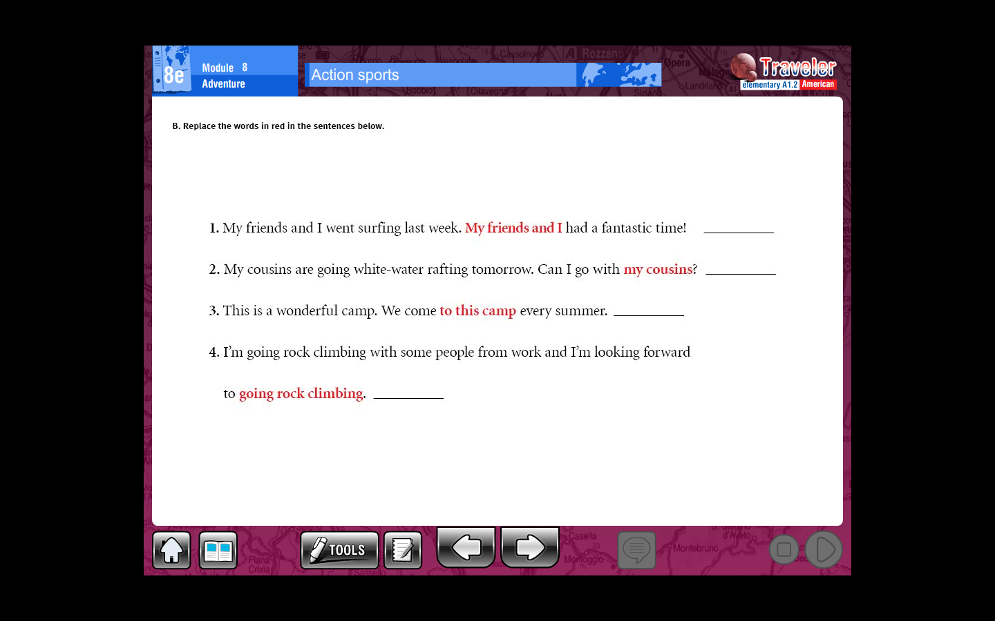

Slide 7
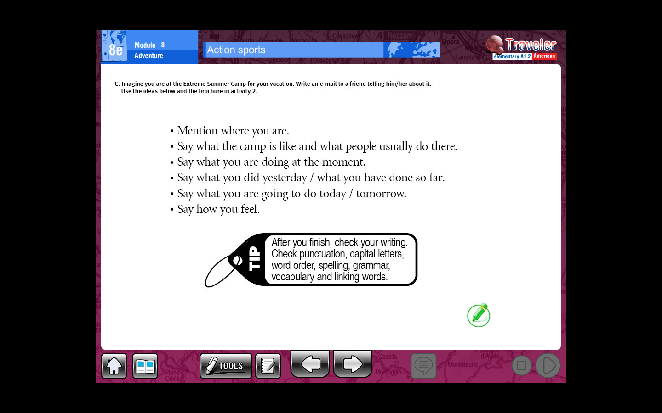
Writting (10 lines min)
________________________________________________________________________________________________________________________________________________________________________________________________________________________________________________________________________________________________________________________________________________________________________________________________________________________________________________________________________________________________________________________________________________________________________________________________________________________________________________________________________

