Slide 1
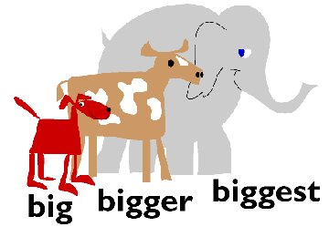

Superlatives
The
The
Click to learn https://www.youtube.com/watch?v=KpzrmoW_gwc&nohtml5=False
Click to Play http://www.eslgame.com/content/AppleCatch/superlatives.swf

Slide 2
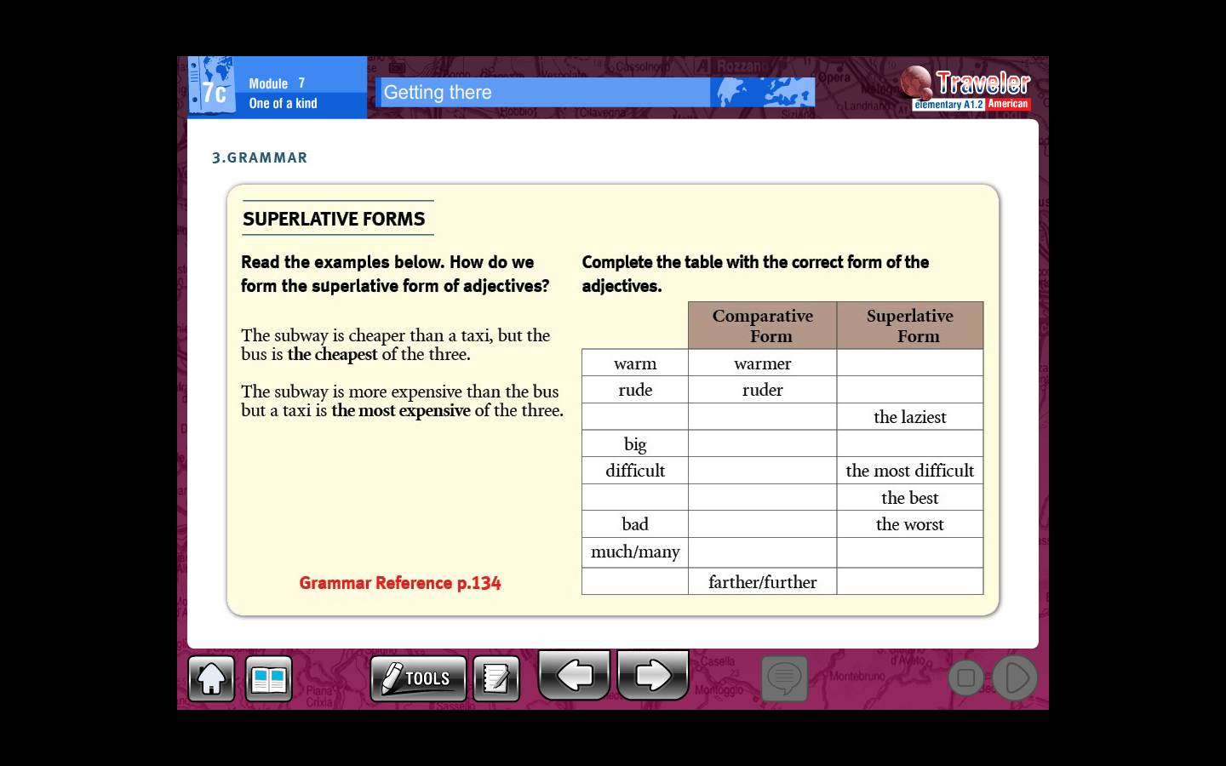
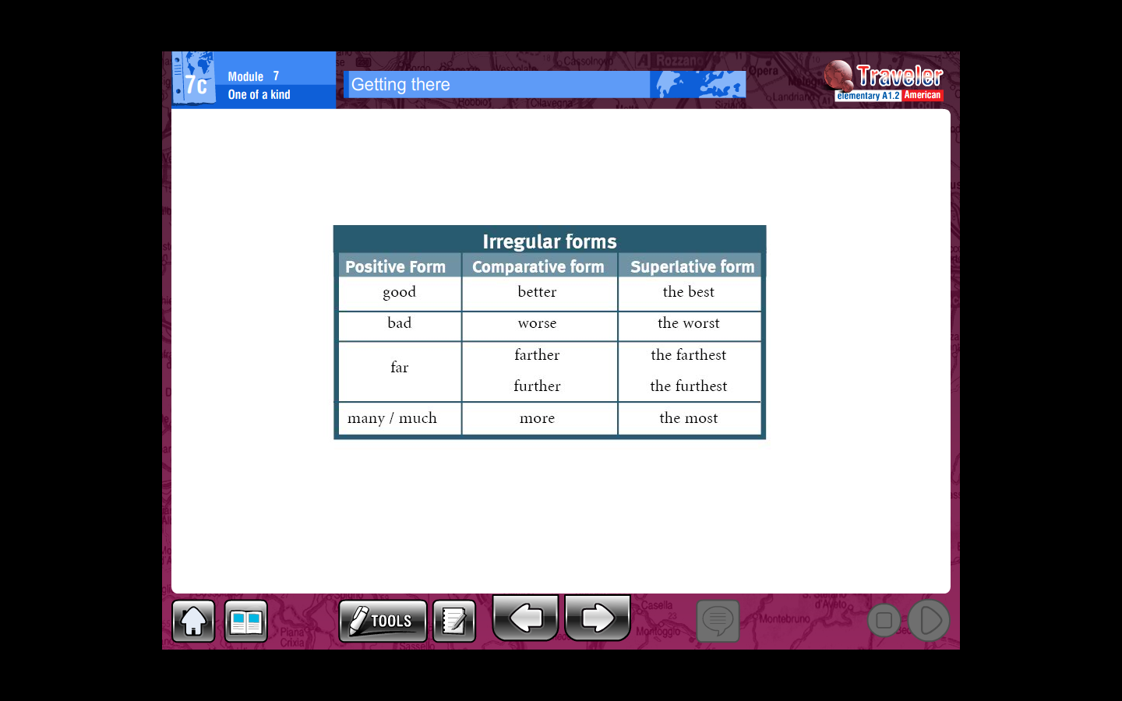
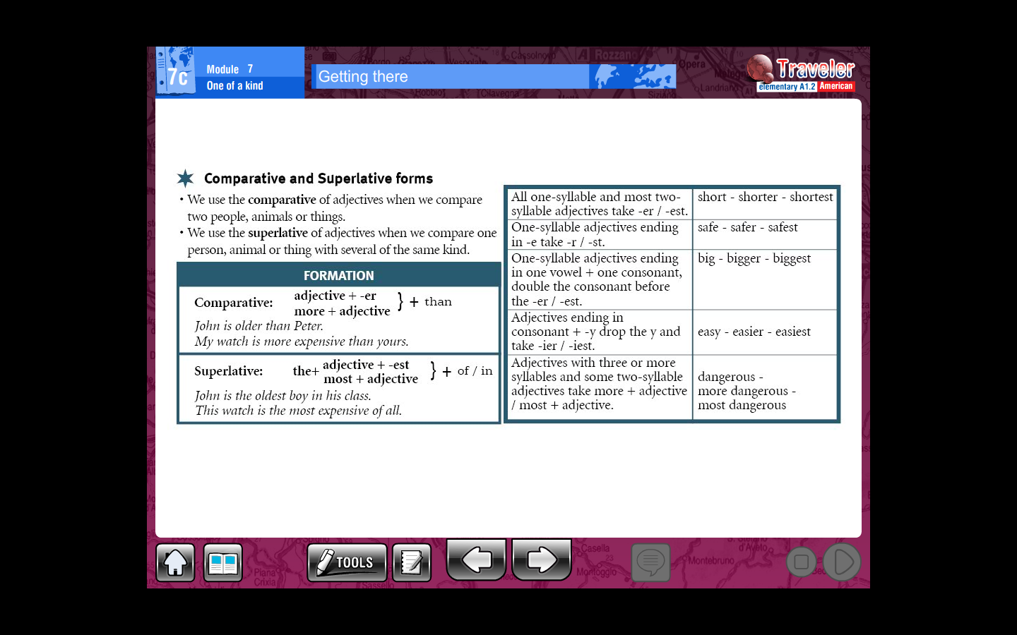

Slide 3
In your classroom find someone who is….
The laziest
The youngest
The tallest
The shortest
The funniest
The fastest
The happiest
The most popular
The most friendly
The best smile
The most artistic
The smartest

Slide 4
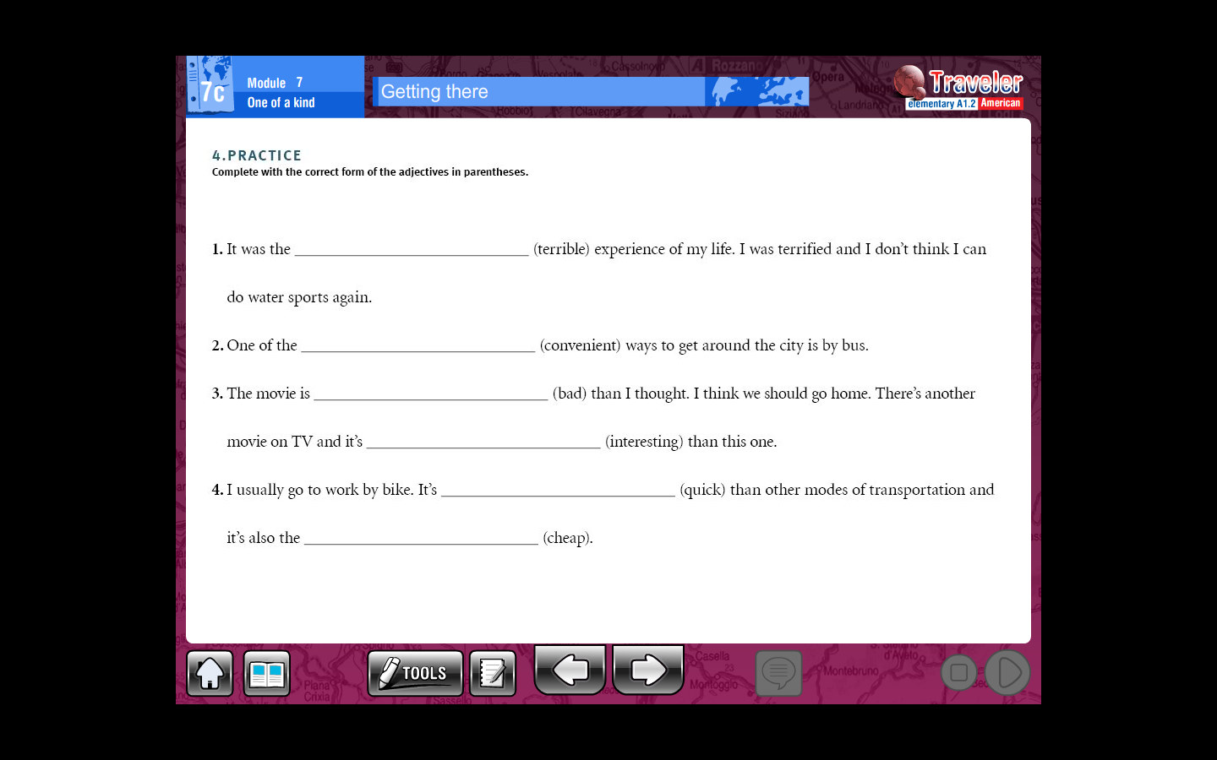
Practice with ex A and B pg 69 lesson 7b workbook

Slide 5
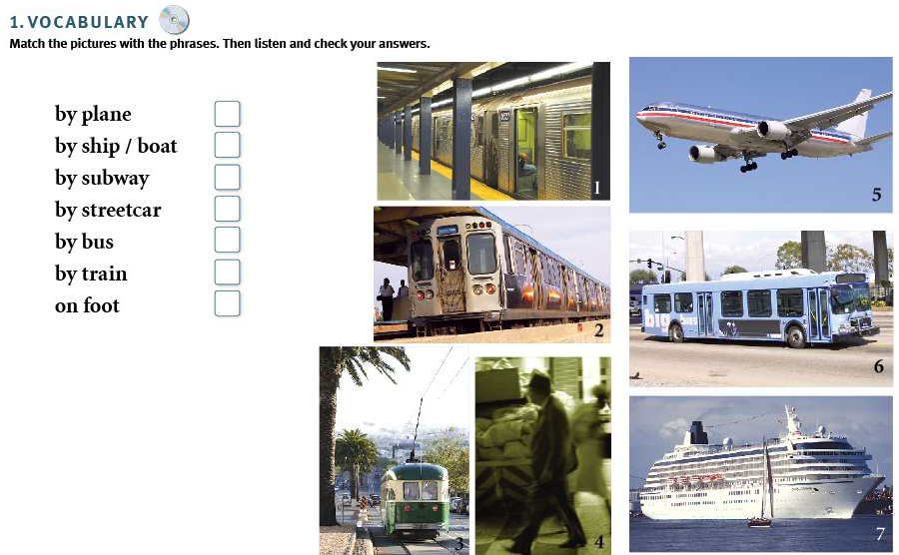
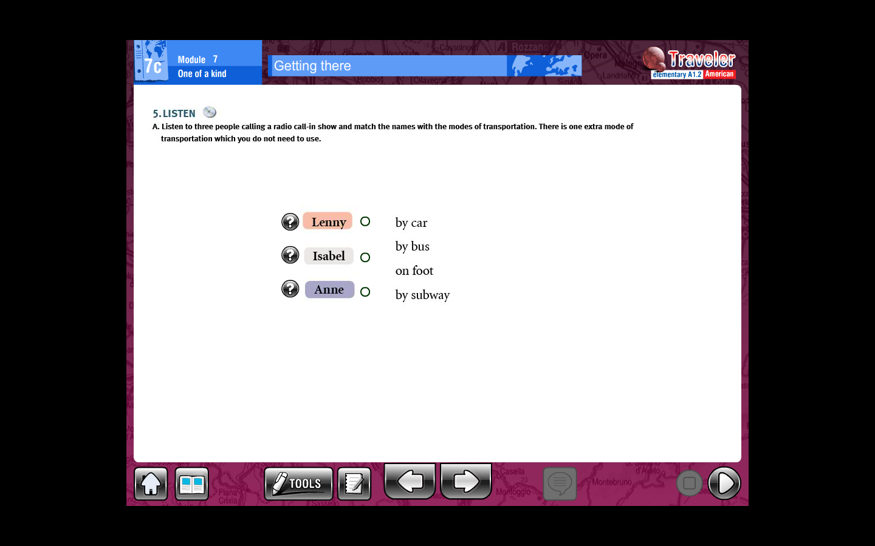
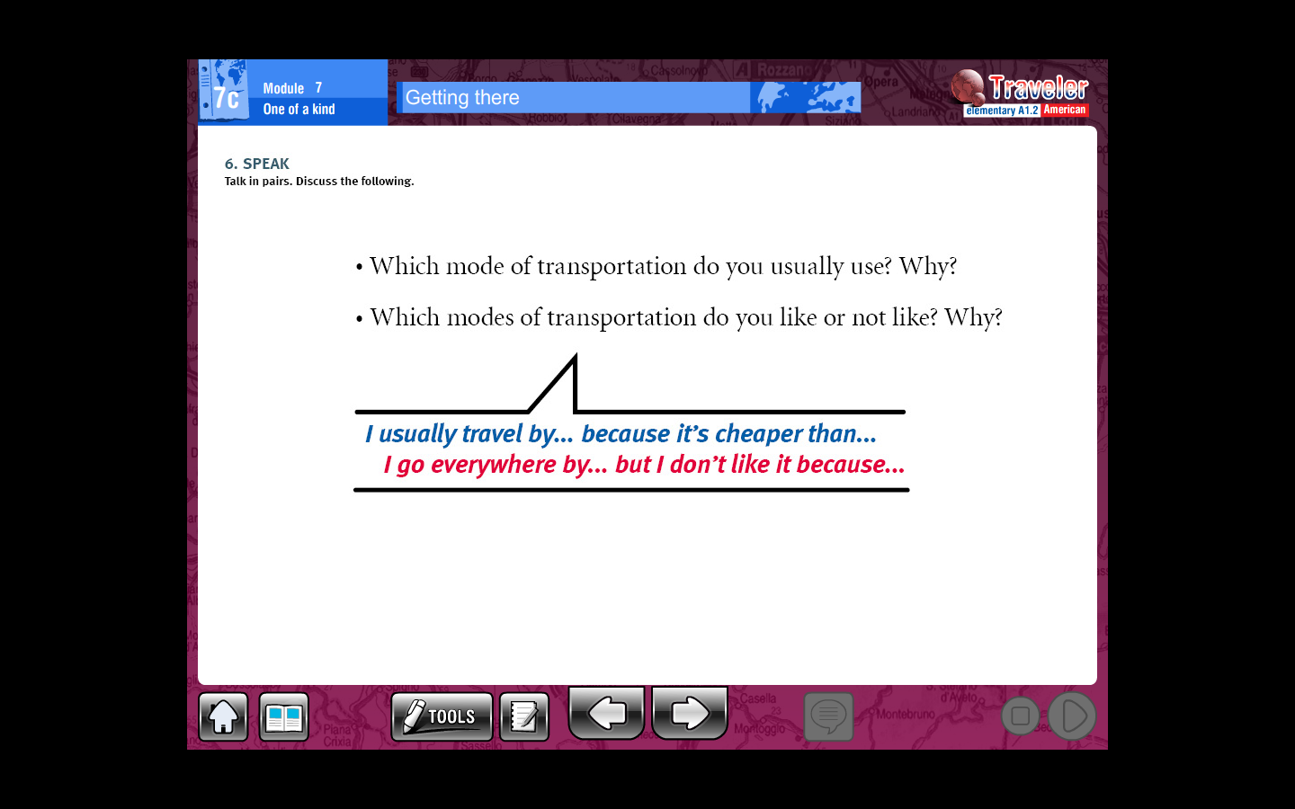

Slide 6
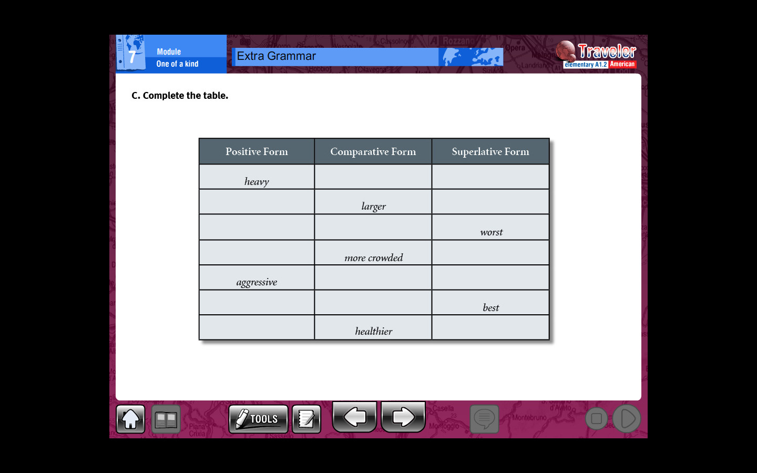
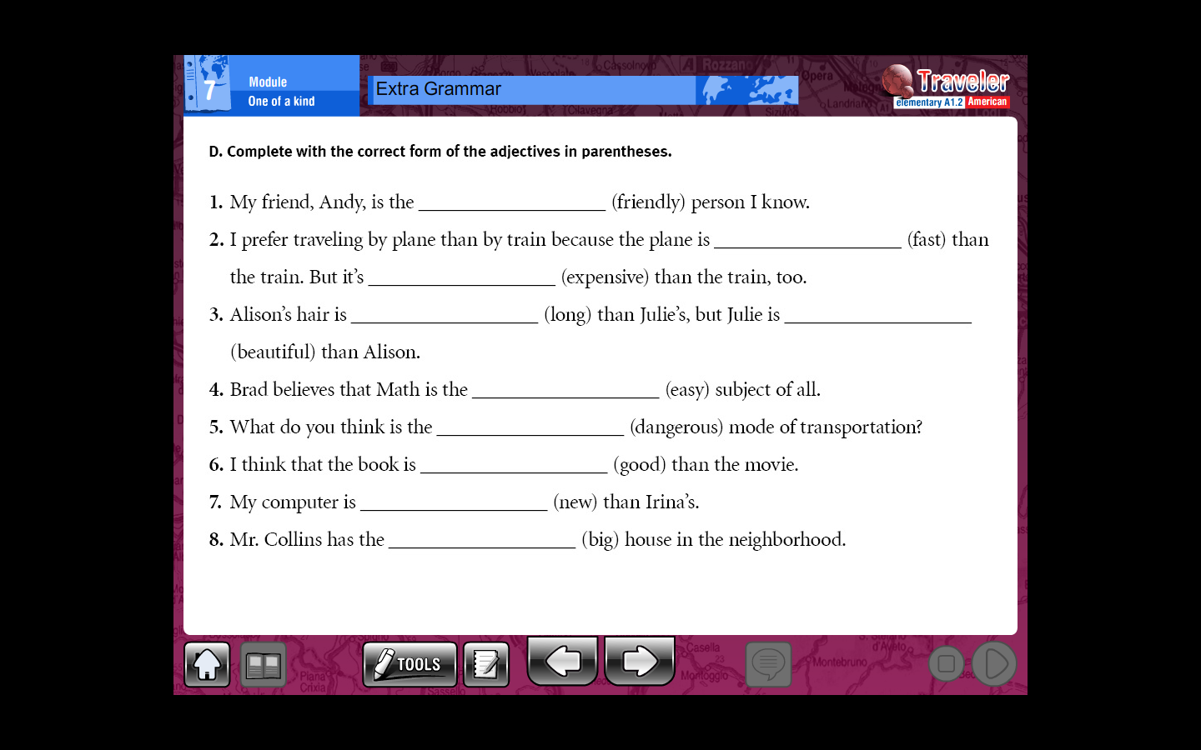
Complete the following chart with comparatives and superlatives
Use comparatives or superlatives to complete the following sentences
Practice with ex C pg 70 lesson 7b workbook

