Slide 1
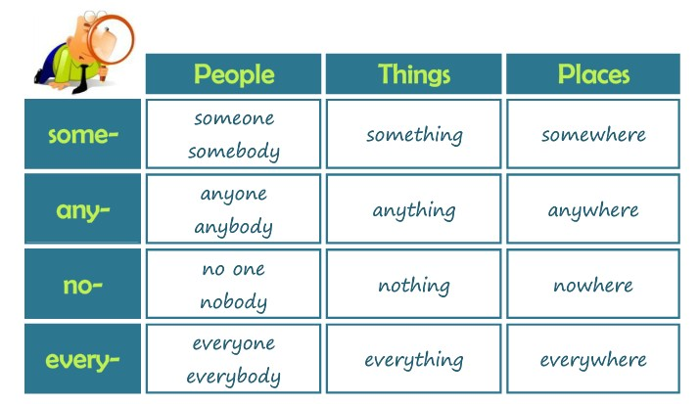

Slide 4
1,- Click on the following link to practice with compounds, then paste your results
http://www.kubbu.com/student/?i=1&a=38049_indefinite_pronouns
2,- Answer the following excercise, practice compounds

