Slide 1







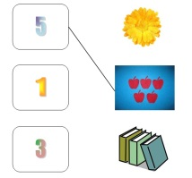




TEACHER´S INSTRUCTIONS

