Slide 1
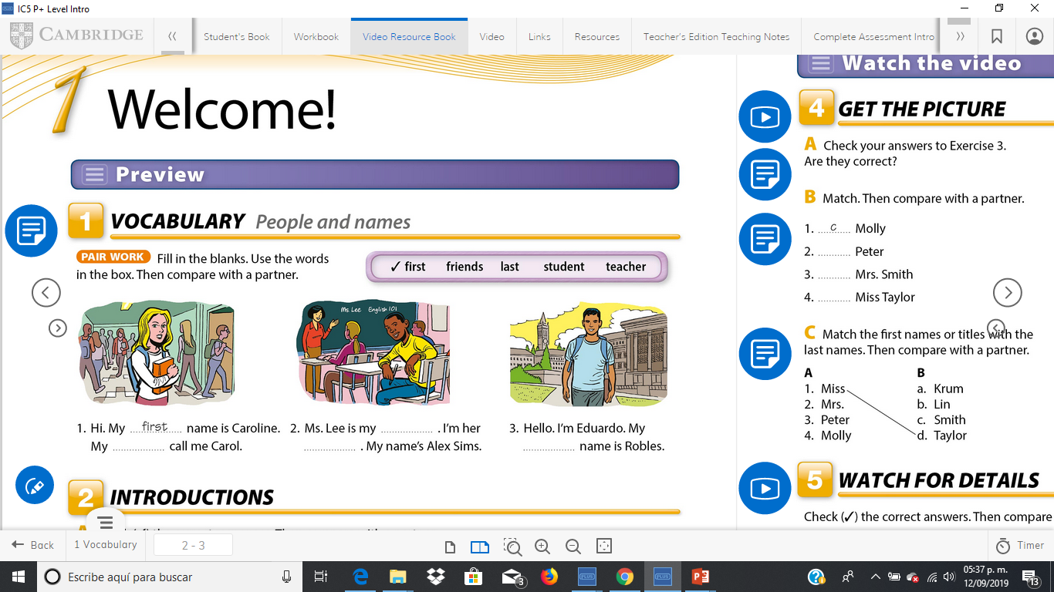
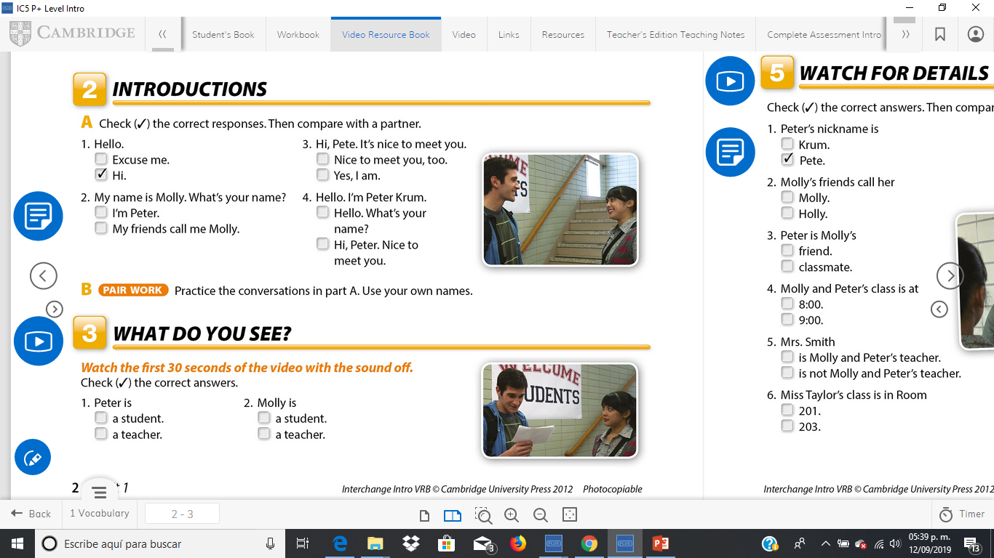
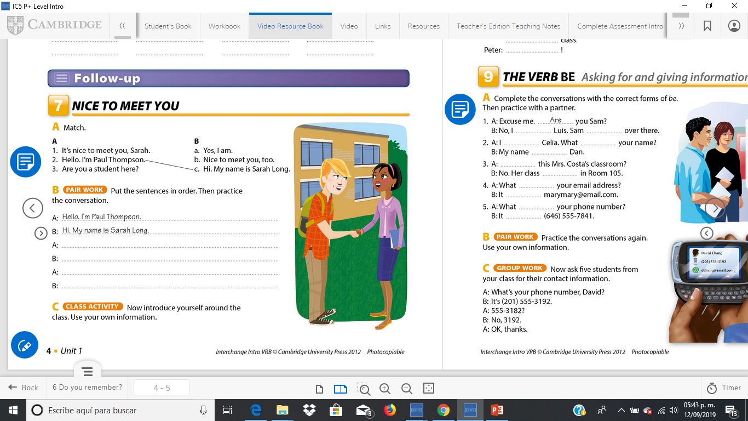
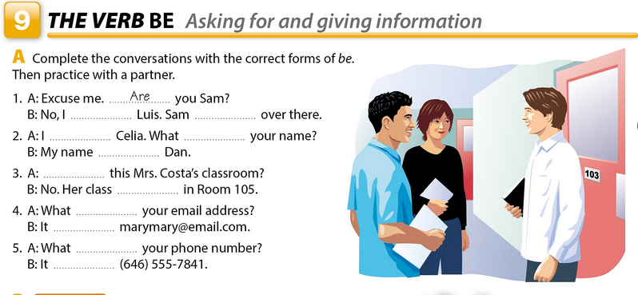
Friends.
student.
Teacher.
Last.
It’s nice to meet you, Sarah.
Nice to meet you, too.
Are you a student here?
Yes, I am.
am
is
am
is
is
Is
is
is
is
is
is

Slide 2
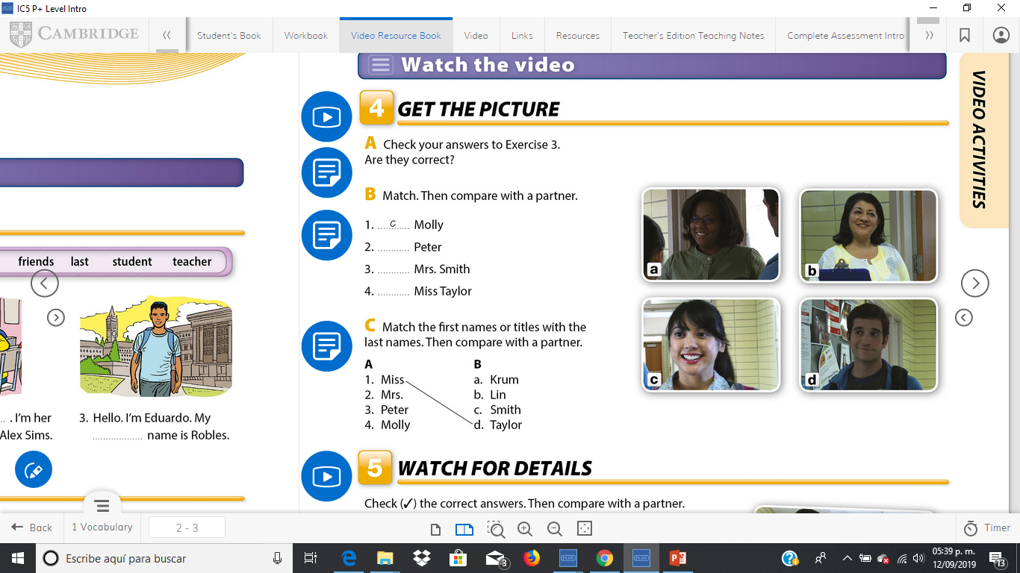
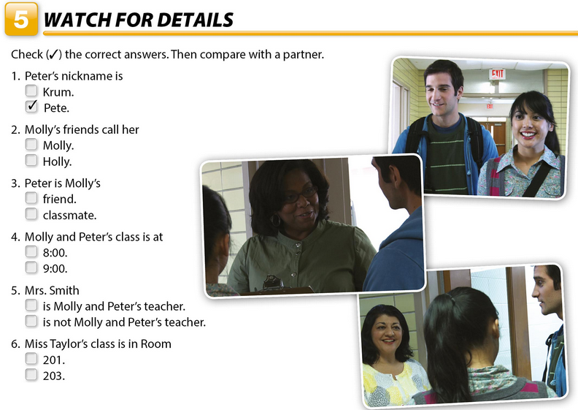
Click on the link to watch a video of unit 1
http://187.160.244.18/sistema/entrada.asp?e=enep&Maq=
Watch the video to answer the following activities
d
a
b

Slide 3
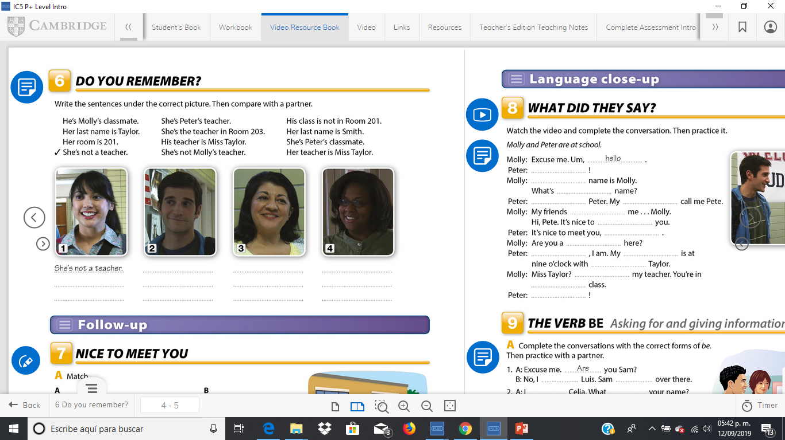
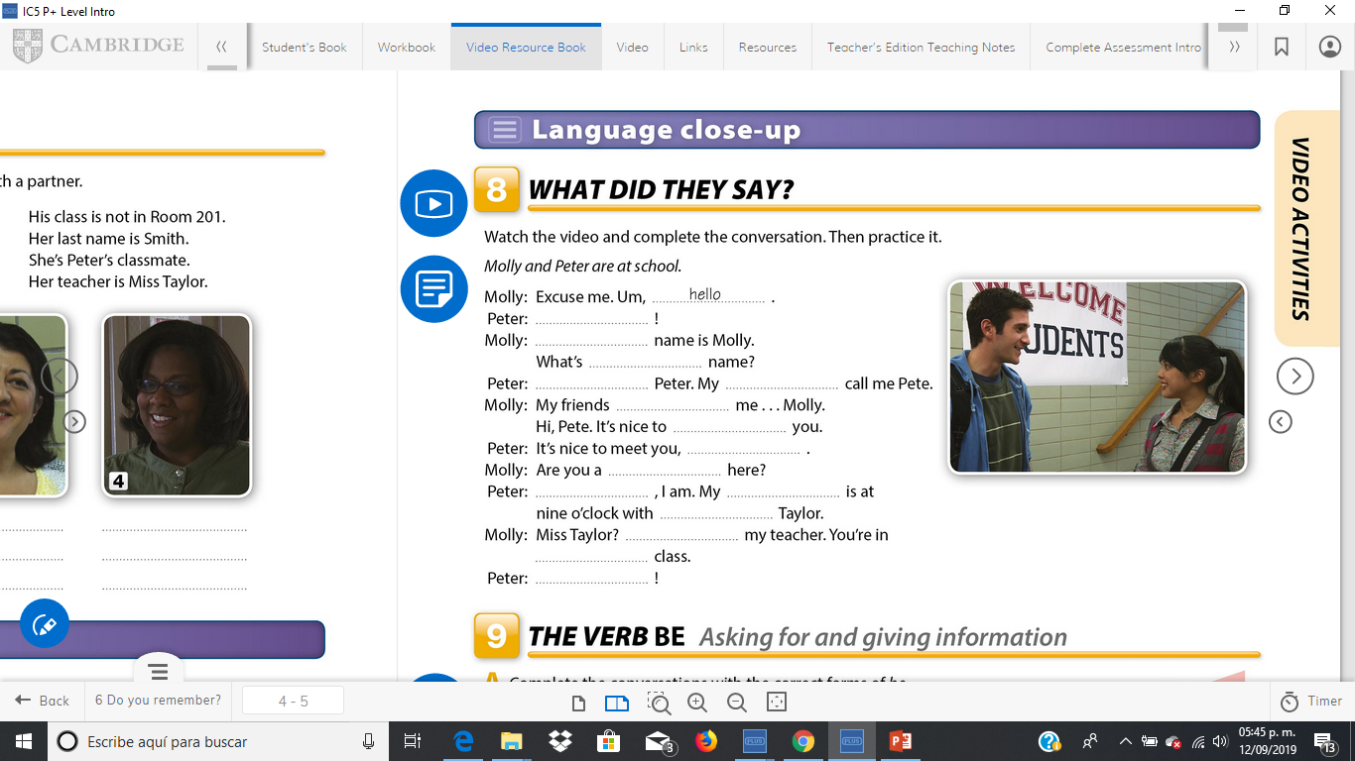
He´s molly´s classmates
Her last name is taylor
Her last name is smith
Her teacher is misss taylor
His class is not in room 201
She´s peter´s teacher
Her room is 201
She´s peter´s classmates
His teacher is miss taylor
She´s the teacher in room 203
She´s not molly´s teacher
Hi
My
your
I´m
friends
Call
Meet
too
studing
yes
class
miss
She´s
My
great

