Slide 1
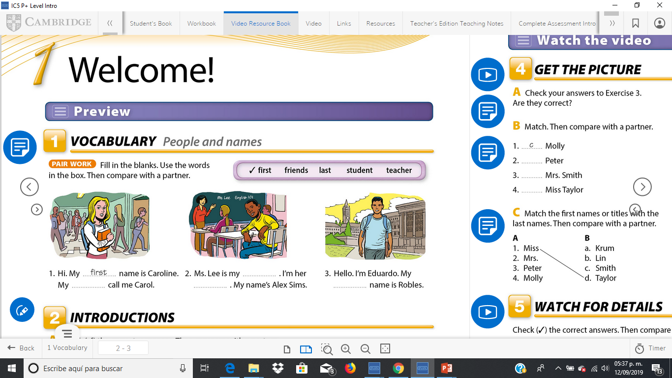
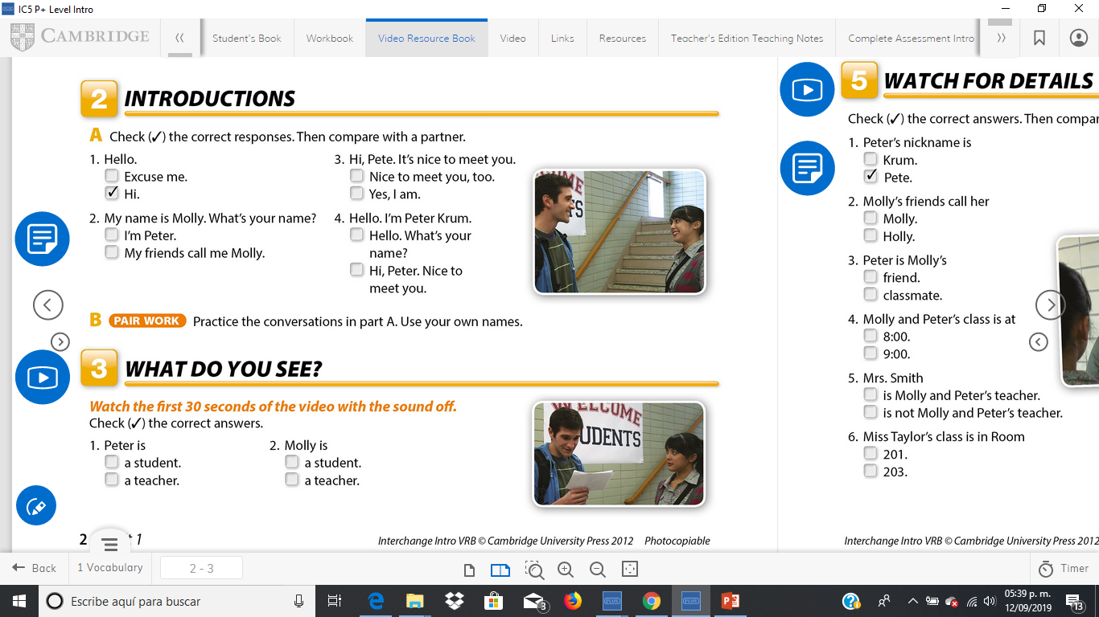
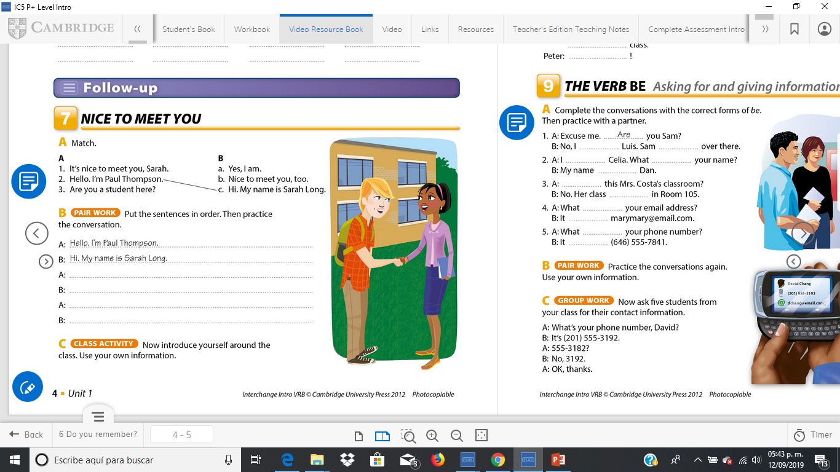
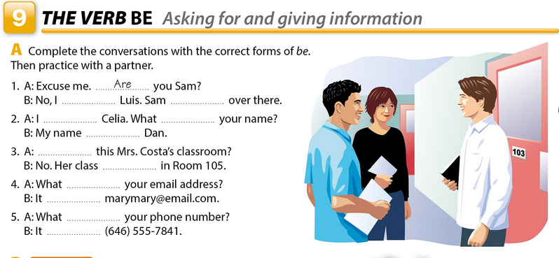
FRIENDS
TEACHER
STUDENT
LAST
It’s nice to meet you Sarah
Nice to meet you, too.
Are you student here?
Yes, l am.
am
is
am
is
is
is
is
is
is
is
is

Slide 2
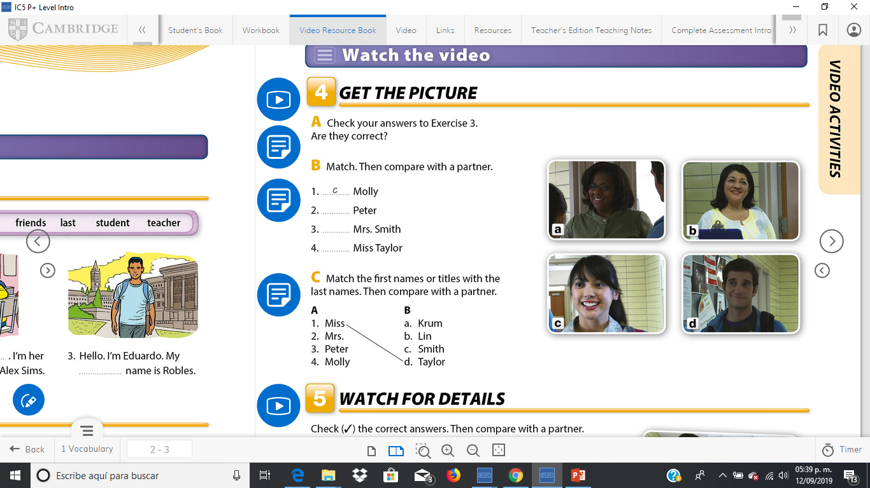
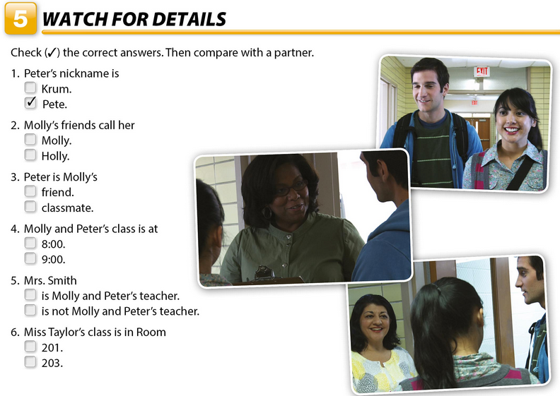
Click on the link to watch a video of unit 1
http://187.160.244.18/sistema/entrada.asp?e=enep&Maq=
Watch the video to answer the following activities
D
A
B

Slide 3
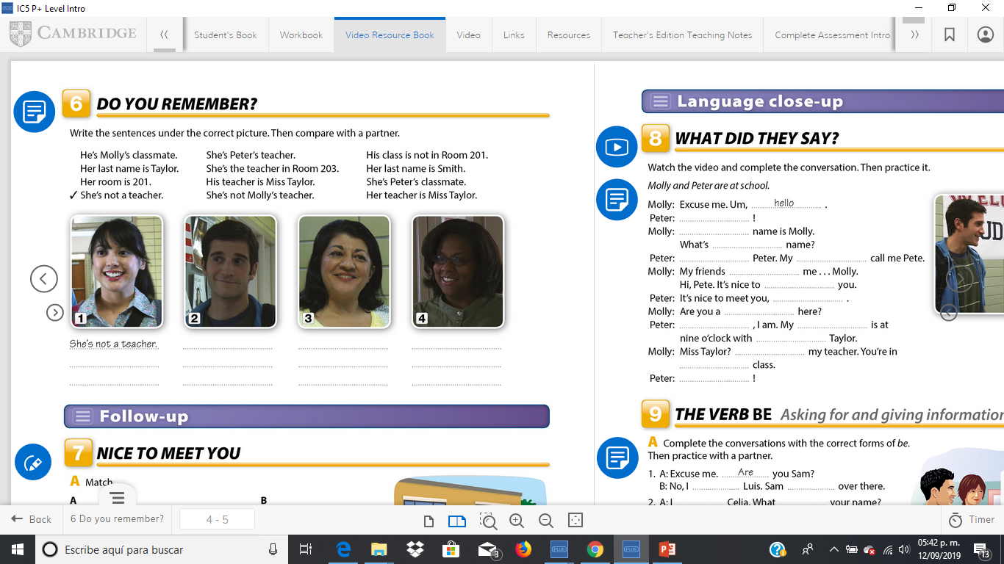
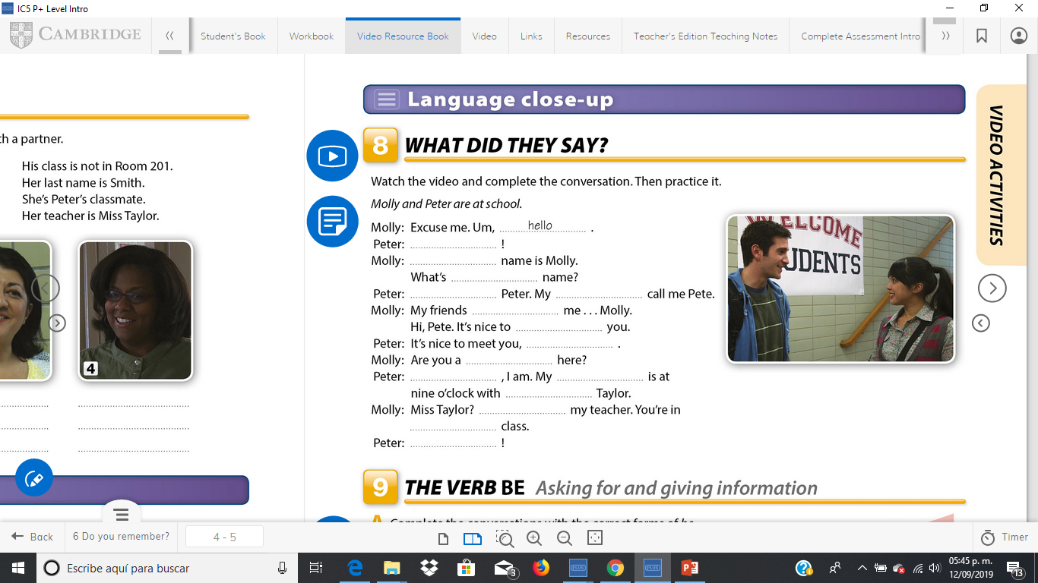
He´s molly´s classmate
She´s peter´s teacher
She´s not molly´s teacher
Her teacher is miss tailor
His teacher is miss tailor
She´s teacher in room203
Her last name is smith
She´s peter´s classmate
His class is not in room201
Her last name is tailor
Her room is 201
hi
my
your
i´m
friends
call
meet
too
student
yes
class
miss
She´s
my
great

