Slide 1
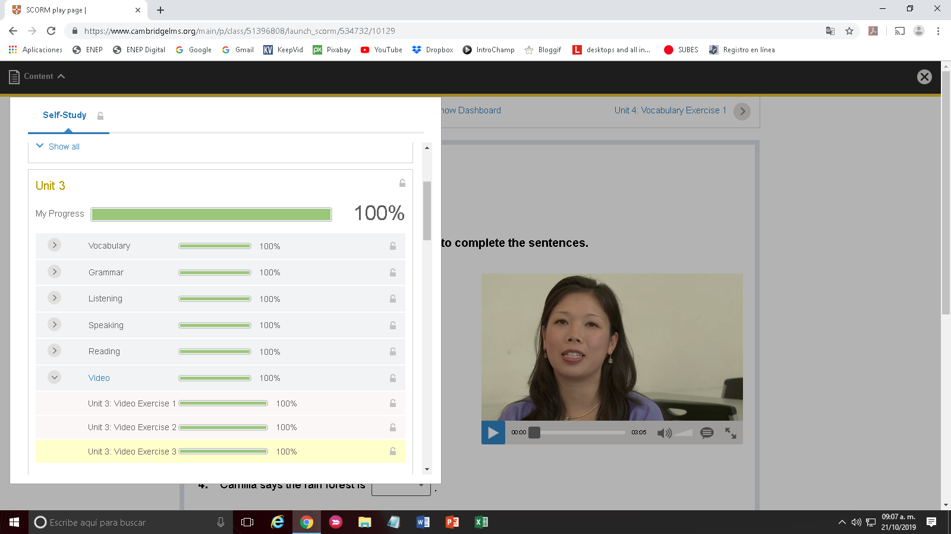
America Monserrath Barrozo Mata

