Slide 1
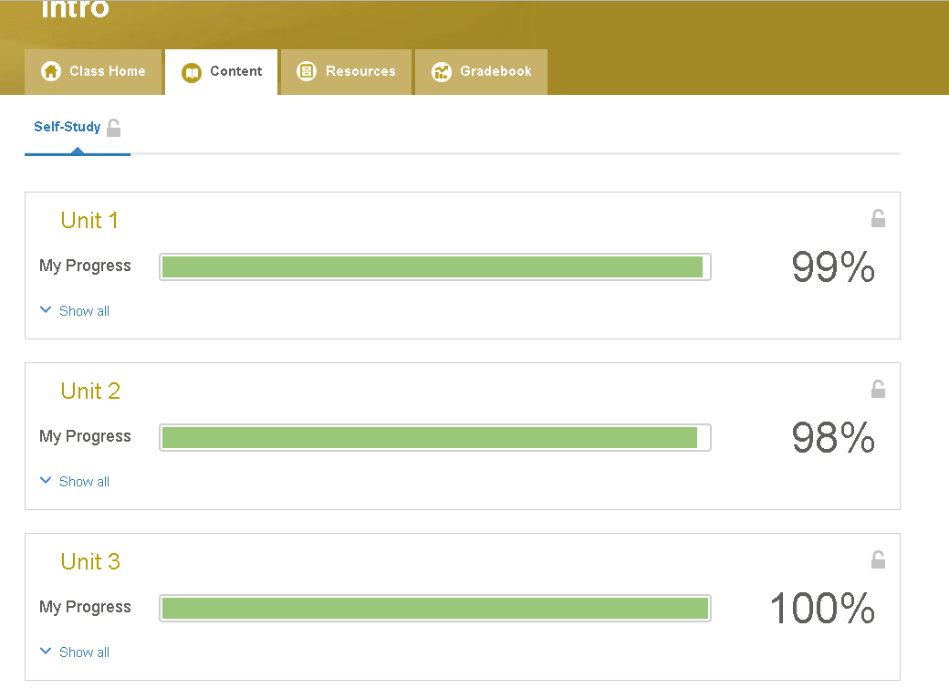
Interchange
Unit 3
results

Slide 2
