Slide 1

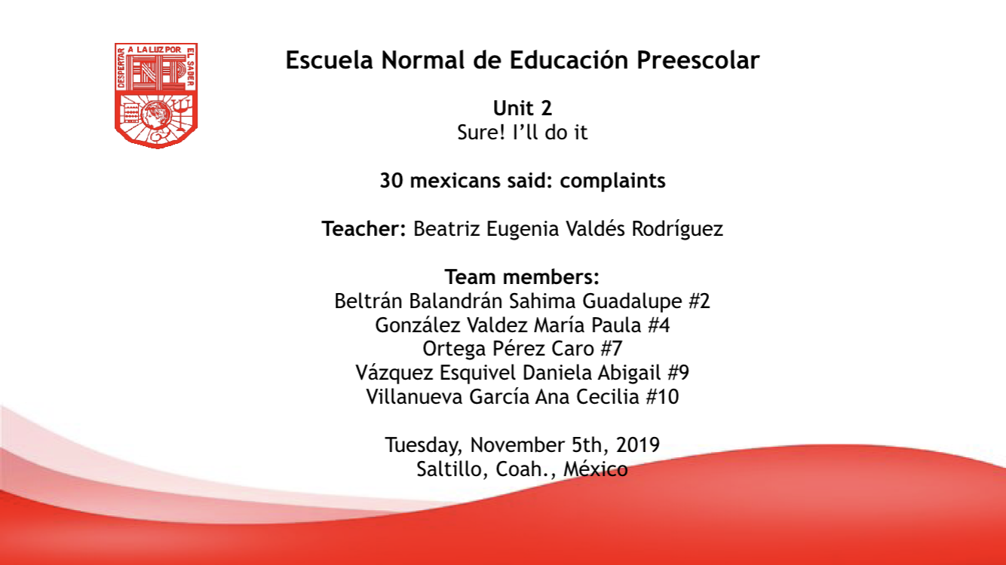

Slide 3
What is your biggest complain about your friends?
That forget of you
That lie to you
That be hypocrites
That they don´t know how to keep secrets
They don´t cooperate for drinks

Slide 4

What is your biggest complaint about your friends?
Person | Answers
1 | That show what they are not
2 | That forget of you
3 | Lend them money and they don´t pay
4 | That forget of you
5 | Lack of values
6 | That are mocking
7 | That forget of you
8 | That they smell bad
9 | That they are vivious
10 | That don´t pay me the same attention that I give them
11 | They only talk to you when they need help
12 | That appear what they are not and change their attitude when there are more people
13 | That criticize without knowing
14 | That don´t put the things they borrow instead in order
15 | That lie to you
16 | That be hypocrites
17 | That be hypocrites
18 | That lie to you
19 | That they don´t know how to keep secrets
20 | That they ask for things in a bad way
21 | They don´t cooperate for drinks
22 | That lie to you
23 | That forget of you
24 | That lend them clothes and not be returned
25 | It bothers me that they eat with their mouths open
26 | That be hypocrites
27 | That they don´t answer me the messages
28 | They don´t cooperate for drinks
29 | That they don´t know how to keep secrets
30 | That they be rudes
Most popular answers
1 | That forget of you
2 | That lie to you
3 | That be hypocrites
4 | That they don´t know how to keep secrets
5 | They don´t cooperate for drinks

Slide 5
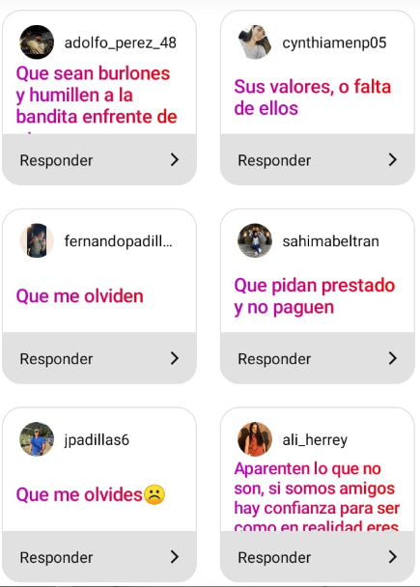
Evidence
Graph

Slide 6
What is your biggest complain about your friends?
Daniela´s Reflexion
I like this project a lot because at the same time we put into practice what we saw in the unit such as complaints and housework, we practice our pronunciation, we work as a team and we have fun.

Slide 7
What is your biggest complain about the house chores?
Wash the dishes
Sweep and mop
Clean the bedroom
Make the bed
Feed the pet

Slide 8
Nothing |  | 2
Cook |  | 1
wash the clothes |  | 2
Wash the dishes |  | 11
sweep and mop |  | 9
feed the pet |  | 2
Paint the house |  | 1
Wash the car |  | 1
clean the bedroom |  | 3
Take out the trash |  | 0
clean the yard |  | 0
Make the bed |  | 3
clean |  | 2
clean the bathroom |  | 1
clean the liviningroom |  | 0
clean the kitchen |  | 0
sing songs |  | 0
fold the clothes |  | 0
Hang out the clothes |  | 0
water plants |  | 0
dust the furniture |  | 0
accommodate the pictures |  | 0
accommodate the dishes |  | 0
look for papers |  | 0
clean the pets area |  | 1
clean doors and windows |  | 1
go to the groceries |  | 0
care the brothers |  | 0
put the clothes in the boat |  | 1
take out the clothes for wash 0 |  | 0
What is your biggest complain about the house chores?
Populars
wash the dishes 11 | 11
sweep and mop | 9
clean the bedroom 3 | 3
make the bed 3 | 3
feed the pet 2 | 3

Slide 9
What is your biggest complain about the house chores?
Sahima´s Reflexion
I liked this activity because to could practiced the English with my girl classmates , I feel more security speaking with they.
The activity was very enjoying for me and i think that for my classmates too.
I would like to have more activities like this

Slide 10
What is your biggest complain about your family?
Judge you for things you did
Get into what they don’t care about
Gossip about me
Stop doing things for them
Don’t let me date with someone special

Slide 11
They are very conformist and do not have the same vision as me. | 1
They expect a lot from us. | 1
We stop doing thing for the fear of what they are goig to think or say | 2
Do not respect what is your. | 1
They don´t leave me food. | 1
They judge for thing you did and they don´t get in your place. | 5
Gossip about me. | 3
They are lazy . | 1
They prejudice against stupid stuff. | 1
They get into what they don´t care about. | 4
They put me to do a lot of house chores in the weekends. | 1
They don´t let me make pj´s. | 1
They don´t pay attention to me when I´m talking to them. | 1
They don´t visit my grandfather and he is getting sick and old. | 1
They don´t let me date with someone special. | 2
That sometimes they lie to me. | 1
They don´t have the same values as me. | 1
They don´t support me when I need to eat healthy. | 1
That they are overprotective. | 1
They judge for thing you did and they don´t get in your place. | 5
They get into what they don´t care about. | 4
They gossip about me. | 3
We stop doing thing for the fear of what they are going to think or say | 2
They don´t let me date with someone special. | 2
What is your biggest complain about your family?

Slide 12
What is your biggest complain about your family?
Caro´s Reflexion
I believe that this project helps us to know more about people and their complains in different areas. It helps us to understand that we think different from other people but also that we have plenty of things in common, I think this is important because we can feel comfortable that other people share the same complains as us.

Slide 13
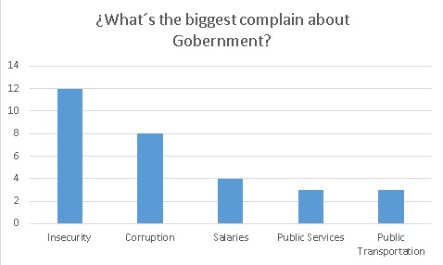

Slide 14
1 | They see me when I'm with my boyfriend
7 | Gossip
12 | They make a lot of noise
1 | Nothing
8 | They steal my WIFI

Slide 15
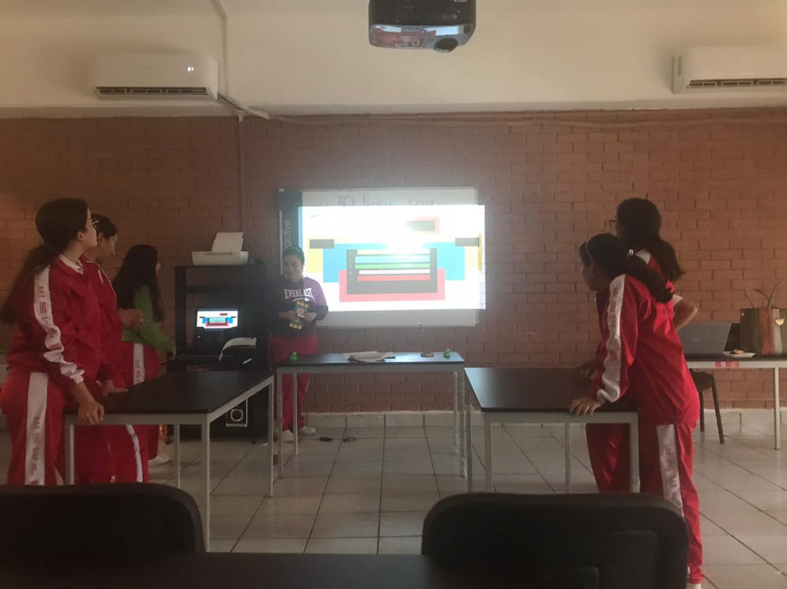
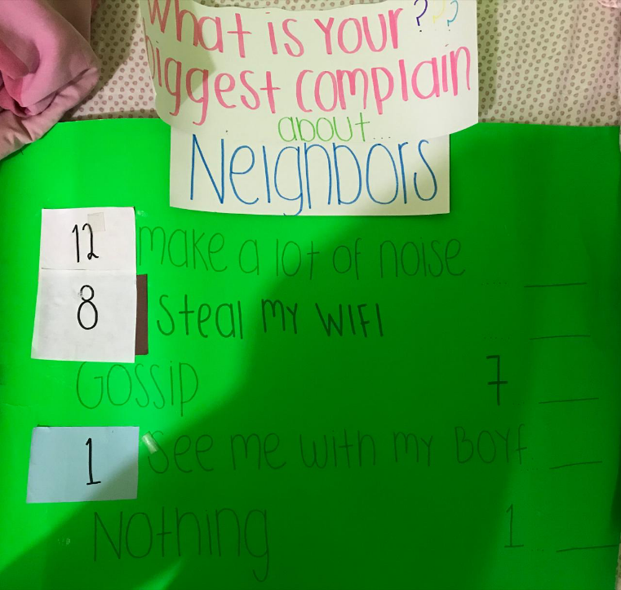
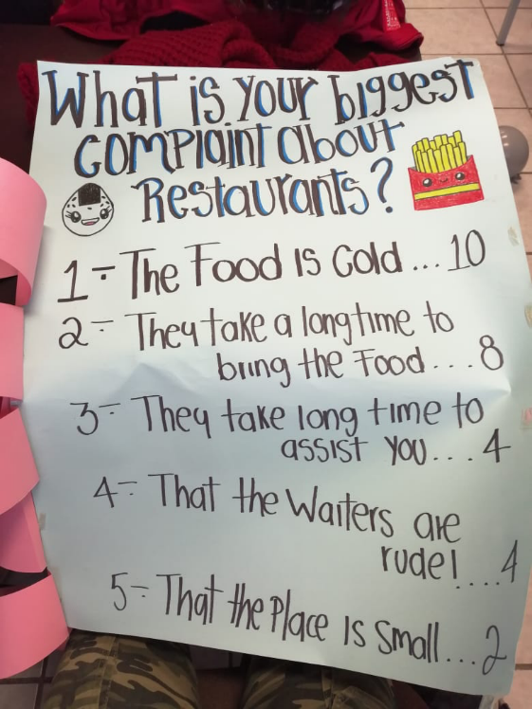
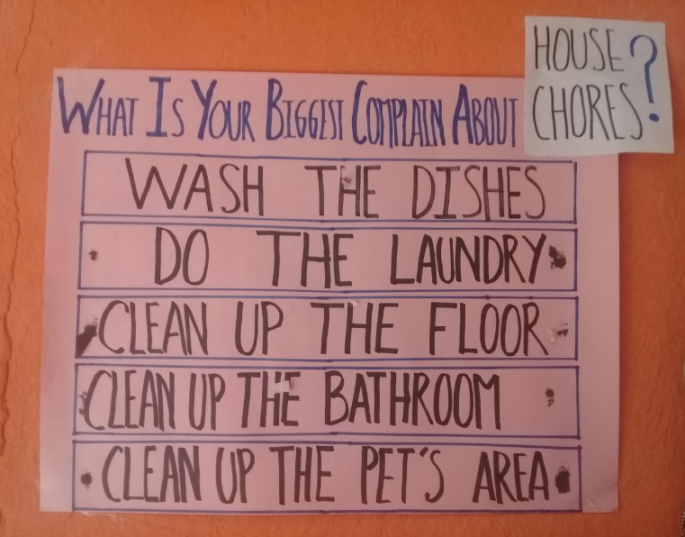
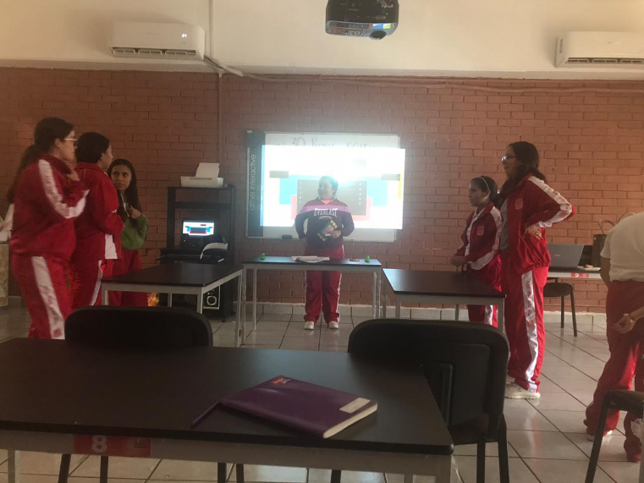
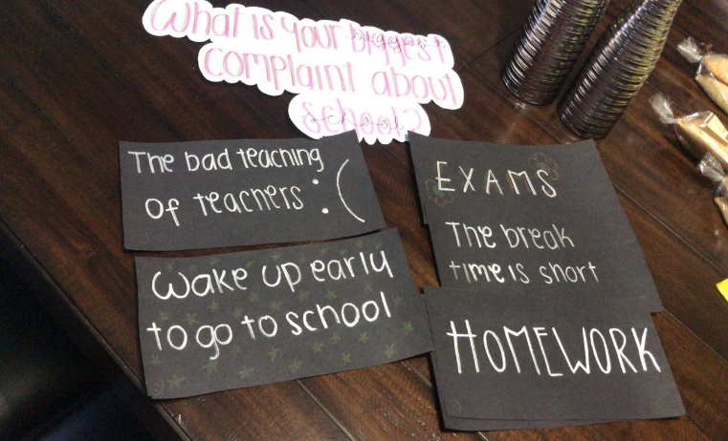

Slide 16
Category | Score 5 | Score 4 | Score 3 | Score 2
Required elements | Goes over and above all required elements stated in the instructions | Includes all of the required elements stated in the instructions | Missing one or more of the required elements. | Several required elements are missing from the project
Overall effectiveness and completion of task | Project is organized and presents material captivating for viewer | Project is somewhat organized and complete and holds attention of viewer | Project is disorganized and incomplete at times and is somewhat able to hold attention of viewer | Project is incomplete and not easy to follow
Organization for game | Exceptionally organized | Thoughtfully and uniquely organized | Well organized but can be improved | Little organization is shown
Grammar | No grammatical or mechanical mistakes | 2 or 3 grammatical mistakes which are not distracting | 4 to 6 grammatical mistakes which are distracting | More than 6 grammar or mechanical mistakes which are very distracting
Conclusion | A thoughtful and reflexive conclusion included shows learning of unit content | Good conclusion, show some learning of unit and project content | Conclusion is somewhat goo but can be improved | Conclusion is weak and not reflexive on learning of unit and project content.
Understanding of content | Shows a sophisticated understanding of the themes | Shows an understanding of the themes | Displays a somewhat limited understanding of the themes and may have few misinterpretations | Does not show an understanding of the themes. Has quite a few misinterpretations.
Total /30 pts
RUBRIC

