Slide 1
What is your biggest complaint?
English b1
Beatriz valdes
Maria fernanda barron lopez

Slide 2
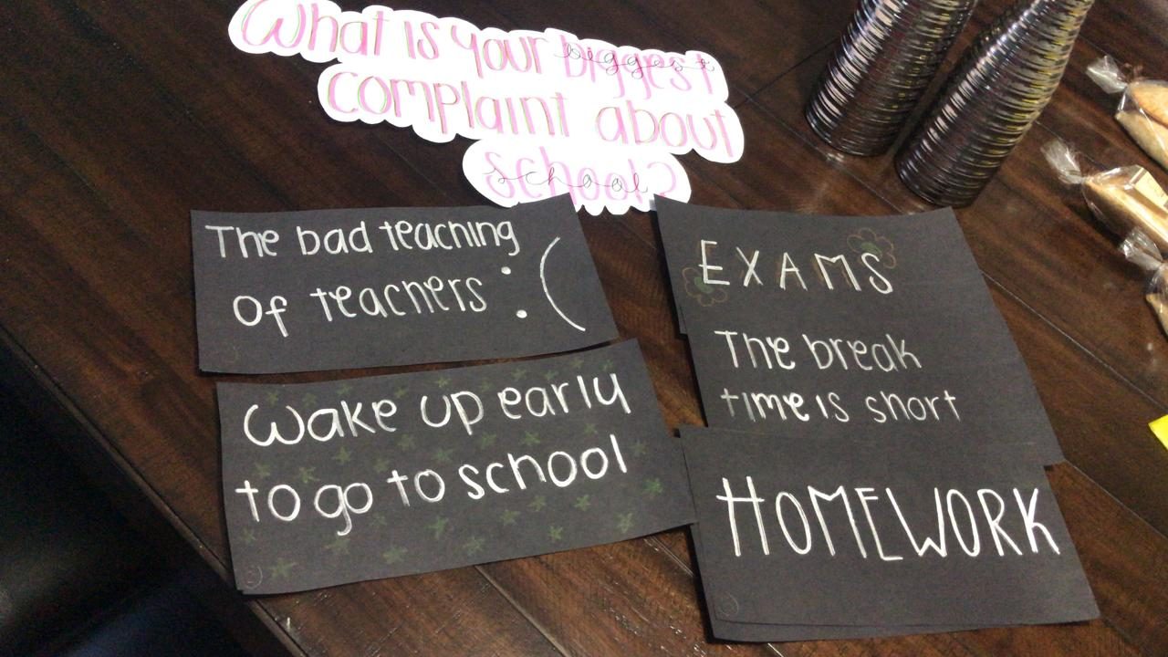

Slide 3
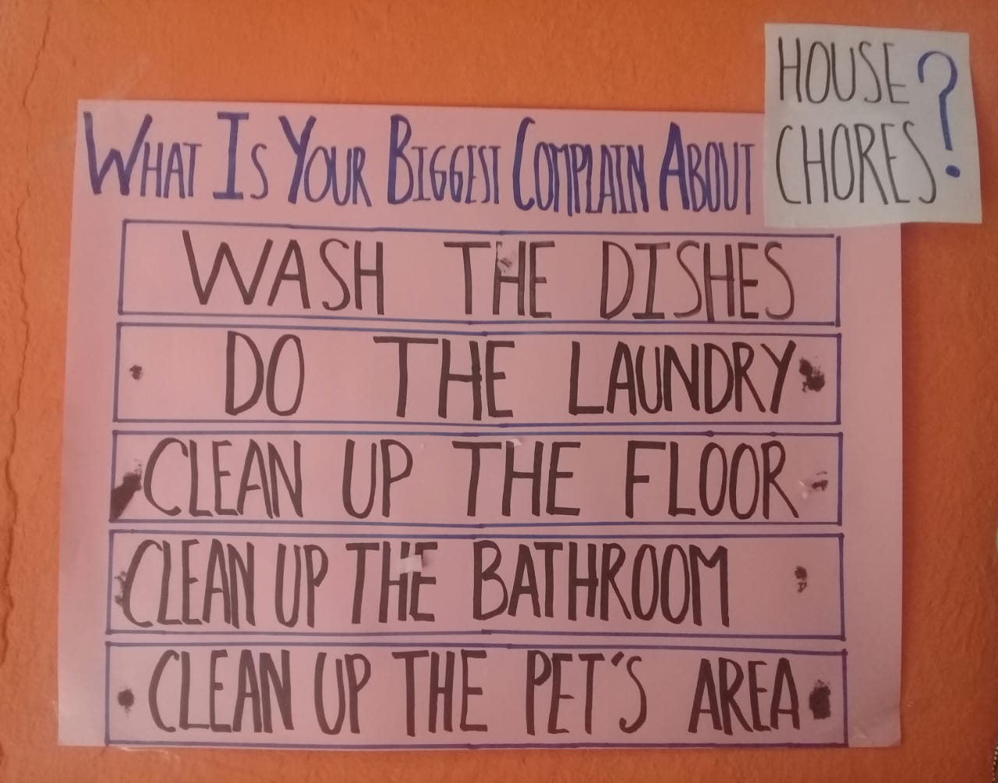

Slide 4
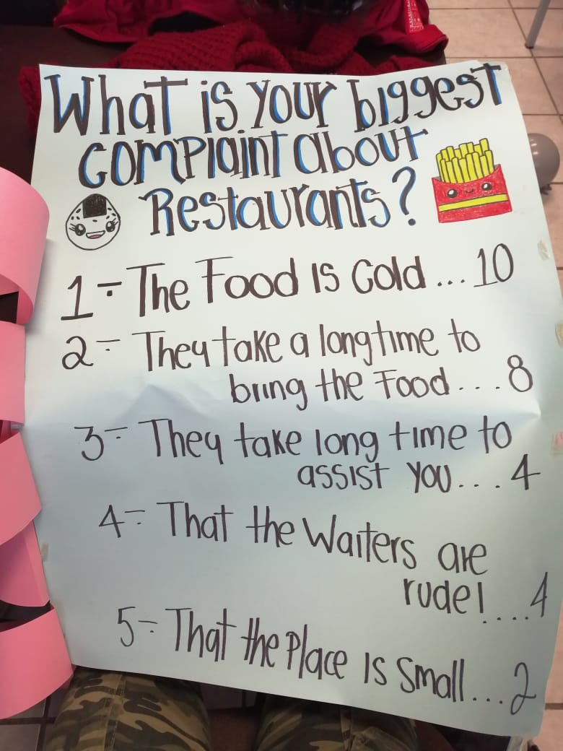

Slide 5
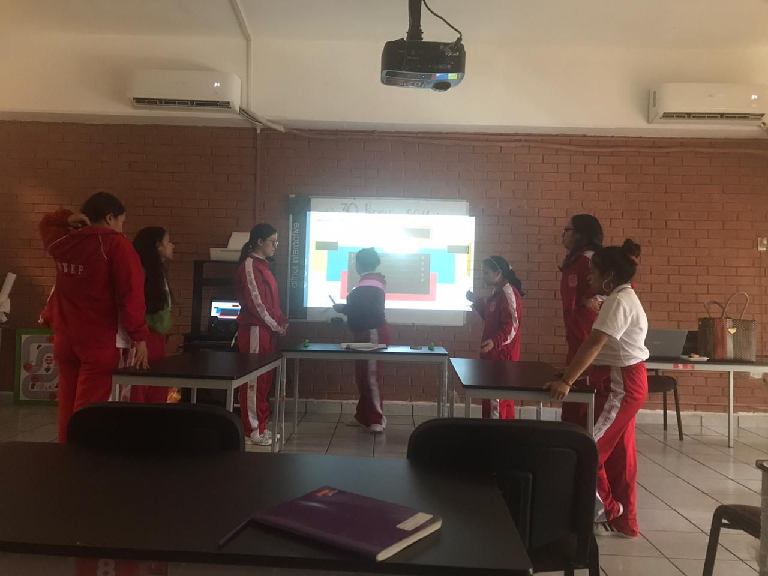
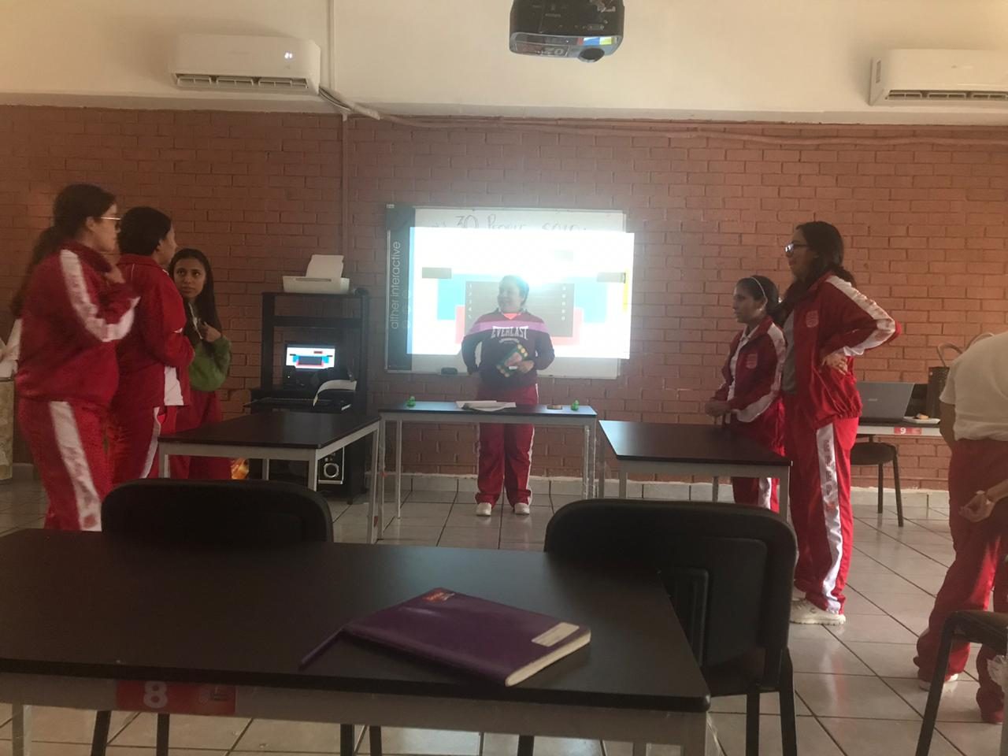

Slide 6
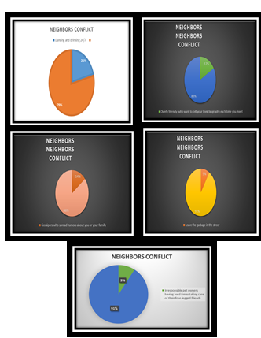
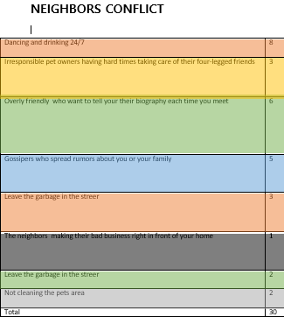
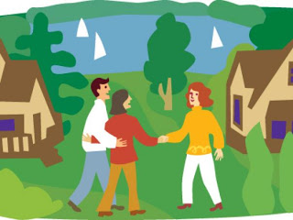
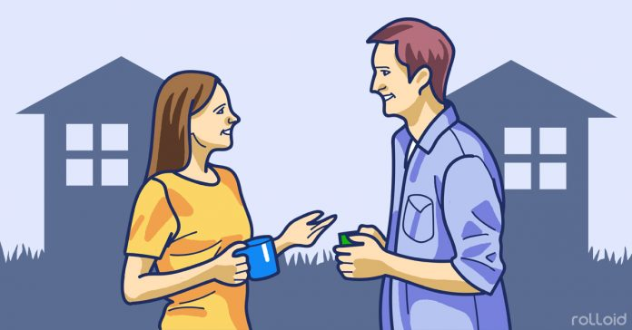
Thamara´s results

Slide 7
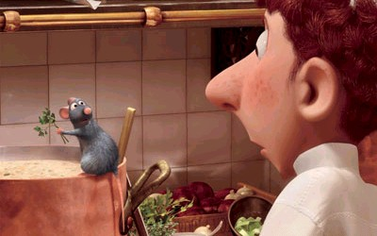
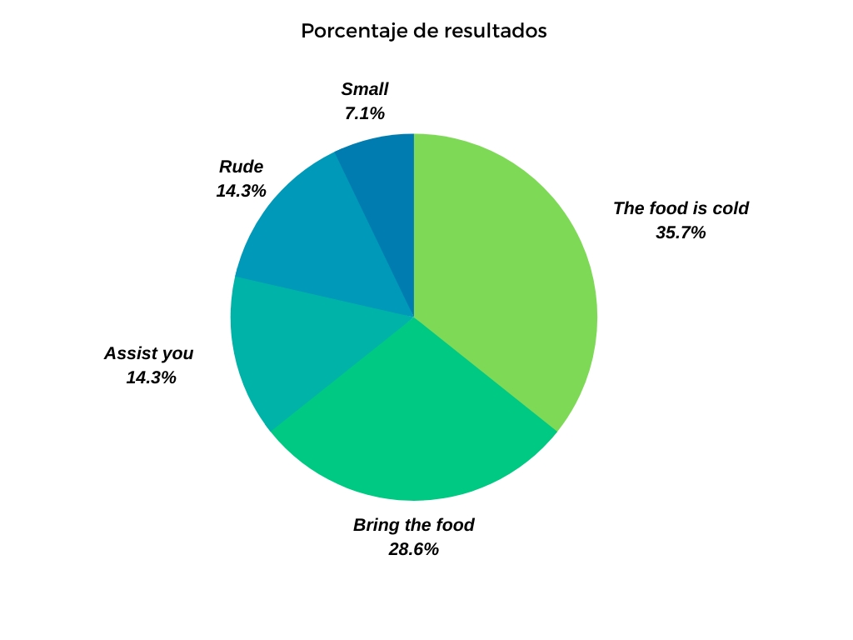
mafer´s results
The food is cold—10 persons
Bring the food- 8 persons
Assist you- 4 persons
Rude- 4 persons
Small- 2 persons

Slide 8
MY RESULTS
The bad teaching of teachers | 8
Wake up early to go to school | 7
The homework | 6
The exams | 5
The breack time is short | 4

Slide 9
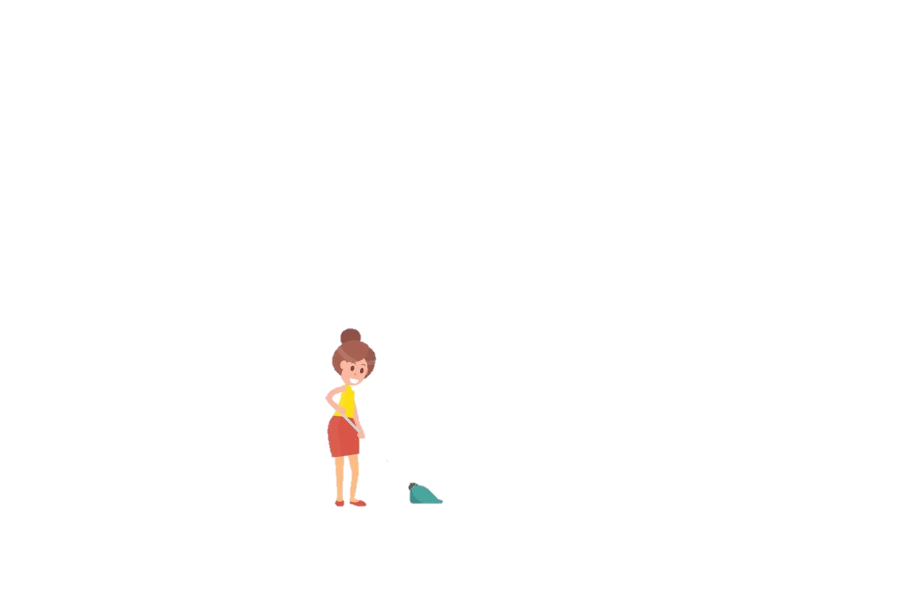
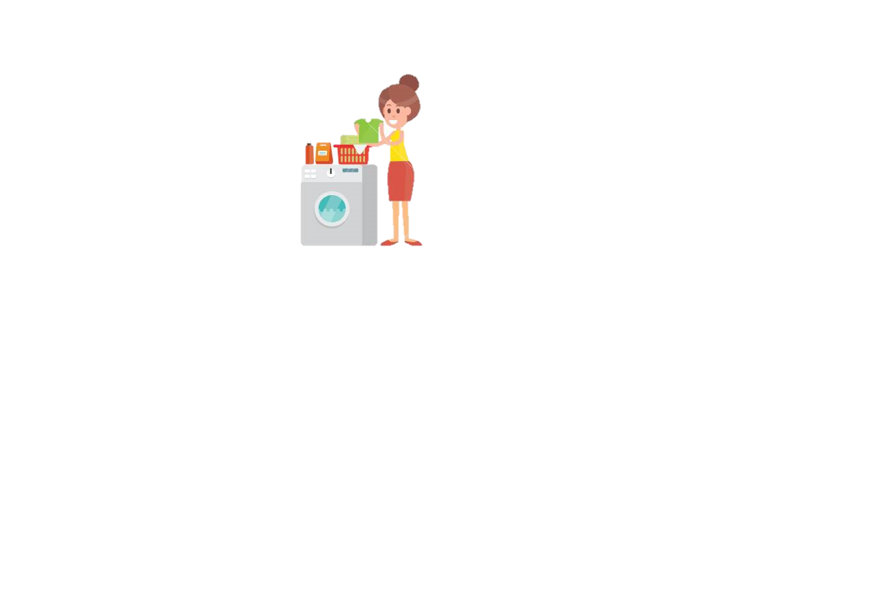
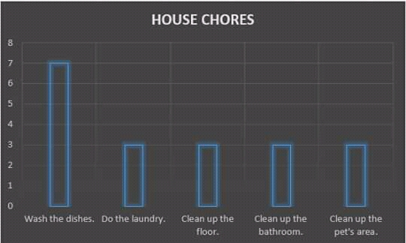
karen´s results

Slide 10
My conclusion
I think this work helped me a lot to see that everyone is annoyd by different things and that we always find a complaint about things.
I think everything is in our minds , we must learn see the life in a different way, try not to be the reason for someone else's complaint and also complain less about things.
I liked doing this proyect because it is very difficult for me speak English and I think I am improving a little, this work helped me to have more confidence in myself and to express myself without fear of failing.
I like this work because i think it´s a way to interact more with my classmates.
Now i can use easier the tow part verbs

Slide 11
