Slide 1
“Escuela Normal de Educación Preescolar”. ASIGNATURA: INGLÉS A2-B1 1 MIXTO MAESTRA: BEATRIZ EUGENIA VALDES RODRIGUEZ Project Unit 2. Due Date. November 5 2019 Karen Lucero Muñiz Torres.

Slide 2
Category | Score 5 | Score 4 | Score 3 | Score 2
Required elements | Goes over and above all required elements stated in the instructions | Includes all of the required elements stated in the instructions | Missing one or more of the required elements. | Several required elements are missing from the project
Overall effectiveness and completion of task | Project is organized and presents material captivating for viewer | Project is somewhat organized and complete and holds attention of viewer | Project is disorganized and incomplete at times and is somewhat able to hold attention of viewer | Project is incomplete and not easy to follow
Organization for game | Exceptionally organized | Thoughtfully and uniquely organized | Well organized but can be improved | Little organization is shown
Grammar | No grammatical or mechanical mistakes | 2 or 3 grammatical mistakes which are not distracting | 4 to 6 grammatical mistakes which are distracting | More than 6 grammar or mechanical mistakes which are very distracting
Conclusion | A thoughtful and reflexive conclusion included shows learning of unit content | Good conclusion, show some learning of unit and project content | Conclusion is somewhat goo but can be imporved | Conclusion is weak and not reflexive on learning of unit and project content.
Understanding of content | Shows a sophisticated understanding of the themes | Shows an understanding of the themes | Displays a somewhat limited understanding of the themes and may have few misinterpretations | Does not show an understanding of the themes. Has quite a few misinterpretations.
Total /30 pts

Slide 4
What is your biggest complain about house chores?
1.- Clean up the floor.
2.- Wash the dishes.
3.- Fold the laundry.
4.- Clean up the floor.
5.- Cook.
6.- Wash the windows.
7.- Do the laundry.
8.- Wash the dishes.
9.- Clean up the room.
10.- Clean up the pet's area.
11.- Iron the laundry.
12.- Wash the dishes.
13.- Do the laundry.
14.- Clean up the floor.
15.- Dust.
16.- Wash the dishes.
17.- Dust.
18.- Pick up the shoes.
19.- Clean up the bathroom.
20.- Wash the dishes.
21.- Clean up the bathroom.
22.- Clean up the mess.
23.- Wash the dishes.
24.- Clean up the bathroom.
25.- Do the laundry.
26.- Make the bed.
27.- Clean up the pet's area.
28.- Clean up the room.
29.- Wash the dishes.
30.- Clean up the pet's area.
5 Most Frecuently Answersː
Wash the dishes.
Do the laundry.
Clean up the floor.
Clean up the bathroom.
Clean up the pet's area.

Slide 5
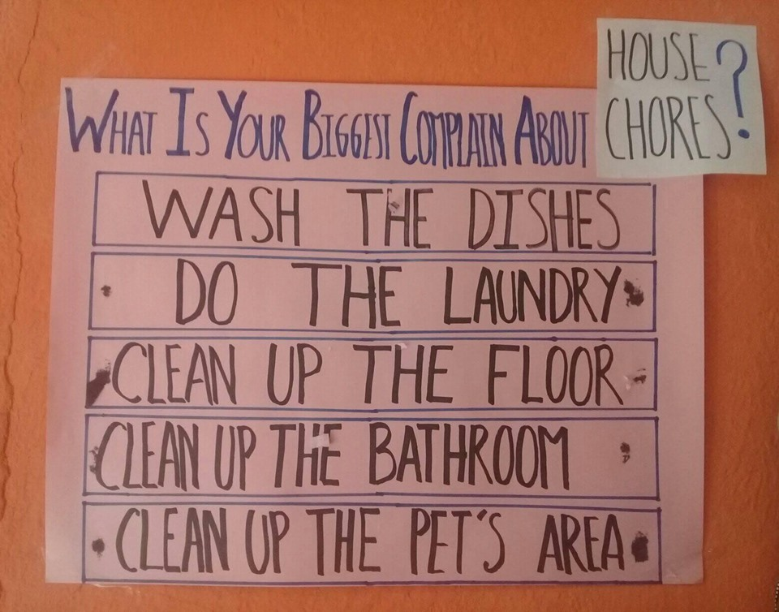
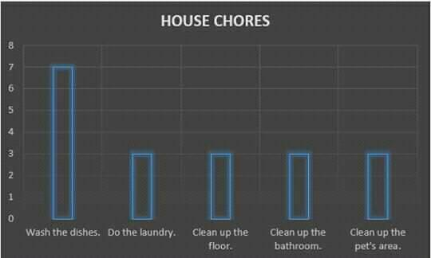
What is your biggest complain about house chores?

Slide 6
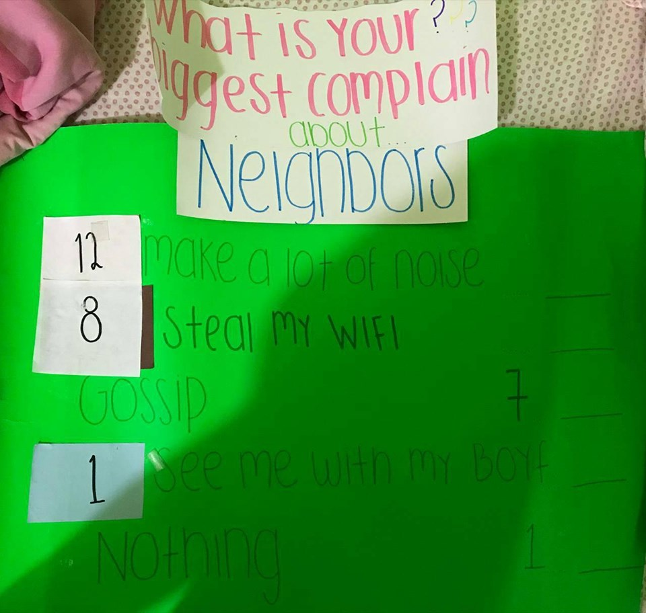
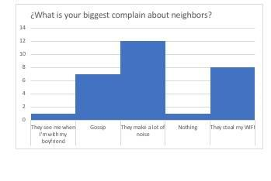
What is your biggest complain about neighbors?

Slide 7
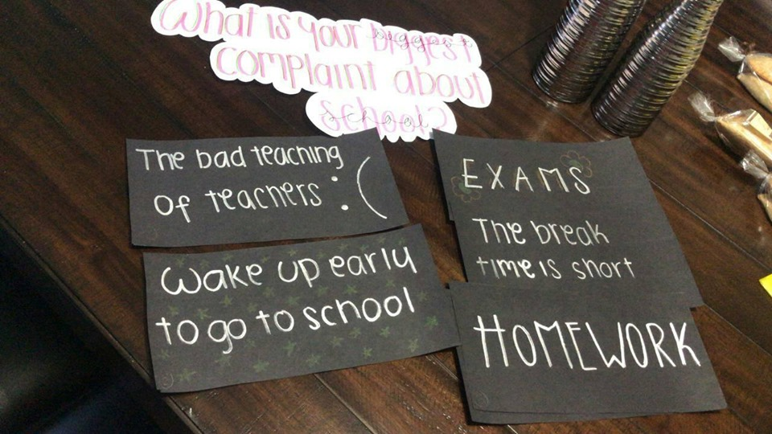
What is your biggest complain about school?

Slide 8
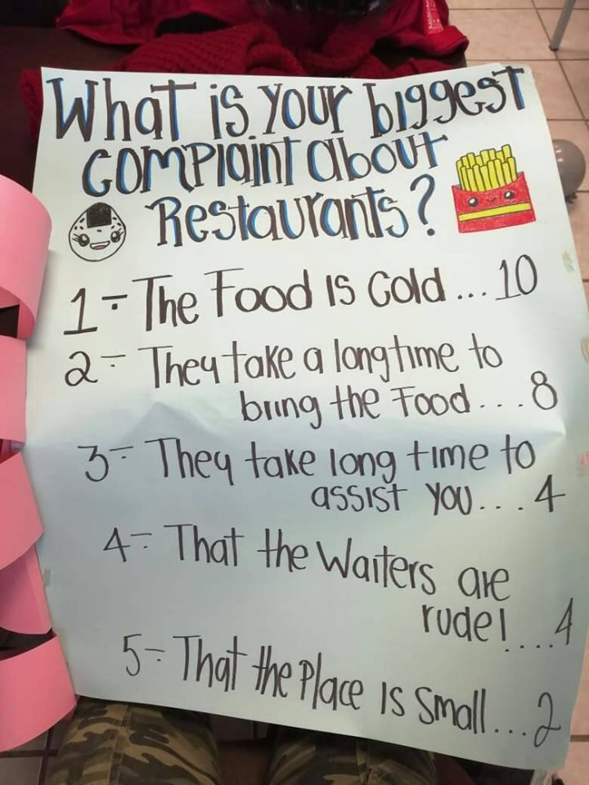
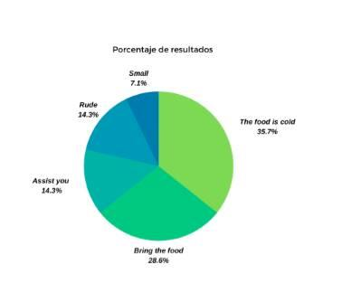
What is your biggest complain about restaurants?

Slide 9
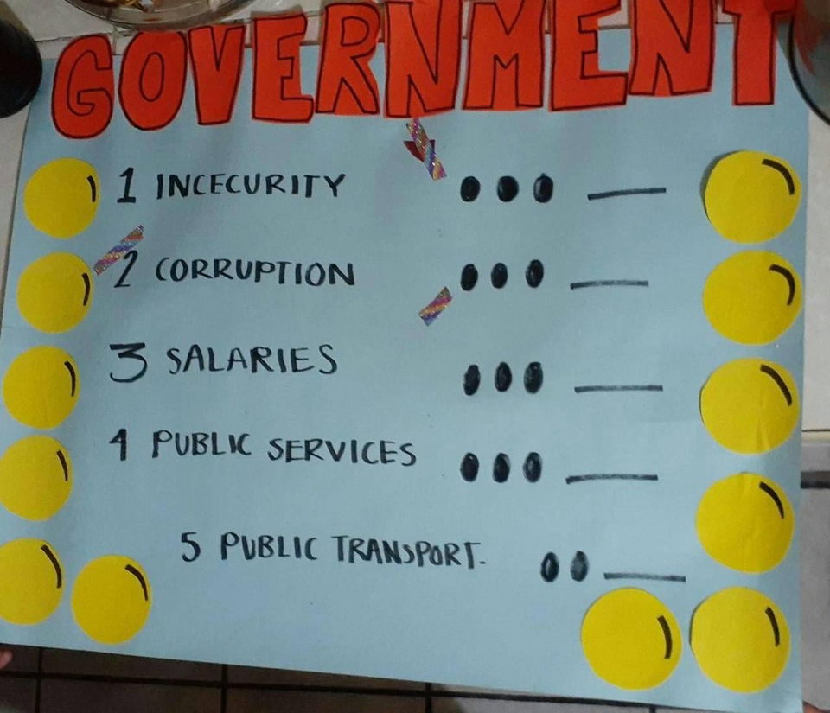
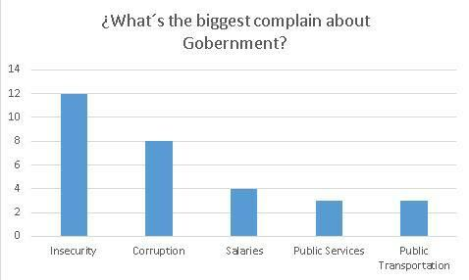
What is your biggest complain about governments?

Slide 10
CONCLUSION.
The project we made it was about 5 most frequently answers about complaints of house chores, restaurants, family, etc. When the play started I was nervous because I had my mind in white, the first complain was about neighbors and in that round the other team won. I liked to play this game because my experience was very fun, my team lost but I enjoyed the laughs with my classmates and my teacher, also the Ceci's participation was adorable. I had to make a presentation about my 5 most frequently answers, it was easy and I liked the final result of my presentation made with poster board. Also, I asked to 30 people, I didn't have many people to ask but my boyfriend helped me to end. I was surprised the answers because the most common was "Wash the dishes", I thought the most common it would "Clean up the room" or the others I learned in class like "get out the garbage". When the rounds were over the wining team danced "Baby Shark". Finally I think it was a good activity I learned complaints like the insecurity of the government or the gossip is very common between family and friends, that was crazy. The project was practical and funny. ː)

Slide 11
