Slide 1
ESCUELA NORMAL DE EDUCACIÓN PREESCOLAR CAMBRIDGE PLATAFORM UNITS 3 AND 4
TEACHER: Cristina Aracely Alvarado Chavarría Karla Andrea Muñiz Ibarra

Slide 2
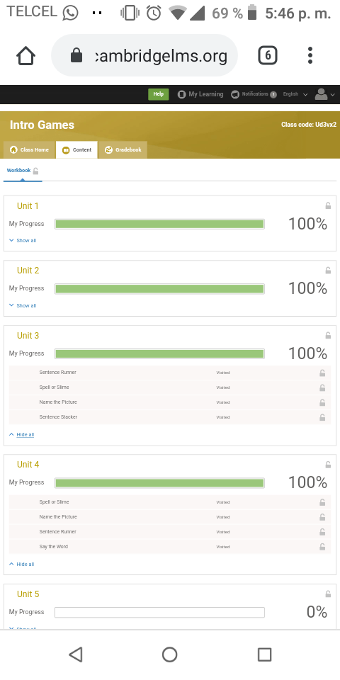
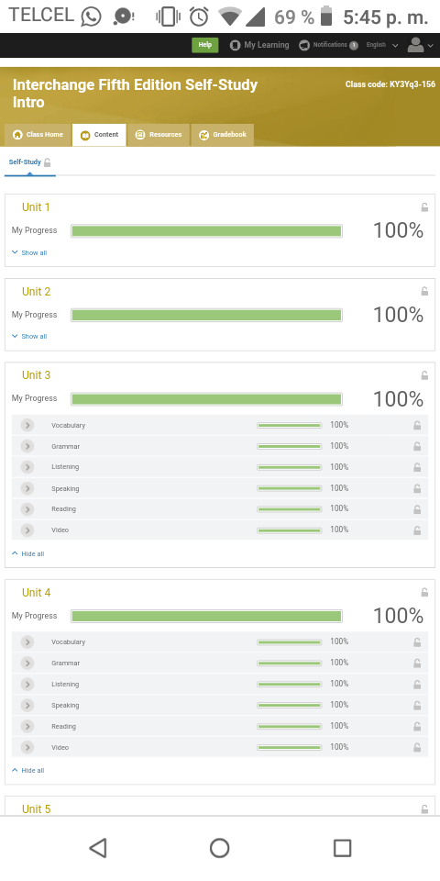
Progress in the games and in the self-study activities

