Slide 1
Escuela Normal de Educación Preescolar.
ENGLISH A1.1 STARTING BASIC COMMUNICATION
Teacher: Cristina Aracely Alvarado Chavarria
CAMBRIDGE PLATFORM UNITS 3 AND 4
Unit 3: Where are you from?
Unit 4: Its this coat yours?
Student: Diana Martinez Rodriguez
1 C 15/11/19

Slide 2
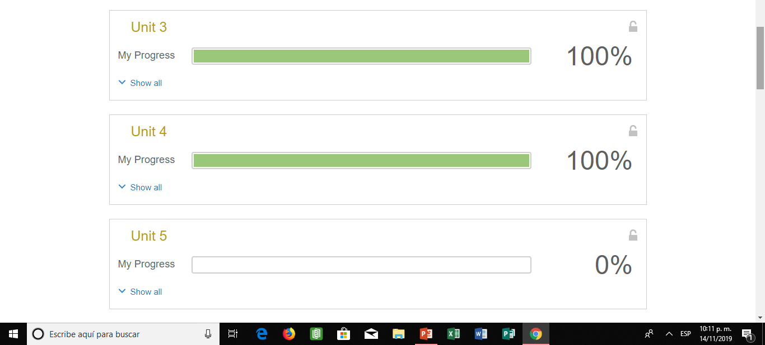
Evidence
Self-study

Slide 4
Intro Games

Slide 5
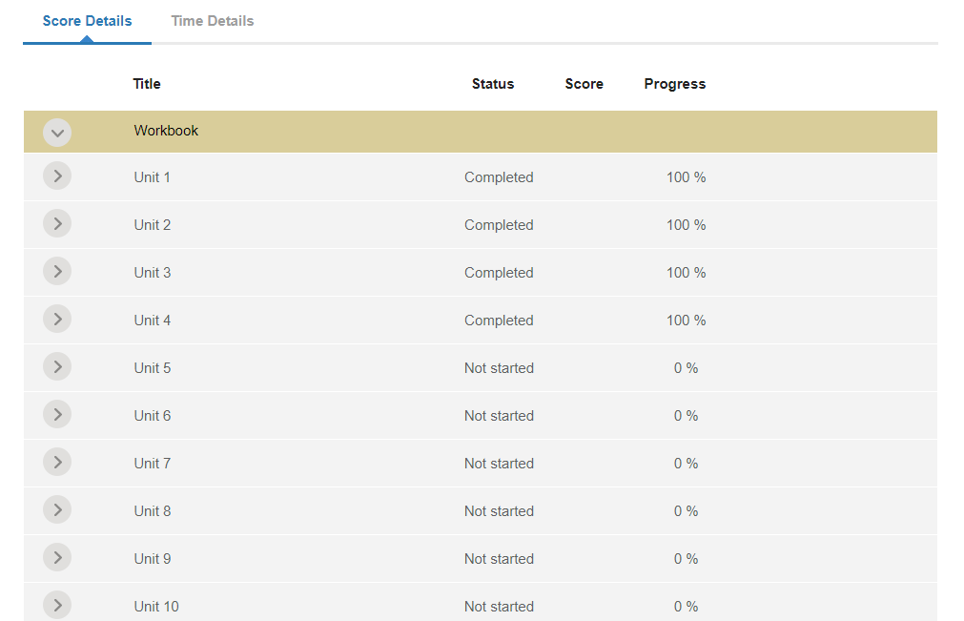

Slide 6
