Slide 1
ENGLISH
TEACHER: CRISTINA ARACELY ALVARADO CHAVARRIA STUDENT: CINTHIA GABRIELA BERNAL CERVANTES

Slide 2
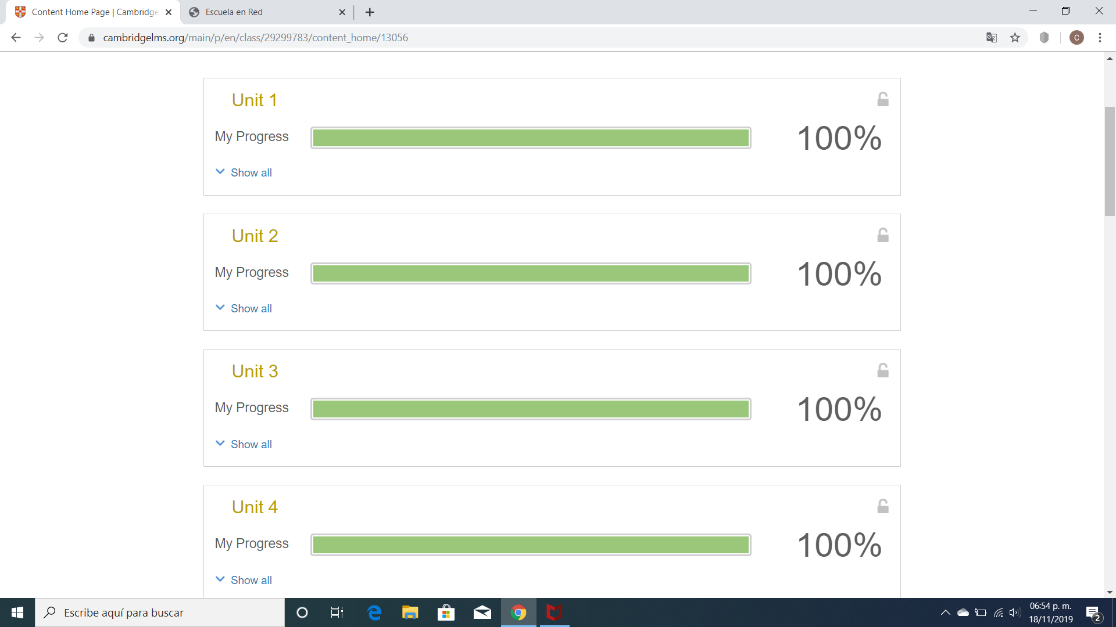

Slide 3
