Slide 1
ESCUELA NORMAL DE EDUCACIÓN PREESCOLAR.
ENGLISH CLASS
CAMBRIDGE PLATFORM UNITS 3 AND 4.
TEACHER: CRISTINA ARACELY ALVARADO CHAVARRIA.
STUDENT: XIMENA ISAMAR JIMÉNEZ ROMO.
november 17, 2019

Slide 2
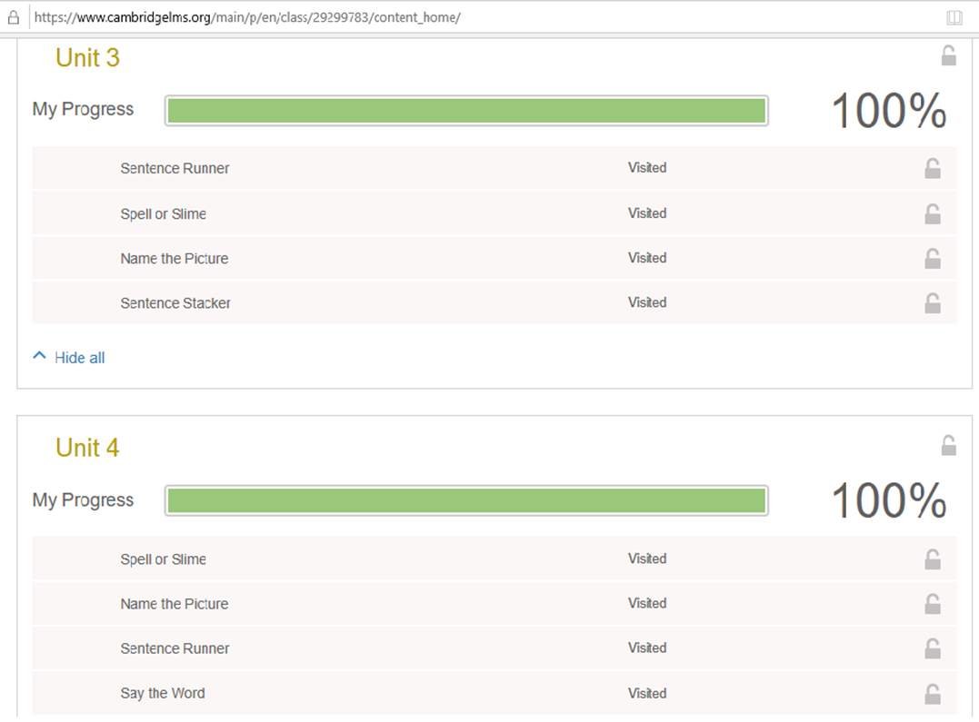

Slide 3
